Slide 1



Please connect to Royal Olympic wifi.
Login : EVFORUM
Password : 2018
To anwser questions on your phone
Please put your mobile on silent mode !

Slide 2

Satellite Symposium held during the 19th European Venous Forum (EVF)
Friday, June 29, 2018 (11:00-12:00)
Burden and suffering in
chronic venous disease
Chairpersons
N. Labropoulos (USA)
A. Nicolaides (Cyprus)
Organized by

Slide 3
Satellite Symposium held during the 19th European Venous Forum (EVF)
Friday, June 29, 2018 (11:00-12:00)
Introduction
N. Labropoulos (USA)
Organized by

Slide 4
Satellite Symposium held during the 19th European Venous Forum (EVF)
Friday, June 29, 2018 (11:00-12:00)
Questions
Organized by

Slide 5
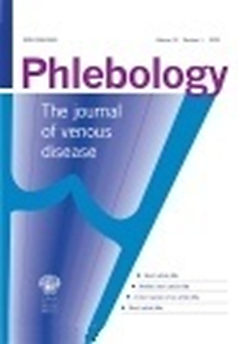


Satellite Symposium held during the 19th European Venous Forum (EVF)
Friday, June 29, 2018 (11:00-12:00)
Real-world evidence:
the seriousness of chronic venous disease
A.H. Davies (UK)
Organized by

Slide 6
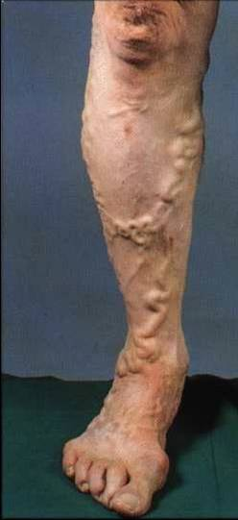


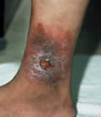
Primary chronic venous disorder
Symptoms and signs
  Pain
  Discomfort
  Heaviness
  Varicose veins
  Oedema
  Skin discolouration
  Lipodermatosclerosis
  Ulceration

Slide 7

Main Issue
???????
Why only some
and how many ?
???????

Slide 8

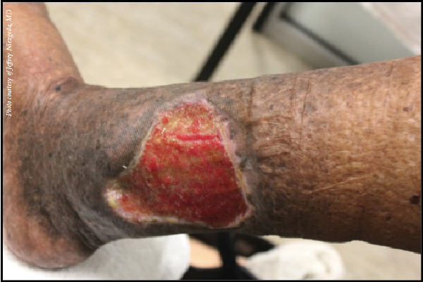

Burden
Disease burden is the impact of a health problem as measured by financial cost, mortality, morbidity, or other indicators. It is often quantified in terms of quality-adjusted life years (QALYs) or disability-adjusted life years (DALYs), both of which quantify the number of years lost due to disease (YLDs).

Slide 9


Slide 10
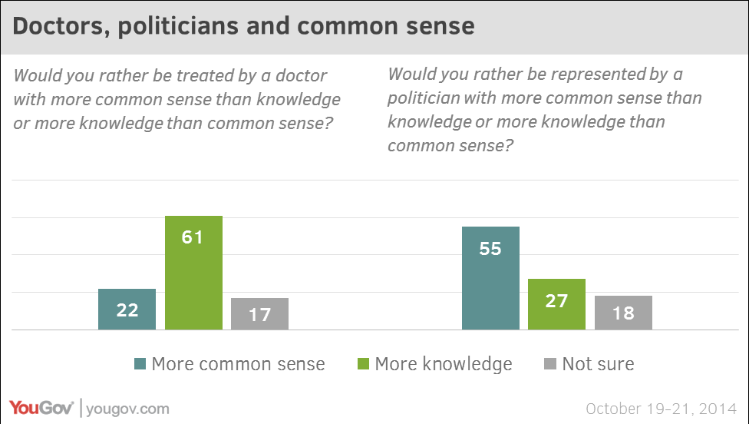

Slide 11
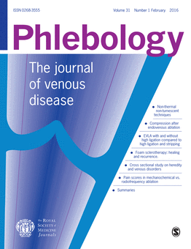

Slide 12

Framingham Study
3,822 adults
Incidence of varicose veins was higher in women than men
2-year incidence of varicose veins
  39.4 new cases per 1000 men
  51.9 new cases per 1000 women
Women |  | Men
Obese | P<0.01 | Low physical activity | P<0.05
Low physical activity | P<0.001 | High smoking rate | P<0.05
High systolic BP | P<0.001
Older at menopause | P<0.001
Brand FN et al. Am J Prev Med 1988

Slide 13

Risk factors for primary CVD
Systematic Review
Phlebology 2008
Postulated risk factors
  Increasing age
  Positive family history
  Gender
  Pregnancy
  Obesity
  Reduced mobility at work
  Smoking
  Decreased fibre intake and constipation

Slide 14
1% pa
progression

Slide 15
Parity
FH
BMI
QoL ↓↓

Slide 16
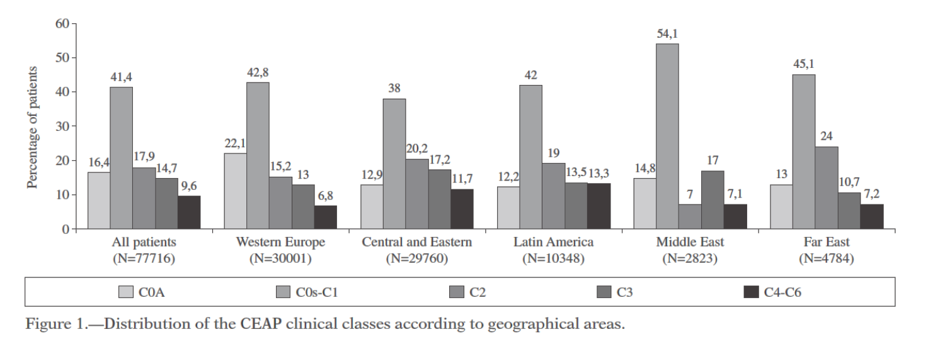
6232GPs
91545 subjects

Slide 17
Majority > 50%
C0s/C1
Referral increases with severity

Slide 18


Slide 20
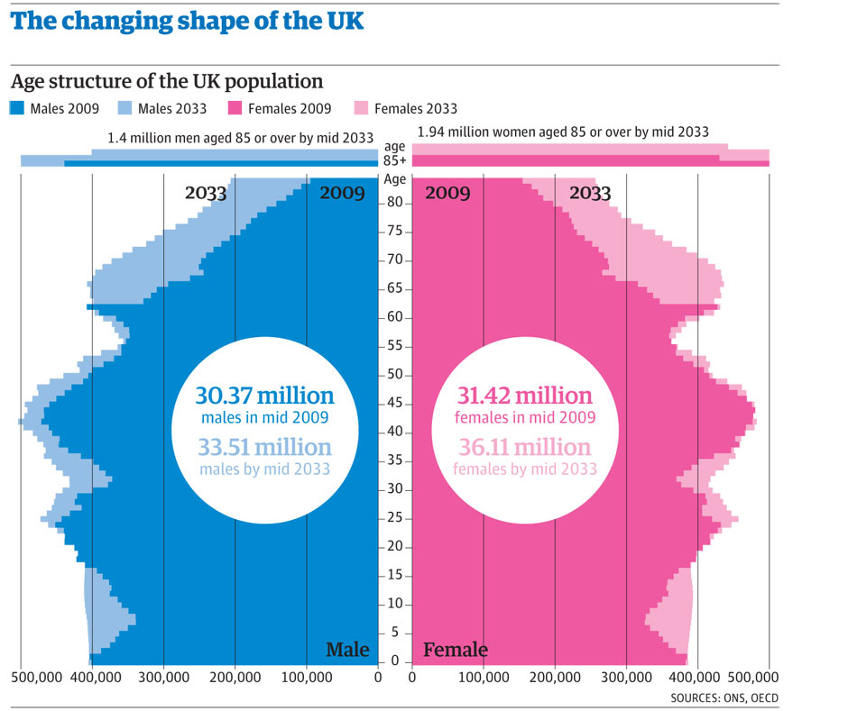
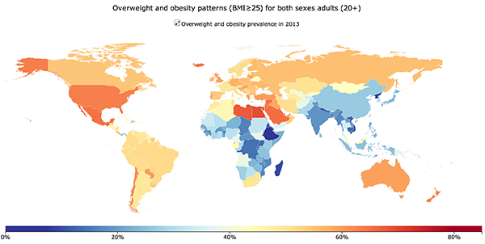
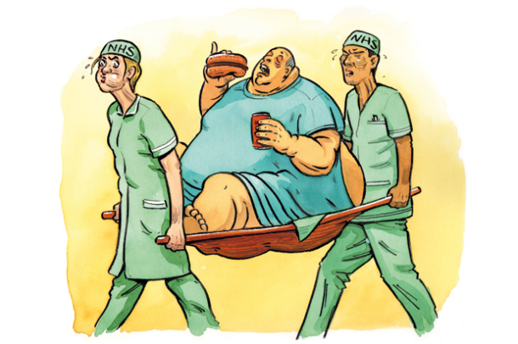
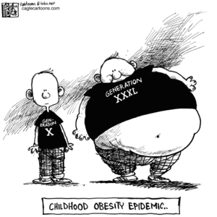
Predicted venous disease
Notes:
https://intothelooneybin.wordpress.com/2013/10/15/obesity-epidemic-in-the-uk/
Overweight and Obesity patterns: WHO
The changing shape of the UK: the Guardian
Age and obesity are two of the main risk factors for venous disease
With our rapidly ageing population and the unfolding obesity epidemic (12), it is predicted that by 2050, superficial venous disease will markedly increase in Europe (13) whilst the number of US adults with VTE is projected to more than double (2) ; this prediction is applicable to the European population.

Slide 21
Phlebology 2016

Slide 22
“This is supported by findings suggesting that QoL in individuals with venous ulceration is comparable to that of patient with congestive cardiac failure, suggesting that the more advanced the class of disease, the more burdensome CVD is to the patient”
Phlebology 2016

Slide 23
Also treating varicose veins is more cost-effective than laparoscopic cholecystectomy for biliary colic &
CABG for angina!
“This is supported by findings suggesting that QoL in individuals with venous ulceration is comparable to that of patient with congestive cardiac failure, suggesting that the more advanced the class of disease, the more burdensome CVD is to the patient”
Phlebology 2016

Slide 24


“ A state of complete physical, mental and social well-being, and not merely the absence of disease”
WHO 1947

Slide 25
General health profiles for UK norms,
main study and recurrent varicose veins
100
UK norms
80
study population
60
score
recurrent varicose veins
40
20
0
PF
RP
BP
GH
VT
SF
RE
MH
20 14 13 18 16 14 13 16
domain
Patients with varicose veins have a poorer QoL than the population

Slide 26
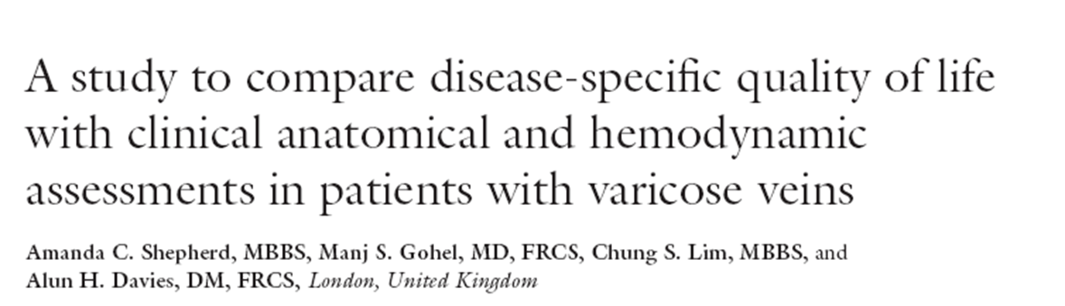
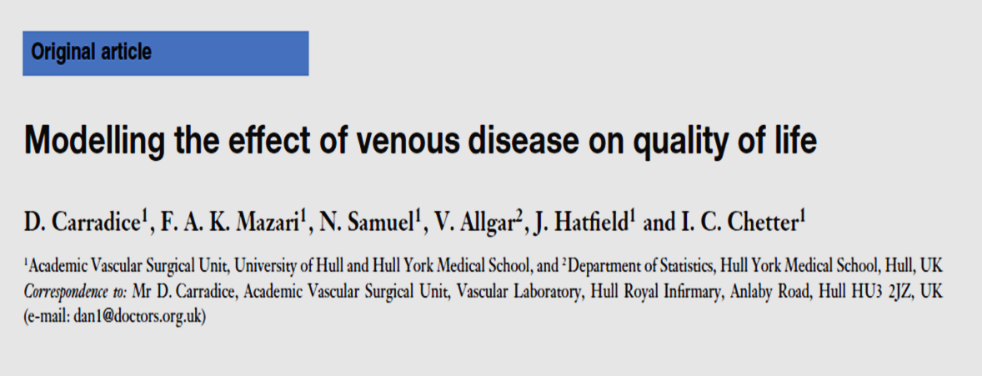
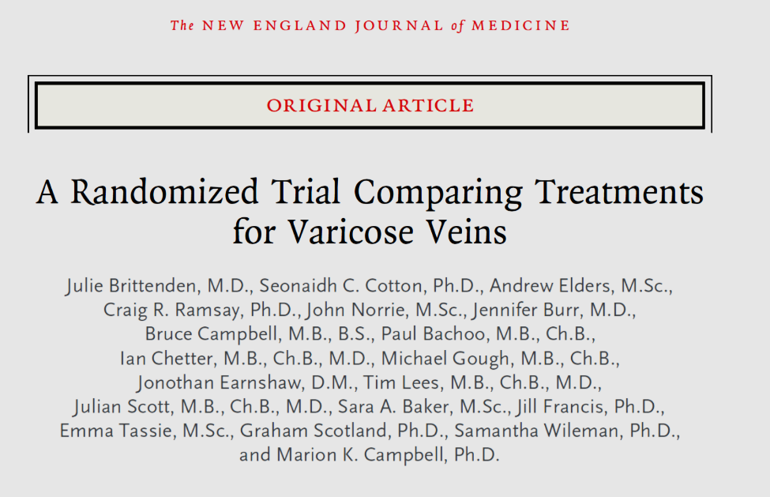
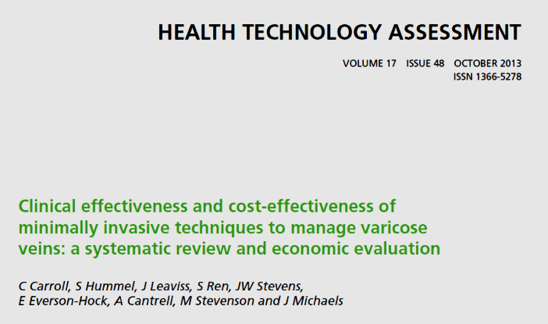
VV intervention
IMPROVES
Quality of life

Slide 27
Progression
De novo
Is not treatment failure
Is not residual varicosities
Is not neovascularisation
“Development of venous reflux in sites where there is no evidence of the above”¹
Progression should be similar between treatment modalities and in a separate anatomical area to that treated.
¹Kostas 2004 EJVES

Slide 28
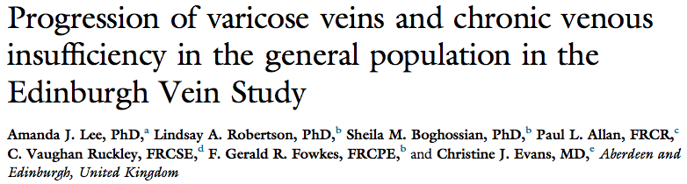
What happens as we get older and heavier?
For those with varicose veins the risk of progression was increased by:
Age >55 OR 3.9 (95% CI 1.1 -14.3)
Obesity OR 1.9 (95% CI 1.1 – 3.1)

Slide 29
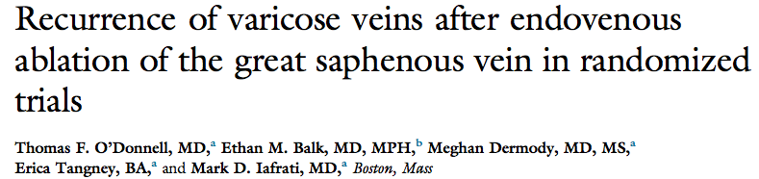
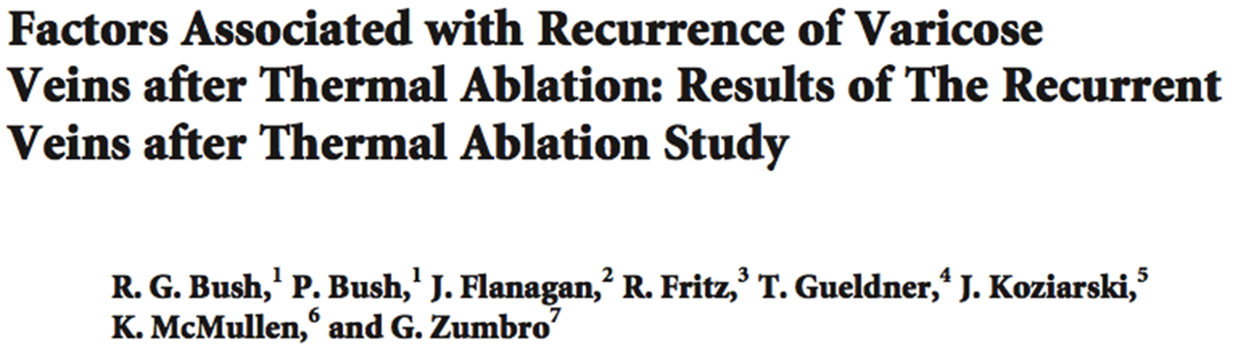
What happens after ablation for C2 disease?
15-47% clinical recurrence 16% of patients with a new area of truncal reflux
16% -24% had new truncal reflux
Notes:
7 RCTs of RFA and EVLT
Minimum 2 years follow up
Only 2% neovascularisation in EVA group but more recanalisation

Slide 30
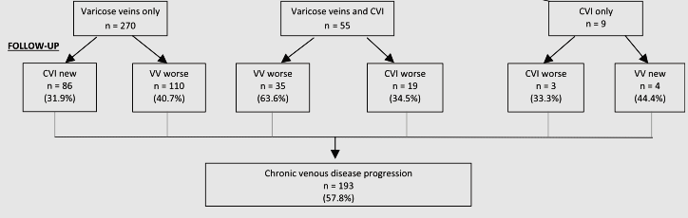


What happens without intervention?
58%
Lee et al. Edinburgh Vein Study 2015 JVS
Bonn Vein study progression approximately
4% pa

Slide 31
FH
Female
Vein incompetence

Slide 33

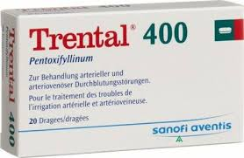
Most evidence
Leg ulcer heaing

Slide 34

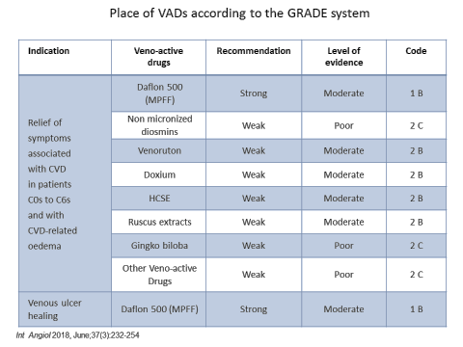
F
Most evidence
Leg ulcer heaing

Slide 35
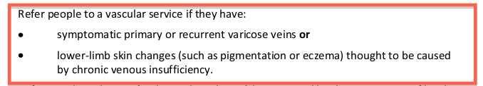

Key Recommendation
Not use CEAP Classification for referral guidance

Slide 36

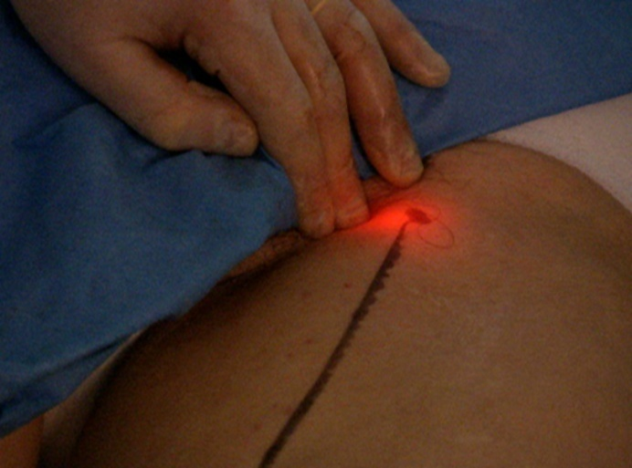

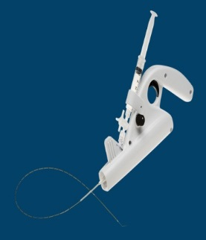
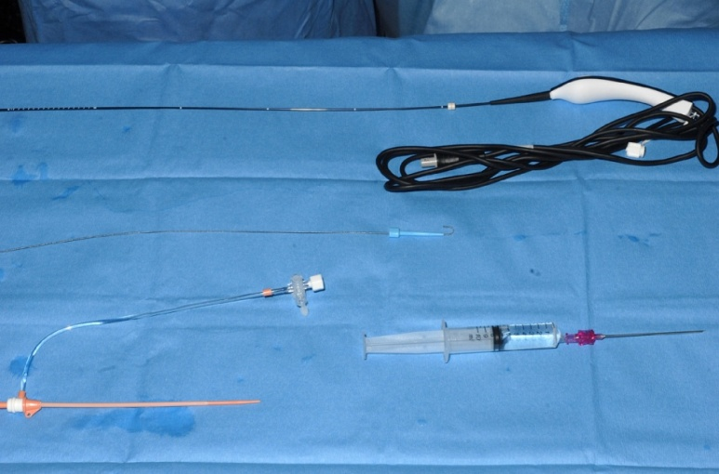
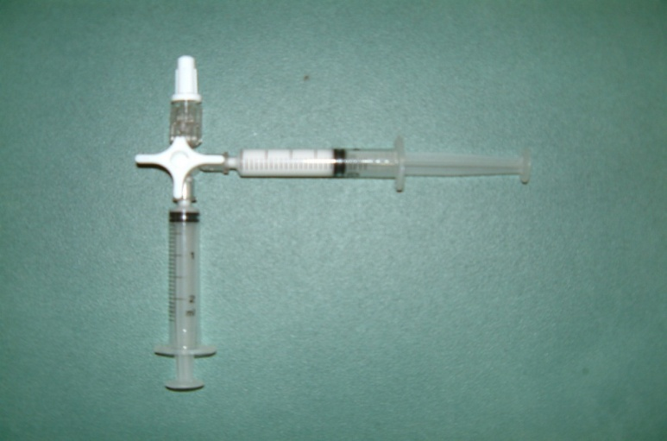
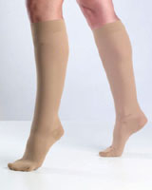
Treatment options
Surgery
Laser
Radiofrequency
Sclerotherapy

Slide 37

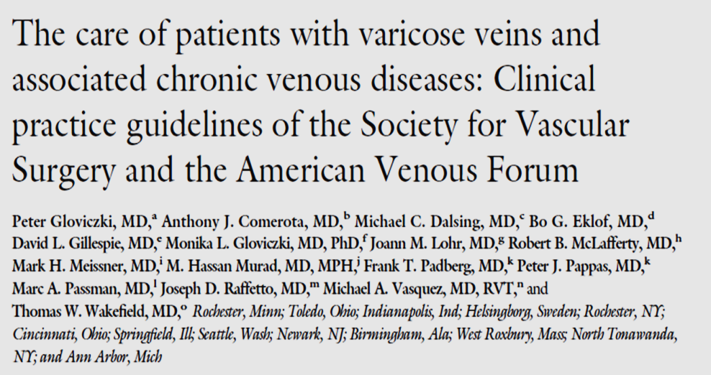


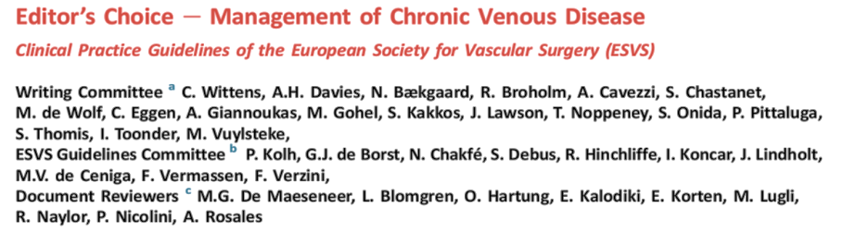
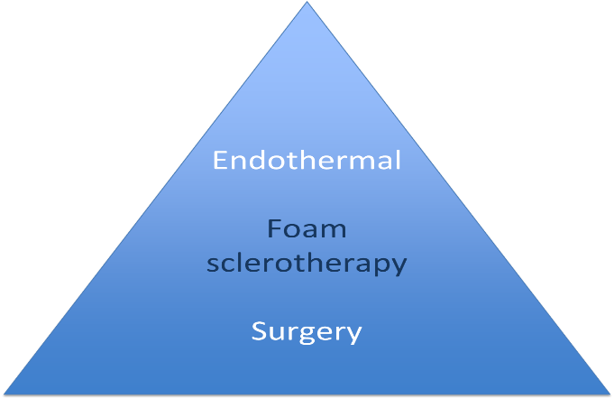

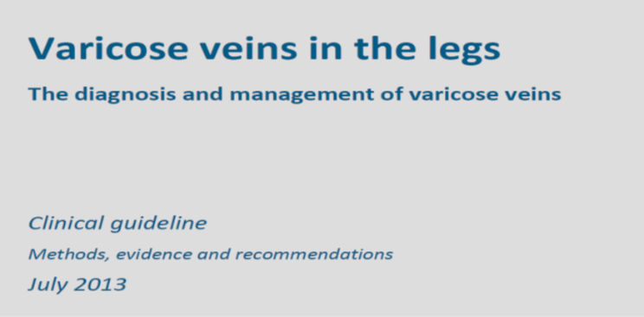
SAME
Poor evidence for compression

Slide 39



By 2021 at $2000 per treatment US cost
=
$8,000,000,000 per annum
Or
1 in 65 of the population will have a vein treatment pa.

Slide 40
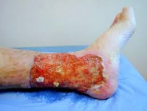
2% of health care budget
Cost saving potential if prevent progression

Slide 41
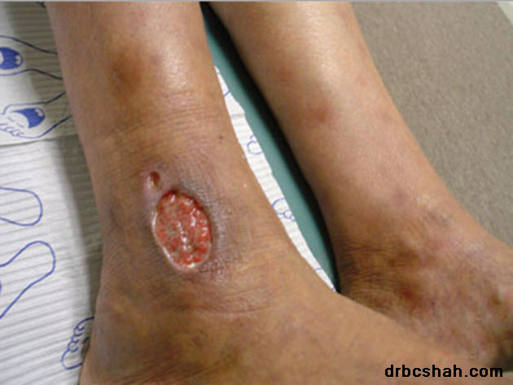
Chronic Venous Ulcers
Affects 1% of the adult population
2% of healthcare budget

Slide 43
15 billion $

Slide 44
15 billion $

Slide 45
1.Likely that a pharmaceutical agent if improves healing and reduces recurrence will be cost effective.
2.Further RCTs needed to confirm this and subsequent cost effectiveness analysis

Slide 46
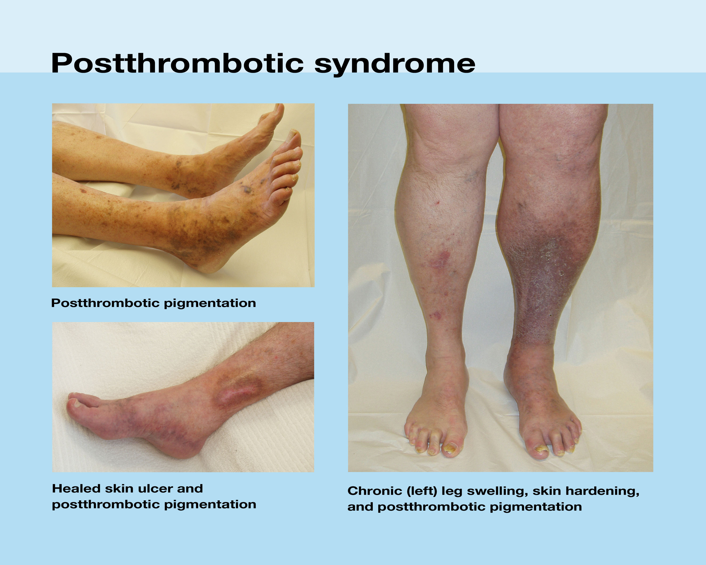
Significant cost?

Slide 47
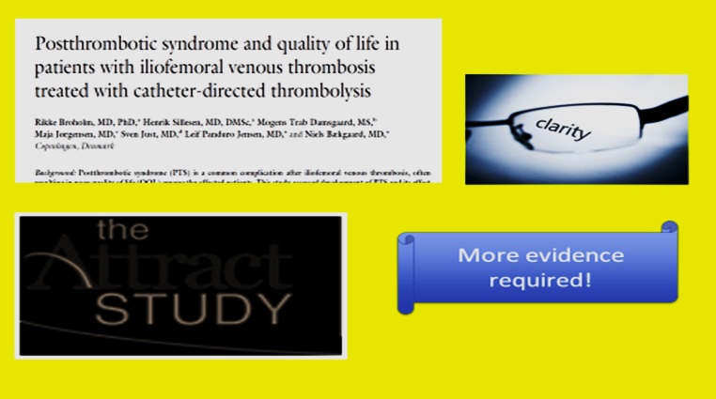

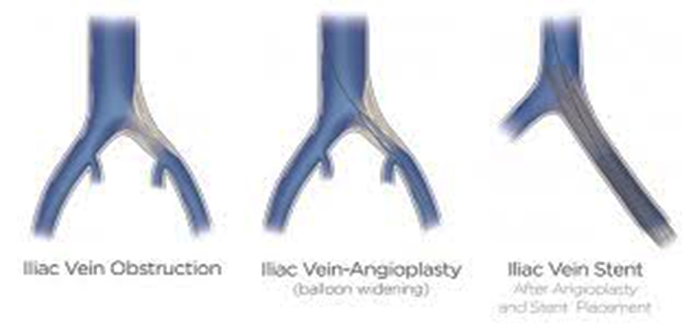
Deep vein disease?

Slide 48


Slide 49


Treatment’s of non proven cost benefit will not be available
Other than to a self payer market!
Is that ethical?

Slide 50

How to cope?

Slide 51
Satellite Symposium held during the 19th European Venous Forum (EVF)
Friday, June 29, 2018 (11:00-12:00)
How does CVD progress from the first symptoms to the advanced stages?
N. Labropoulos (USA)
Organized by

Slide 52
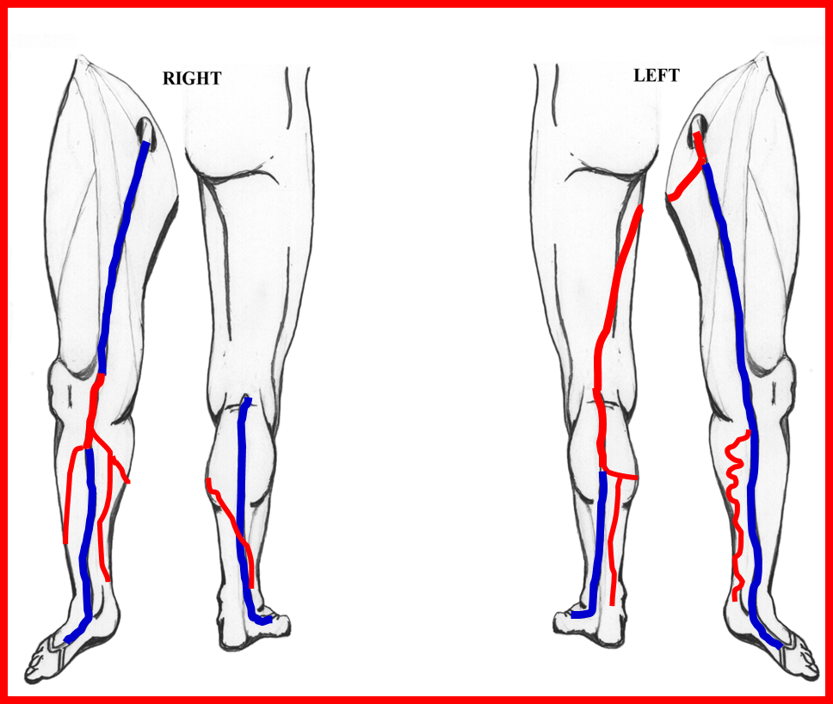
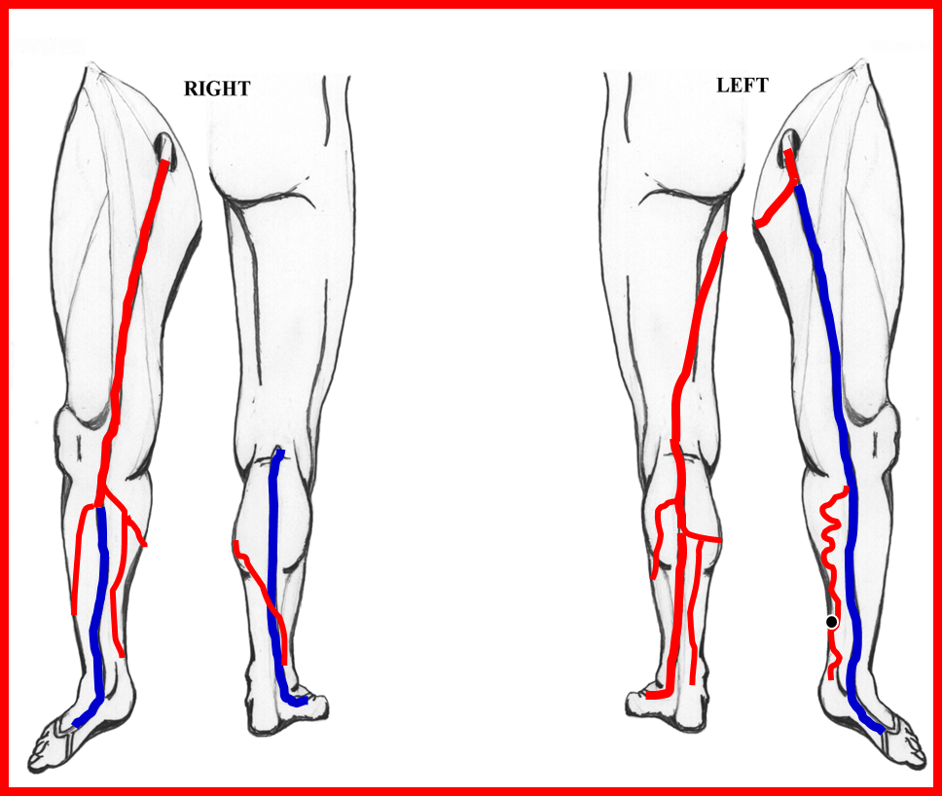
How does CVD progress from the first symptoms to the advanced stages?
First exam
2 years later
Nicos Labropoulos
Professor of Surgery and Radiology
Director, Vascular Laboratory
Division of Vascular Surgery
Stony Brook Medicine
Stony Brook, New York, USA
nlabrop@yahoo.com

Slide 53
Progression of CVD
The genetic disposition for VV cannot be stopped
You cannot chose your parents!
Aging cannot be stopped
You can look younger but still you get older!
Obesity can be reduced
    Only a few manage to lose weight and maintain it
SVI VVs

Slide 54
CVD progression
Change in clinical signs
i.e. from one CEAP class to another
Change in symptoms
i.e. asymptomatic patient developed pain
Change in both signs and symptoms

Slide 55
Original observations on CVD progression in patients waiting for surgery
116 limbs in 90 patients
Reflux (97.4) was the predominant pathology
31 limbs (26.7%) progressed
Labropoulos N et al. Study of venous reflux progression. J Vasc Surg 2005;41:291-5

Slide 56
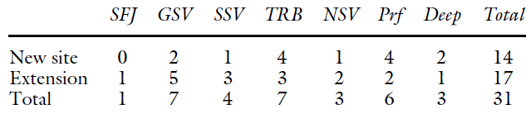
Sites and extension of reflux
Labropoulos N et al. Study of venous reflux progression. J Vasc Surg 2005;41:291-5

Slide 57
Clinical Deterioration
C Class Change | Limbs
C2 → C3 | 7
C3 → C4 | 4
C4 → C6 | 2
New duplex findings were seen in 7 of the 13 limbs
Labropoulos N et al. Study of venous reflux progression. J Vasc Surg 2005;41:291-5

Slide 58
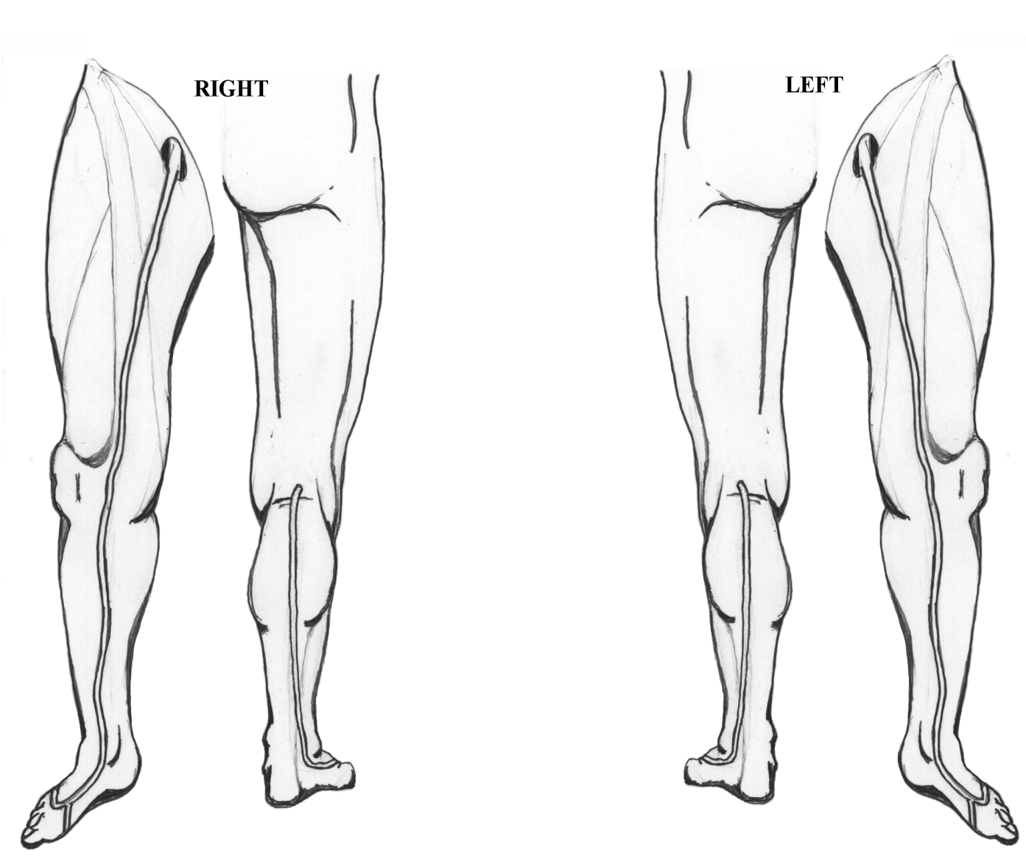
Venous reflux progression - Labropoulos N et al. J Vasc Surg 2005;41:291-5
Female 48y, 2 pregnancies, FH: +ve, duration of disease: 12y
C1-2A EP AS+P PR
C1-3A EP AS PR
First exam

Slide 59
Female 48y, 2 pregnancies, FH: +ve, Duration of disease: 14y
C1-3A EP AS+P PR
C1-4S EP AS+P PR
2nd exam at 26 months

Slide 60


Macromolecules
Leukocyte adhesion
and margination
TGF-
β
RBC
extravasation
1
Endothelial cell
activation
RBC degradation
fibrin+hemosiderin
Fibroblast
Collagen
Mast cells
Macrophages

Slide 61
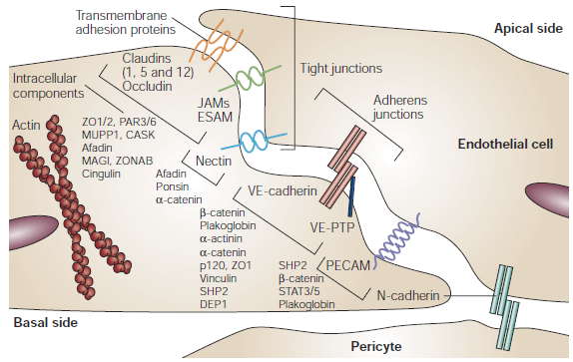
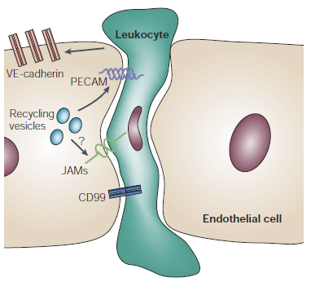
Molecular organization
of endothelial junctions
Leukocyte diapedesis through endothelial junctions
Dejana E. Nature Reviews 2004;5:261-270

Slide 62
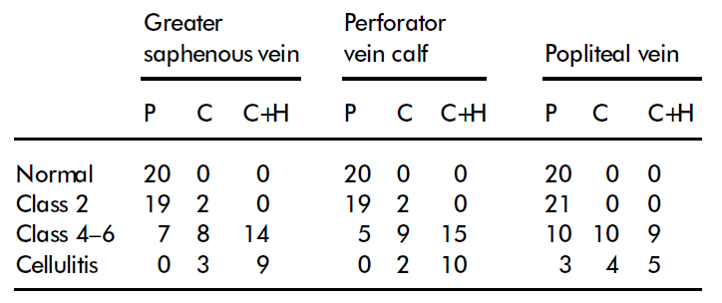
Labropoulos N et al. Phlebology 2003;18:78–82
Inflammation parallels severity of chronic venous
insufficiency
P: phasic flow C: continuous flow
C+H: Continuous and hyperemic flow

Slide 63
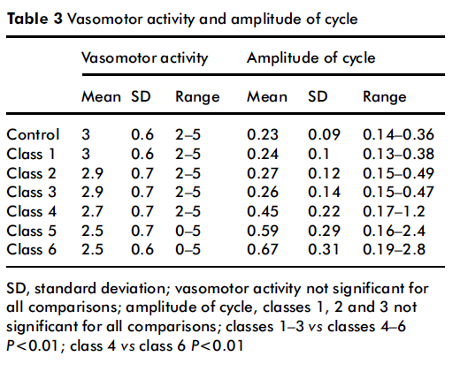
Labropoulos N et al. Phlebology 2004;19:81–86
Impairment of microcirculation in CVI

Slide 64
Venous ulcer from an 86 year-old male.
Gross, resin-filled, ulcer margin specimen
Light microscope showing the tortuous microvessels within this specimen

Slide 65
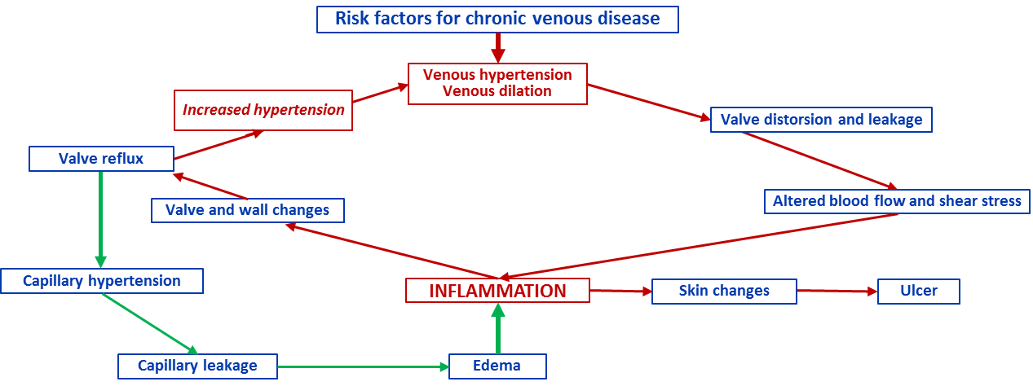
The vicious circle of venous hypertension/venous inflammation, emphasizing the importance of inflammation
Adapted from Bergan J, et al. NEJM 2006;355:488-98

Slide 66
A 39 years old female patient, presented with symptomatic
right lower limb. She noticed the symptoms 5 years ago.
Signs and symptoms
-Tenderness
-Local pain
Worst at the end of the day and during standing
Symptoms are relieved with limb elevation
She had 3 pregnancies 2005, 2011 and 2013
Symptoms started 5 years ago after the 2nd pregnancy
She is feeling worse after her last pregnancy 3 years ago

Slide 67
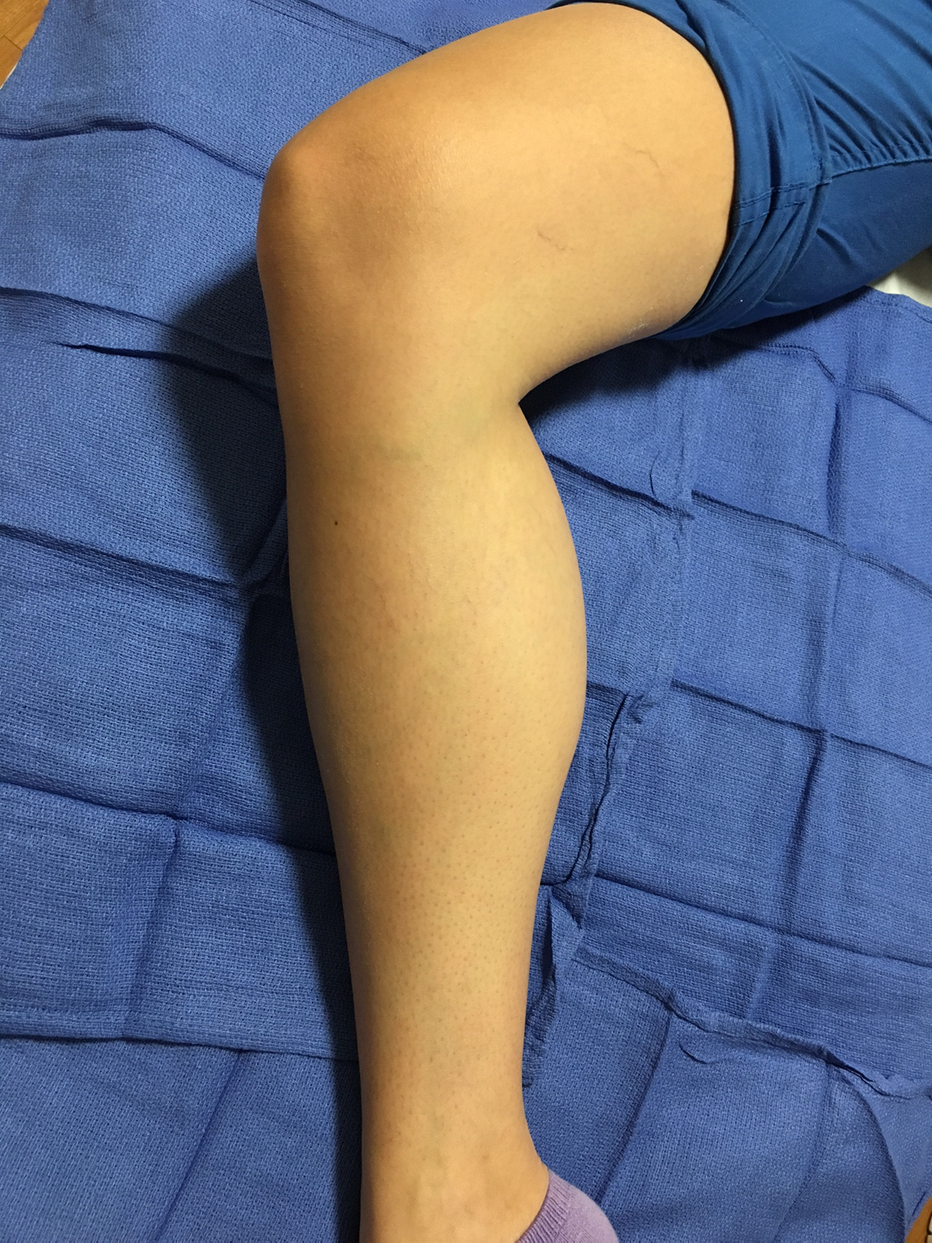
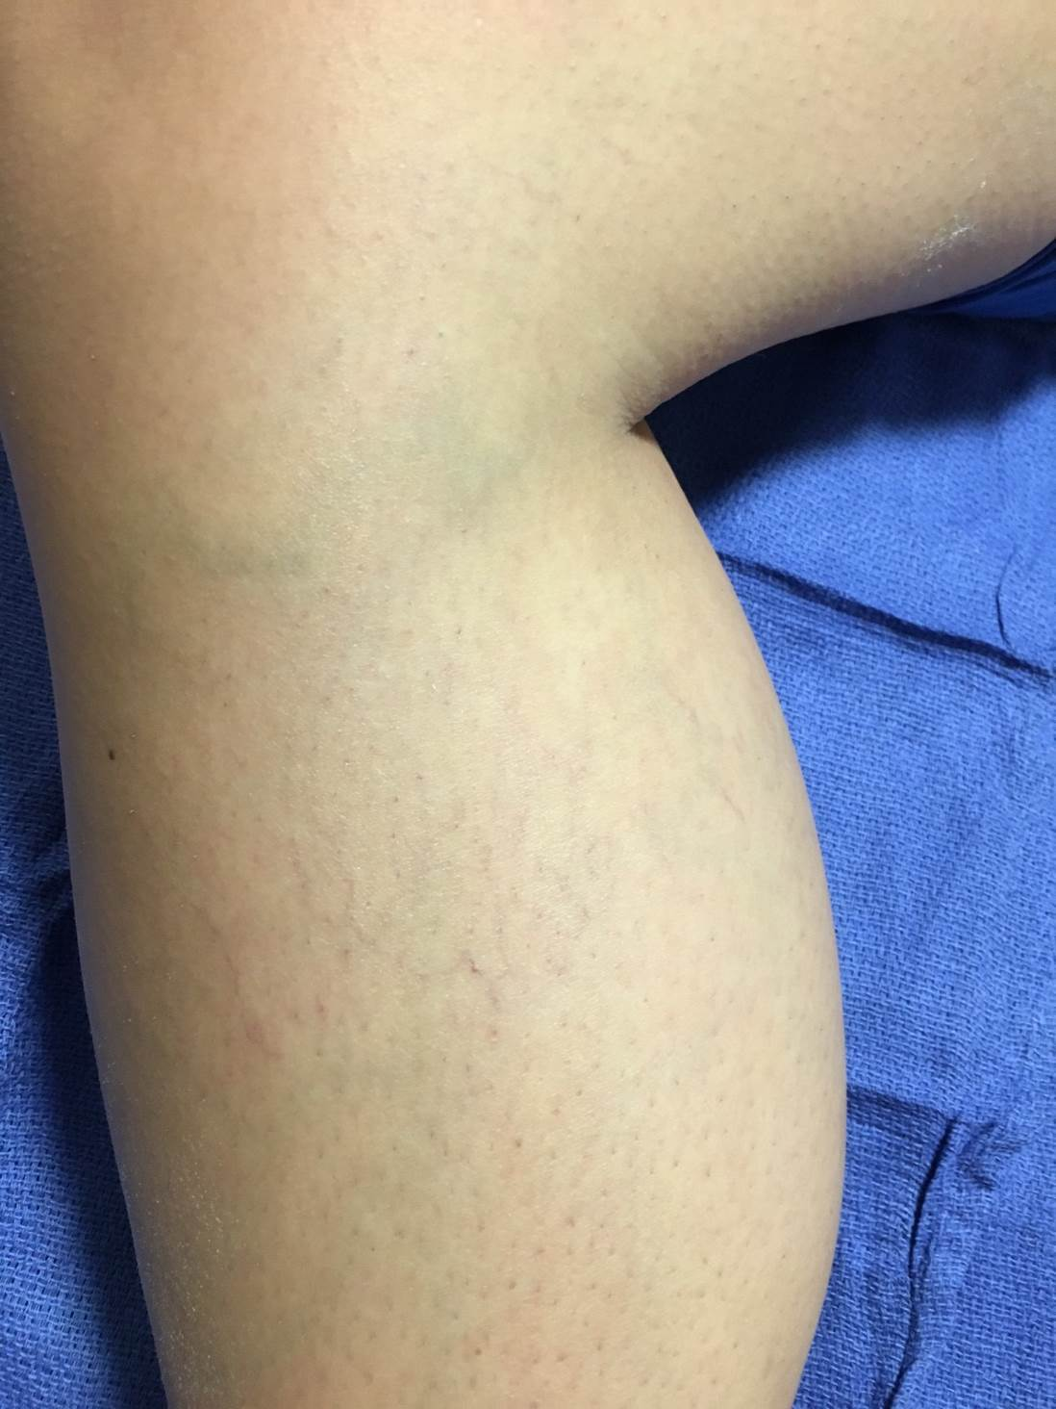
No varicose veins

Slide 68
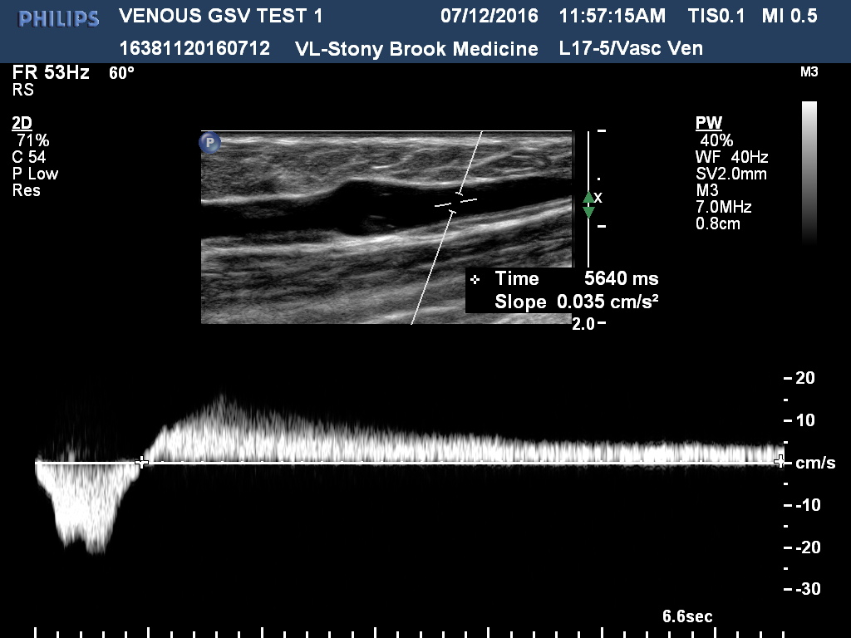
GSV reflux at the knee and upper calf
Long reflux duration induced by calf compression
Labropoulos N, et al. Definition of venous reflux in lower-extremity veins. J Vasc Surg 2003;38:793–8.

Slide 69
C0S EP AS PR
4.6mm
4.2mm
No varicose veins
GSV reflux
SSV and deep veins were normal
No venous obstruction
4.2mm
4.1mm
6.2mm
3.4mm
1.2mm
1.7mm
3.3mm
0.9mm
GSV reflux extended from the
pre-terminal valve to upper calf.
A small 1st order and a few
2nd and 3rd order tributaries had reflux.
2.5mm
3.0mm

Slide 70
Treatment plan
The patient has subclinical segmental disease.
She may benefit from
-Elastic compression stockings
-MPFF
Follow-up
She should be followed-up to determine the effects of treatment.
If the patient feels better and tolerates the treatment
she should continue the above management.
Treating such patients with endovenous techniques is
controversial and no guidelines exist for their management.

Slide 71
A systematic review of compression hosiery for uncomplicated varicose veins. Palfreyman SJ, Michaels JA. Phlebology 2009; 24 (Suppl 1) 13 – 33
25 prospective randomized controlled trials
Wearing compression improved the symptoms of the CVD
Wearing compression to slow the progression or prevent the recurrence of varicose veins could not be supported by the current published evidence

Slide 72
Progression of CVD
Summary of Bonn Vein Study I/II
Incidences of varicose veins and CVI after 6.6 years follow-up reach 14%
Progression from C2 towards C3-C6 reaches 31% if saphenous varicose veins are involved
Main risk factors are advanced age and high BMI
Swelling sensation in varicose patients may predict higher risk for progression

Slide 73
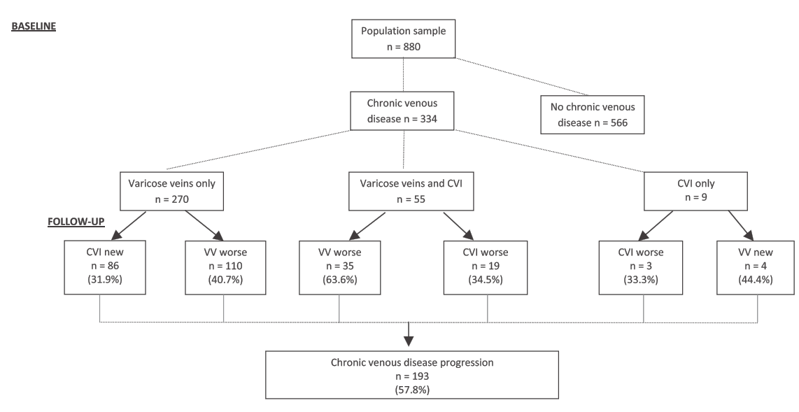
Edinburgh Vein Study - Progression of CVD
Lee AJ, et al. Progression of varicose veins and chronic venous insufficiency in the general population in the Edinburgh Vein Study. J Vasc Surg VL 2015;3:18-26

Slide 74
Edinburgh Vein Study - Progression of CVD
CVD progression 1/20 per year
Almost 1/3 with VVS developed skin changes putting them at risk of ulcer
CVD progression cannot be ignored. Research is required on interventions to prevent progression for benefiting patients and reducing health service costs.
Lifestyle and clinical factors most strongly related to progression were family history of varicose veins and history of DVT.
Venous reflux, particularly superficial (worse S+D), was an indicator of greater progression suggesting that duplex scanning could be a useful prognostic tool.
Further research encompassing large longitudinal studies is required.
Lee AJ, et al. Progression of varicose veins and chronic venous insufficiency in the general population in the Edinburgh Vein Study. J Vasc Surg VL 2015;3:18-26

Slide 75
Progression in venous disease
Labropoulos N, et al. Study of the venous reflux progression. J Vasc Surg 2005;41:291–295.
Labropoulos N, et al. Secondary chronic venous disease progresses faster than primary.
J Vasc Surg 2009;49:704–710.
Kostas TI, et al. Chronic venous disease progression and modification of predisposing factors. J Vasc Surg 2010;51:900–907.
Rabe E, et al. Incidence of varicose veins, chronic venous insufficiency, and progression of disease in the Bonn vein study II. J Vasc Surg 2010;51:791.
Engelhorn CA, et al. Progression of reflux patterns in saphenous veins of women with chronic venous valvular insufficiency. Phlebology 2012;27:25–32.
Lee AJ, et al. Progression of varicose veins and chronic venous insufficiency in the general population in the Edinburgh Vein Study. J Vasc Surg 2015;3:18–26.
High progression rate of chronic venous disease.
More studies are needed to
-determine the risk for progression to venous ulcers
-define which patients may benefit from early vein interventions
Pannier F, Rabe E. Progression in venous pathology. Phlebology 2015;30(1 Suppl):95-7.

Slide 76
Recommendations for the referral and treatment of patients with lower limb chronic venous insufficiency (including varicose veins).
Berridge D et al. Phlebology 2011; 26: 91 – 93
There is ample published evidence to show that, when patients are correctly selected, treatment for CVI, both conservative and interventional, can:
Significantly improve disease specific and generic HRQL
Relieve a wide range of troublesome lower limb symptoms
Delay and prevent the onset of complications of CVI
Represent a highly cost-effective use of NHS ressources

Slide 77
Key points
There is no prophylaxis for VV
Early treatment of symptomatic VV can
  Improve symptoms and HRQOL
  Improve CVI signs
  Slow down progression
  Cannot prevent recurrence of VV
Patients should
  Control weight
  Improve mobility
  Wear compression if applicable
  Use pharmacologic treatment

Slide 78


A powerhouse in venous education
10TH ANNUAL
VENOUS SYMPOSIUM
APRIL 11-13, 2019 · NEW YORK, NY
venous-symposium.com
Venous Education

Slide 79
Satellite Symposium held during the 19th European Venous Forum (EVF)
Friday, June 29, 2018 (11:00-12:00)
MPFF for patients suffering from CVD: New evidence
J.-H. Ulloa (Colombia)
Organized by

Slide 80
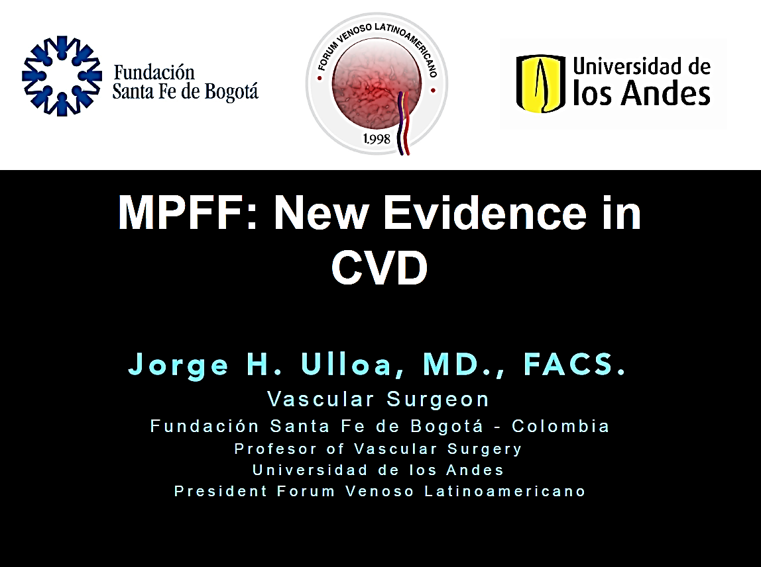

Slide 81


Slide 82


Slide 83

Development of a chronic animal model of hind limb venous hypertension with low blood flow
Ligature(s):
Common femoral vein (A) + right (B) and left (C) branches
Sham-operated animals A+B+C
Common iliac vein (D)
Sham-operated animals D
Sacrifice and measures
W0 W2 W4 W6 W8 W10
B
D
2
4
A
C
Systemic and Microcirculatory Hemodynamics
  Jugular venous pressure
  Epigastric venous pressure
  Venular diameter
  Functional capillary density
Leukocyte-endothelium interaction
  In vivo experiment: adhesion and rolling
1
3
5
Das Graças M, Bouskela E. Eur J Vasc Endovasc Surg, 2018
Notes:
Development of an animal model of low flow and high pressure in veins
Objectives:
To achieve long periods of time for observations
To investigate the alterations in venous pressure with time
To assess changes in microcirculatory parameters.
Material and methods:
Experimental group
Groin incisions and ligation of the right common femoral vein + ligation of left and/or right branch of the right femoral vein
Laparotomy incision and ligation of right iliac vein.
Sham group
Same vascular dissections without ligation of the veins.
Assessments
Evolution with time of venous pressure
Arterial blood pressure and heart rate
Investigation of microcirculatory parameters with Cytoscan (OPS probe) as well as with intravital microscopy.

Slide 84
Leukocyte-endothelium interaction
Rolling
Sticking
60

p<0.001
20
p<0.001


p<0.001
15
p<0.001
➲
40

Sticking leukocytes/6 mm²

Rolling leukocytes/6 mm²

10

20
5

0
0
Sham
Vehicle
MPFF
100
Diosmin
100
Hesperidin
fraction
10
Sham
Vehicle
MPFF
100
Diosmin
100
Hesperidin
fraction
10
mg/kg/d
mg/kg/d
 p<0.001 versus sham;  p<0.05  p<0.001 versus vehicle
Das Graças M, Bouskela E. Eur J Vasc Endovasc Surg, 2018
Notes:
The number of rolling and adherent leukocytes significantly increased in vehicle treated group versus sham operated animals.
MPFF significantly decreased the number of rolling and adherent leukocytes more intensively than diosmin by itself.
The Hesperidin fraction also significantly decreased the number of rolling and adherent leukocytes.

Slide 85
Microvascular alterations
Functional capillary density
P=0.0070
50
P=0,0040


40


30
Number/area
20
10
0
Sham
Vehicle
MPFF
100
Diosmin
100
Active flavonoids
10
: P<0,01 versus sham
: P<0,001 versus vehicle
mg/kg/d
MPFF prevented the decrease in functional capillary density
Synergistic beneficial effects of the association between diosmin and active flavonoids of MPFF
Das Graças M, Bouskela E. Eur J Vasc Endovasc Surg, 2018
Notes:
more recentlly, the effect of MPFF was investigated on microcirculatory hemodynamic parameter, versus its components ( diosmin and active flavonoids) in a new model which allowed
To have long periods of time for observations
To investigate the alterations in venous pressure with time
To assess changes in microcirculatory parameters.
Material and methods:
Groin incisions and ligation of the right common femoral vein + ligation of left and/or right branch of the right femoral vein
Laparotomy incision and ligation of right iliac vein.
Sham group: Same vascular dissections without ligation of the veins.
Assessments
Evolution with time of venous pressure; BP and HR ; microcirculatory parameters with Cytoscan (OPS probe) as well as with intravital microscopy.
Systemic and Microcirculatory Hemodynamics
Jugular venous pressure
Epigastric venous pressure
Venular diameter
Functional capillary density
Leukocyte-endothelium interaction
In vivo experiment: adhesion and rolling

Slide 86


Slide 87
Leg pain reduction in C0s to C4 patients
Intensity of pain on VAS
1 tablet MPFF 1000 mg/day
7


2 tablets MPFF 500 mg/day
5,9
6,1

6

5
4,9

4,4

4
3,5
3,3
3
2,1
2
1,7
1
N=174
0
Baseline
W2
W4
W8
*** P<0.001
Kirienko A et al. Int Angiol 2016
8-week randomized double-blind study
Notes:
KIRIENKO
Objectives
To compare the clinical acceptability and efficacy of Daflon1000 mg tablets and 500 mg tablets administered at the same daily dose (1 gram / day) in patients suffering from symptomatic Chronic Venous Disease
Methods
8- week international, randomised, double-blind, parallel-group study
1 tablet of Daflon1000mg /day or 2 tablets of Daflon 500mg /day
Leg pain was assessed by visual analogue scale (VAS).
Adverse events were recorded by patient in a diary.
Results
174 C0s to C4patients included.
Both treatments were associated with a significant reduction in leg pain score after 8 weeks of treatment: a reduction of 4.12 was observed (4.24 cm for Daflon 1000 tablets 1000 mg versus 4.00 cm for Daflon 500 mg tablets).
The reduction of pain was noted after 2 weeks of treatment and continuously observed throughout the treatment.
No serious Adverse Event occurred. 8- week, randomised, double-blind, parallel-group study involving 174 C_{0s} to C₄ patients

Slide 88


Slide 89

Lower limb discomfort and improved QoL
1076 C0s to C4 patients
Lower limb discomfort
Quality of life (CIVIQ-20
+20,28
+19,33
W0
W8
N= 1076 patients
MPFF 500mg twice daily
MPFF 1000mg once daily
Carpentier et al. Int Angiol. 2017
8-week randomized double-blind multi-center study
Notes:
Objective: To demonstrate the clinical non-inferiority of Daflon1000 mg once daily as oral suspension versus 2 tablets daily of Daflon 500 mg on CVD-related symptoms and quality of life of patients
Methodology:
Randomized, double-blind, multi-center study.
C0s to C4 patients received either Daflon1000mg in oral suspension or 2 tablets of Daflon 500mg for 8 weeks
Lower limb symptoms (discomfort, pain and heaviness) were assessed using VAS
QOL was measured with CIVIQ-20.
Results:
1076 patients completed the study
The efficacy of Daflon 1000mg once daily on lower limb disconfort , leg pain and leg heaviness was not inferior to Daflon 500 mg twice daily
QOL was improved by about 20 points on the CIVIQ scale in both groups
Similar safety profile in both groups
Conclusion:
The efficacy of the new Daflon 1000mg once daily was similar to Daflon 500 mg on lower limbs symptoms with the advantage of once daily intake, potentially associated with improved adherence and easier CVD management

Slide 90


Slide 91
A recent meta analysis assessed the effects
of MPFF
  magnitude of the effect on each symptom
  the number of patients needed to treat (NNT) to have benefit in one patient
Kakkos S and Nicolaides AN. Int Angiol 2018, April;37(2):143-154

Slide 92


Slide 93

7 randomized, double-blind, placebo-controlled trials in 1692 patients with CVD
Individual and global symptoms, signs(leg edema, redness, skin changes), QoL, and overall effectiveness of the treatment
Kakkos S and Nicolaides AN. Int Angiol 2018, April;37(2):143-154

Slide 94
High Quality of Evidence with MPFF
Outcomes | Relative Effect (95% CI) | No of Patients (studies) | Quality of the evidence (GRADE)
Pain (continuous variable) | -0.25 [-0.038 to -0.11] | 839 (3 studies) | ⊕⊕⊕⊕ high
Pain (categorical variable) | RR 0.53 (0.38 to 0.73) | 271 (3 studies) | ⊕⊕⊕⊝ moderate
Heaviness (categorical variable) | RR 0.35 (0.24 to 0.51) | 283 (3 studies) | ⊕⊕⊕⊕ high
Feeling of swelling (categorical variable) | RR 0.39 (0.27 to 0.56) | 267 (3 studies) | ⊕⊕⊕⊕ high
Global symptoms (categorical variable) | RR 0.36 (0.09 to 1.53) | 189 (3 studies) | ⊕⊕⊕⊝ moderate
Ankle circumference (mm) | SMD : -0.59 [-1.15 to -0.02] | 282 (3 studies) | ⊕⊕⊕⊝ moderate
Objective improvement | RR 0.31 (0.19 to 0.49) | 231 (4 studies) | ⊕⊕⊕⊝ moderate
Kakkos S and Nicolaides AN. Int Angiol 2018, April;37(2):143-154

Slide 95
Number Needed to Treat (NNT)
Leg pain | 4.2
Heaviness | 2.9
Feeling of swelling | 3.1
Functional discomfort | 3.0
Cramps | 4.8
Paresthesia | 3.5
Leg redness | 3.6
Kakkos S and Nicolaides AN. Int Angiol 2018, April;37(2):143-154

Slide 96
Conclusions
Based on high quality evidence:
MPFF is highly effective in reducing leg pain, heaviness, feeling of swelling, paresthesia, cramps, edema and quality of life in patients with CVD.
The NNT to obtain significant clinical benefit was very small (<5) for the main symptoms: very few patients need to be treated with MPFF to observe clinical improvement.
These findings warrant a detailed cost effectiveness analysis.
Kakkos S and Nicolaides AN. Int Angiol 2018, April;37(2):143-154

Slide 97

Chronic VEnous DIsorder MaNagement and EvAluation of Chronic venous disease treatment EffecTiveness, an International Program
The Vein Act Program
Under the auspices of the European Venous Forum with an unrestricted grant from Servier

Slide 98
International, prospective, observational study involving 7987 adult outpatients consulting for lower limb pain or any clinical presentation related to CVD.
Assessment of symptoms, CEAP classification and symptom intensity.
After prescription of conservative treatments, follow-up visit.

Slide 99

Baseline characteristics of the patients
Demographic characteristics at inclusion
Gender | Male : 21%; Female 79%
Mean age (year) | 54.0 ± 15.1
Mean BMI (kg/m²) | 26.84 ± 4.82
Previous consultation for leg problems | 30.7%
Previous treatment for leg problems | 24.3%
CEAP Classification at baseline
35%
  Female
30%
  Male
CVD treatment prescription at baseline
25%
  Global
20%
3,4%
% patients
6,8%
15%
33,4%
10%
5%
0%
C0
C1
C2
C3
C4a
C4b
C5
C6
  VAD alone (incuding MPFF)
56,3%
  VAD + compression
  VAD + compression + pain killer drug
  Other
N=7397

Slide 100
Signs and symptoms at baseline
Patient-reported signs
Telangiectases, reticular veins, spider veins | 67.8%
Varicose veins | 60.0%
Edema | 50.8%
Skin changes | 18.2%
Leg ulcer | 5.6%
Patient-report symptoms
Heaviness, leg pain, sensation swelling, cramps | 89.6%
Mean number of symptoms | 2.7 ± 1.1
Quantification of symptoms in cm on VAS
Heaviness | 5.7 ± 2.1
Leg pain | 5.8 ± 2.2
Sensation of sweling | 5.5 ± 2.2
Cramps | 5.1 ± 2.5
When those leg problems are the most intense
At the end of the day | 72.8%
After prolonged standing | 60.4%
During the night | 30.7%
Frequency of symptoms
Never | 0.5%
Rarely | 2.8%
Occasionally | 24.4%
Regularly | 62.6%
All day and night | 9.1%

Slide 101
Results
 | % of adherent patients
 | Venoactive drug | MPFF | Compression
Adherent to prescribed treatment duration / wearing as prescribed | 65.2% (n=7352) | 65.9% (n=6841) | 29.1% (n=5003)
p<0.0001
p<0.0001
p<0.0001
p<0.0001

Slide 102


Slide 103


Symptoms in Early Stages
The severity of leg heaviness (VAS)
Correlation between clinical and ultrasound results
with MPFF treatment
Group 1: C0s and C1s with situational reflux
Group 2: C2 patients with situational reflux
Group 3: C2 patients with situational reflux after phlebectomy
N=294 WOMEN
Follow-up: 3 months
Tsukanov y Phlebolymphology 2017
Notes:
Another data came from Tsukanov. He presented in his article that in C_{1s} patients with telangiectasia and reticular vein,
Daflon (1000 mg/day for 3 months) eliminates the saphenous vein reflux that occurs in the evening and has beneficial effects on symptom relief and quality of life
____________________
At baseline, 96 C_{1s} women were investigated, of which 53 presented TVR after DOL-test, and all complained of leg heaviness at the end of the day. They were enrolled in the study and re-assessed after a 3-month treatment with Daflon, 1000 mg a day. After Daflon treatment, TVR was eliminated in 92.5% of patients and the saphenous vein diameter was significantly reduced (from 5.69 mm to 5.14 mm, P=0.000001). This was accompanied with symptoms cessation in 88.6% and symptom relief in 11.4%, together with an improvement in the QOL.
Spontaneous study performed in Russia on C_{1s} patients presenting with symptomatic telangiectasies and/or reticular veins of which more than half (55.2%) had a transient venous reflux (TVR) in the evening,
C_{1s} patients with TVR received a Daflon treatment (1000 mg/day for 3 months) and investigations redone at the end of treatment. Symptoms were assessed on the visual analogue scale, and the quality of life (QOL) on CIVIQ.

Slide 104


Slide 105
MPFF in 2018 Recommendations
Management of Chronic Venous Disease
of the lower limbs
Guidelines according to scientific evidence developed under the auspices of EVF, IUA, UIP, and the Cardiovascular Disease Educational and Research Trust
Int Angiol 2018, June;37(3):232-254

Slide 106
Level Of Evidence That Merits Grade A Or B For The Effects On Individual Symptoms, Signs And Qol
Symptom/sign | MPFF | Ruscus | Oxerutins | HCSE | Calcium dobesilate
Pain (NNT) SMD | A (4,2) -0,25 | A (5) -0,80 | B -1,07 | A (5,1) | B (1,4)
Heaviness (NNT) SMD | A (2,9) -0,80 | A (2,4) -1,23 | B (17) -1,00 |  | A (1)
Feeling of swelling (NNT) SMD | A (3,1) -0,99 | A (4) -2,27
Functional discomfort (NNT) SMD | A (3,0) -0,87 |  |  |  | B (4)
Leg fatigue (NNT) SMD | NS | B -1,16
Cramps (NNT) SMD | B (4,8) -0,46 | B/C | B -1,7
Paresthesiae (NNT) SMD | B/C (3,5) -0,11 | A (1,8) -0,86 |  |  | B (2)
Burning (NNT) SMD | B/C -0,46 | NS
Pruritus/itching (NNT) |  | B/C |  | A(6,1)
Tightness (NNT) | NS
Restless legs (NNT) | NS
Leg redness (NNT) SMD | B (3,6) -0,32
Skin changes (NNT) | A (1,6)
Ankle circumference (NNT) SMD | B -0,59 | A -0,74 | NS | A (4)
Foot or leg volume SMD | NS | A -0,61 | NS | A -0,34 | A -11,4
Quality of life SMD | A -0,21 |  |  |  | NS
Int Angiol 2018, June;37(3):232-254

Slide 107
Level of Evidence for the Effects of
the Main Medications on the Healing of Leg Ulcers¹
 | MPFF | Pentoxifylline | Sulodexide | Hydroxyethyl rutosides
Healing of leg ulcers | Grade A | Grade A | Grade A | Grade B
Statins²
Aspirin³
1 : Int Angiol 2018, June;37(3):232-254 2 : PURL’s study Evangielista et al 2014 3 : BMJ 2017

Slide 108
Strength of Recommendations Based on Magnitude Effects on Individual Symptoms or Signs vs Side-effects
 | MPFF | Ruscus | oxerutins | HCSE | Ca. dobesilate
Pain | Strong | Strong | Strong | Strong | Weak in view of the possibility of inducing agranulocytosis
Heaviness | Strong | Strong | Strong | -
Feeling of swelling | Strong | Strong | - | -
Functional discomfort | Strong | - | - | -
Cramps | Strong | Weak | Strong | -
Leg redness | Strong | - | - | -
Skin changes | Strong | - | - | -
Edema | Strong | Strong | Weak | Strong
Quality of life | Strong | - | - | -
Paresthesiae | Weak | Strong | - | -
Burning | Weak | - | - | -
Leg fatigue | - | Strong | - | -
Pruritus | - | Weak | - | Strong
Int Angiol 2018, June;37(3):232-254

Slide 109
Concluding messages
MPFF prevents the microcirculatory dysfunction and breaks the vicious cycle of venous inflammation
MPFF is highly effective on symptoms, signs and QoL at all stages of CEAP (0-6), based on high quality of evidence
MPFF has the highest strength of recommendations for the management of CVD in the 2018 guidelines.

Slide 110
Satellite Symposium held during the 19th European Venous Forum (EVF)
Friday, June 29, 2018 (11:00-12:00)
Discussion
Organized by

Slide 111
Satellite Symposium held during the 19th European Venous Forum (EVF)
Friday, June 29, 2018 (11:00-12:00)
Concluding remarks
A. Nicolaides (Cyprus)
Organized by

