Slide 1
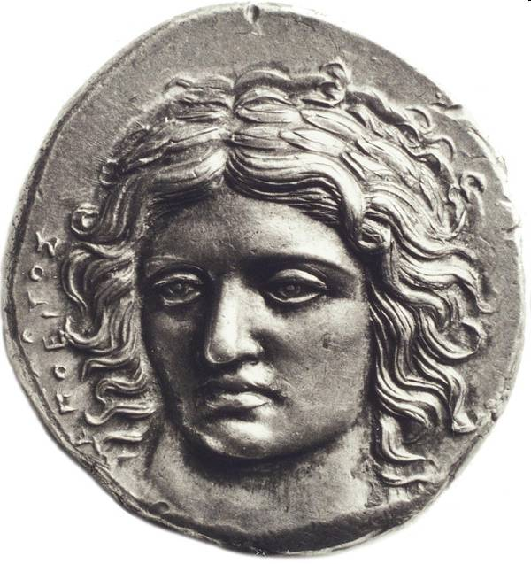
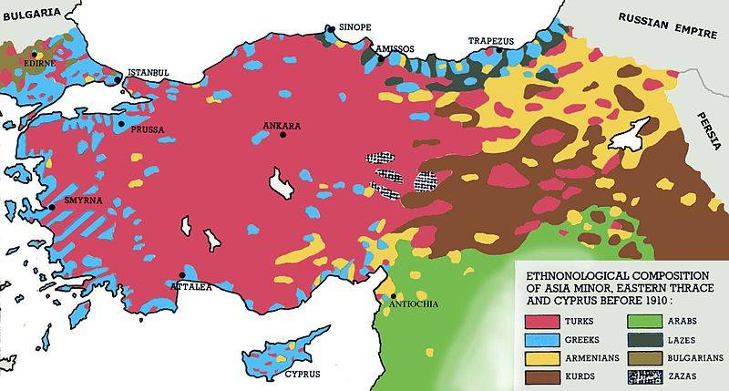
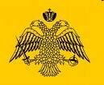
The Ottoman Genocide against Greek Orthodox Christians: Outline, Interpretation, and Commemoration in Comparative Perspective
Dr. phil. Tessa Hofmann

Slide 2
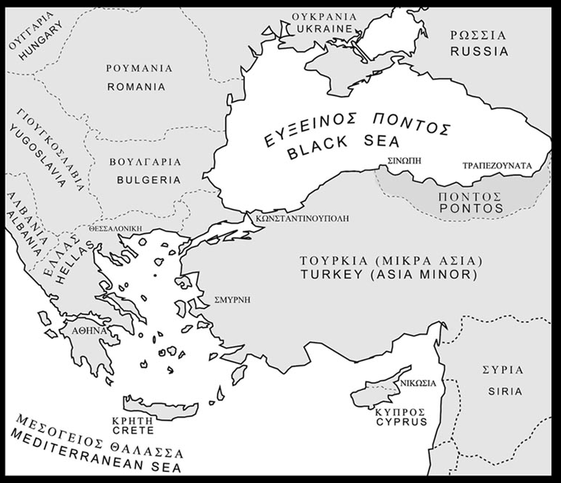
Asia Minor and Pontos
Tης Μικράς Ασίας και του Πόντου
Asia Minor (Μικρά Ἀσία): Peninsula in the NW of the Near East: Diverging geographical definitions in Greek or other languages
Anatolia (ἀνατολή – „East; Orient“ – as seen from Greece): originally the West of Asia Minor → since the second half of the 19th century synonym for the Armenian Highland (= „Eastern Anatolia“)
Ionia → Turkish and Kurdish „Yunanistan“; Armenian: Hnastan
Romania (Eastern Rome, Byzantion)
Ethnonyms: Own and external designations:
Greeks in Greece: Éllines (Έλληνες – Hellenes) – External designation: Greeks (from Latin Graeci)
Greeks of Asia Minor:
Ῥωμαῖοι, Rhōmaîoi; contemporary pronunciation: Romäi → Romiosini („Romans“, „Romäans“ = Eastern Romans, Byzantines; Turkish rumlar)
External designation: Ionians - Yunan (Ἴωνες“)

Slide 3
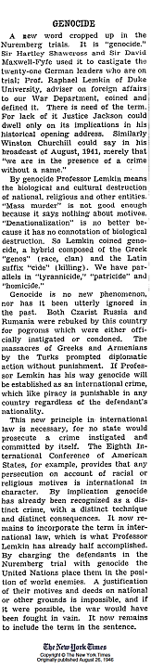

Definition of Genocide
Convention on the Prevention and Punishment of the Crime of Genocide (1948; ratified by Turkey, 1950)
Article 2
In the present Convention, genocide means any of the following acts committed with intent to destroy, in whole or in part, a national, ethnical, racial or religious group, as such:
(a) Killing members of the group;
(b) Causing serious bodily or mental harm to members of the group;
(c) Deliberately inflicting on the group conditions of life calculated to bring about its physical destruction in whole or in part;
(d) Imposing measures intended to prevent births within the group;
(e) Forcibly transferring children of the group to another group.

Slide 4
1820s-1920s: Minorization of majorities –
Ottoman Non-Muslims in a century
Decade | Percentage of Non-Muslims in overall Ottoman population (%) | Percentage of Muslims in overall Ottoman population (%)
1820s | 68.0 | 32.0
1840s | 63.9 | 36.1
1870s | 57.0 | 43.0
1890s | 52.5 | 47.5
1927 (population census of the Turkish Republic) | 2.0
1935 (census) | 0.1
2012 (estimation) | 0.1
Kemal H. Karpat, Ottoman Population, 1830-1914: Demographic and Social Characteristics (Madison: University of Wisconsin Press, 1985), 72, cited from Ergun Özbudun, “Turkey—Plural Society and Monolithic State,” in: Democracy, Islam, and Secularism in Turkey, ed. Ahmet T. Kuru and Alfred Stepan (New York: Columbia UP, 2012), 61–94,p. 65

Slide 5
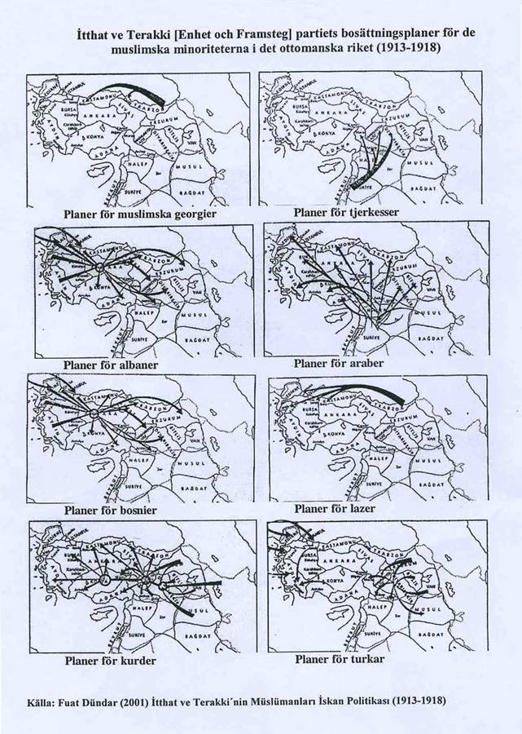
Nation-Building for A New State:
Turkey of the Turks, Turkey for the Turks
Transformation of a multi-ethnic state into a mono-ethnic national state
‚Islamization‘ of economy
Homogeneity through cultural and linguistic assimilation, Islamization, deportation and ethnic dispersion (2 – 10% of local and regional populaces)
Extermination of not assimiliable collectives

Slide 6
Building a national (Muslim) economy by boycott, dispossession, expropriation
Genocide = Raid
In the Ottoman Empire the state organized genocidal transfer of properties was paraphrased as „administration of abandoned property“ (emval-ı metruke)
Motifs: Supply of the political followers; of Muslim refugees; personal enrichment; building a national (Muslim) economy
CUP-law on „abandoned property“ abolished as late as June 11th, 1986
Since 1909, in particular since the Balkan Wars 1912/13 introduced and propagandistically orchestrated boycotts and repressions in order to bankrupt Ottoman Christians, in particular Greeks and Armenians: for example with the prohibition to collect the leaves of mulberry trees → δestruction of silkworm breed, silk production and textile; call not to buy from Christians

Slide 7
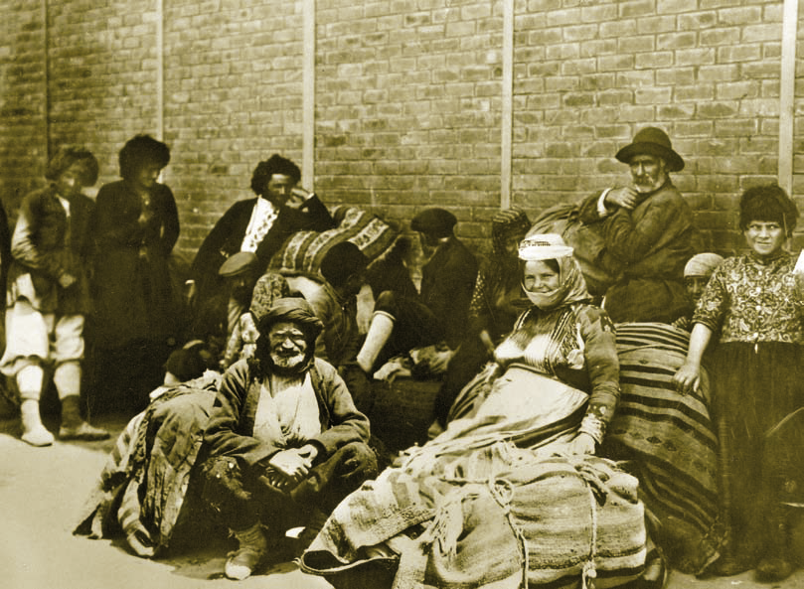
First Balkan War (Oct. 1912-May 1913): Expelled Greeks from Asia Minor arrive in Saloniki (Turkish Selanik; liberated in 1912 by Greeks → massive flight of Muslims and Jews into remaining Ottoman territories)

Slide 8
Γενοκτονία έν Ροή –
Continuous and cumulative genocide
Genocidal acts were committed
before, during and after the First World War under the rule of the Committee for Union and Progress (Ittihat ve Terakki Cemiyeti; C.U.P.) and Kemalists.
1912/13-Summer 1914: Massacres and deportations in Eastern Thrace (overall 350,000 Greek Orthodox Christians), of these 119,000 deported to Central Anatolia; of these 46,000 victims of diseases and compulsory labor); administrative confiscation of properties in Eastern Thrace;
1913: Deportations start in Ionia (Western Anatolia)
14th May 1914 - 1916: Deportations from the Dardanelles up to Çeşme → depopulation of the Ionian and Marmara littorals; massacre in Phokea (June 1914)
June 1916-Febr. 1917: Deportations and massacres in Pontos
Total of Ottoman Greeks, deported before and during WW1: 773.859
May 1919 – 1922: Irregular armed gangs (çeteler) of the so-called liberation units commit nation-wide massacres against Ottoman Greeks and Armenian genocide survivors/returnees. Deportations (death marches) in Pontos und Ionia 1922

Slide 9
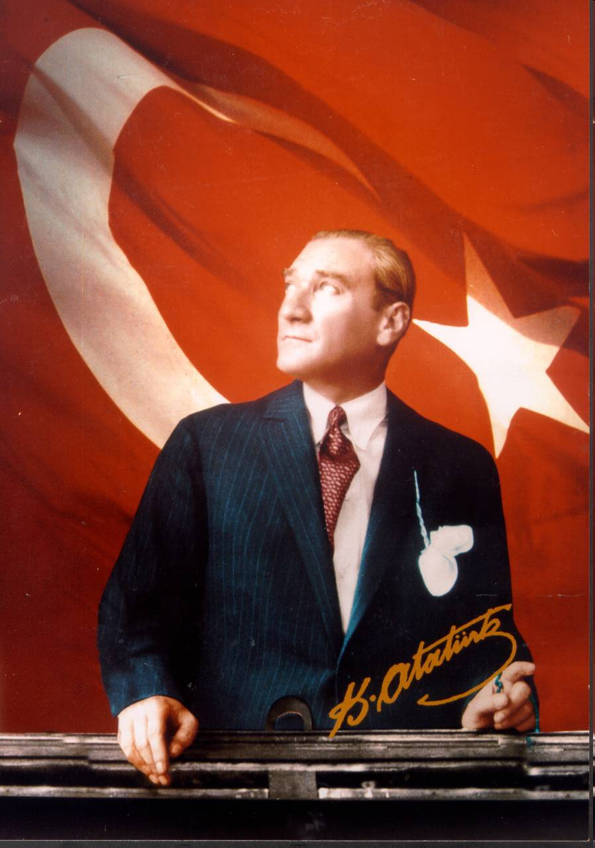
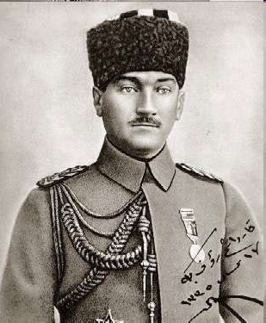
Mustafa Kemal „Atatürk“: War hero (Gazi – „Conqueror“) and founder of the Turkish Republic
Left:
At Samsun 1919
Gazi = a warrior and participant in the Holy War against the infidels (Arab. „Ghazw“). Kemal received the honorary title Gazi for his victory over the Hellenic Forces, 1922

Slide 10
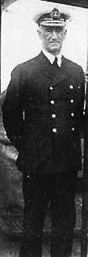
1919-1922: Patriotic banditry
“(…) the Christians are now bewildered and terrified… Every district has its band of brigands now posing as patriots and even in the vicinity of Constantinople robbery under arms is of daily occurrence, the principal victims being naturally the unprotected Christian villagers. Behind all these elements of disorder stands Mustapha Kemal… The government cannot and will not move a finger to help the Christians.”
John de Robeck, British Admiral of the Fleet, commander-in-chief of the Mediterranean Fleet (1919-1922) and until his death Allied High Commissioner at Constantinople
John de Robeck

Slide 11
Death Toll
1912/13-1923: Up to 1.4m
Number of deported under C.U.P. rule 1912-17: 500,000 (Ecumenical Patriarchate; Near East Relief) – 773,915 (René Puaux, 1923); casualties: 300,000 (Venizelos, 1918) – 550,000 (Ottoman Greek MPs in 1918/19)
Overall Greek-Orthodox population before 1914: 2.7m
./. 1,221m refugees/expatriated, registered in Greece after 1922
= 1,470m casualties or missing; of the casualties
In Eastern Thrace ca. 46,000 – 230,000 victims
In Pontos 353,000 (of a Greek overall population of 550,000)
In Asia Minor 900,000, of these
Diocese Nikomedia: 15,000 – 100,000 (1920-22)
in Smyrna at least 120,000 (= 20% of the overall population, according to „Daily Chronicle“, London; of these ca. 25,000 Armenians)
in Smyrna and vicinity 250,000 (H. Tsirkinidis) – 300,000 (Spiros Markezinis) in the second half of Sept. 1922 and up to 150,000 (René Puaux) - 300,000 (Tsirkindis) deported men during mass executions and forced labour

Slide 12
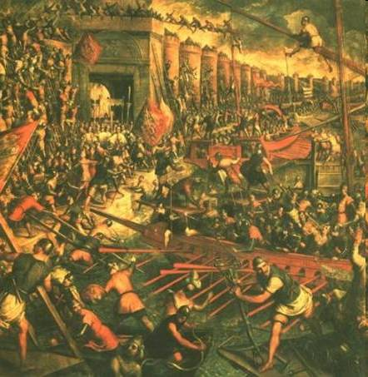
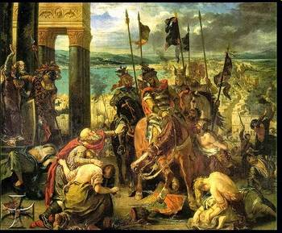
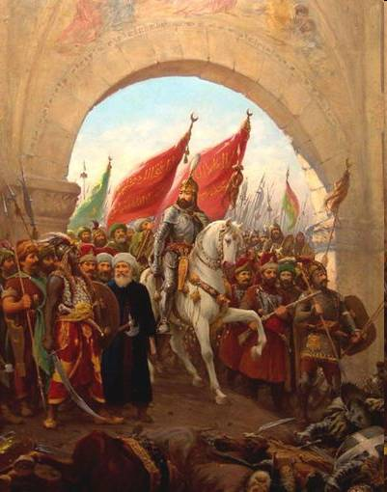
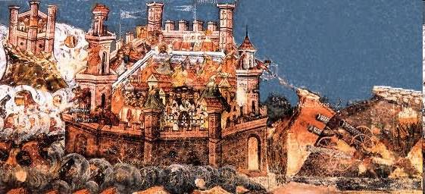
The Conquest of Constantinople, 1453

Slide 13
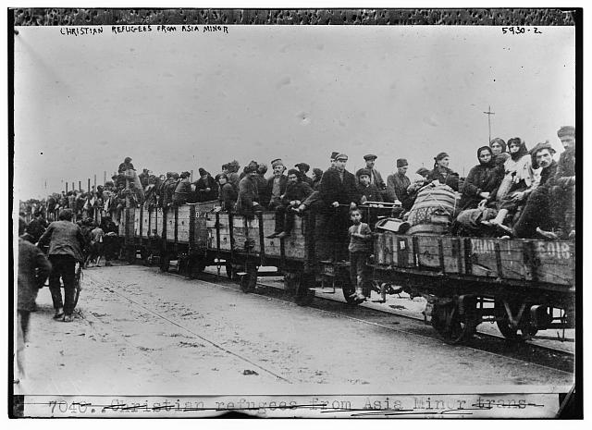
Christian refugees from Asia Minor, embarked in Samsun (Pontos), photographed c. 1922-1925 at their arrival at Patras (Greece), from where they were transported in car trains into the interior
Photograph by C.D. Morris. (Source: "History's Greatest Trek," National Geographic Magazine, Nov. 1925 (Vol. 48), p. 568.

