Slide 1

Μια «ιδιάζουσα» ταχυ-μυοκαρδιοπάθεια
Ευστάθιος Δ. Παγκουρέλιας, MD, MSc, PhD
Ακαδημαϊκός Υπότροφος, Υπεύθυνος Ιατρείου Μυοκαρδιοπαθειών & Νευρομυϊκών Νοσημάτων, Γ’ Καρδιολογική Κλινική, ΓΝΘ Ιπποκράτειο, Ιατρική Σχολή, Αριστοτέλειο Πανεπιστήμιο Θεσσαλονίκης

Slide 2
Conflicts of interest:
Nothing to declare.

Slide 3
Case presentation (I)
32-year-old man
Lightheadness and ongoing dyspnea during exertion.
Two pre-syncope episodes the last 2 weeks before visit 1.
Palpitations for years especially during evening hours.
Smoking (-), moderate alcohol intake till 5 years ago.

Slide 4
Case presentation (II)
Hospitalisation at the age of 18 due to increased PACs and PVCs (>20000/24h ambulatory Holter monitoring).
Investigations (including Echo and CMR at that time) excluded ARVC as well as significant structural cardiomyopathy or other underlying causes.
The patient was reassured and discharged back home.

Slide 5
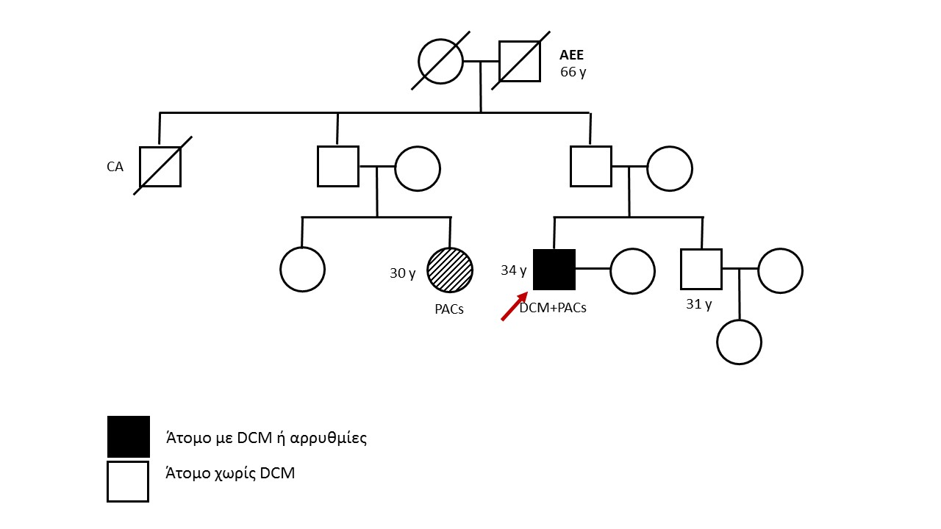
Case presentation (III)-Family History
Family History was negative for SCD, CMP or CAD.
A female cousin was reported to suffer from arrhythmias

Slide 6
Clinical examination (I)
BP 96/65, pulses palpable-irregular
S1S2S3, holo-systolic murmur heard left parasternal border and at the apex (4/6).
Mild peripheral (ankle) oedema.
Mild basal rales
No dysmorphies or phenotypic characteristics indicative of inherited abnormalities.

Slide 7
ECG (I)

Slide 8
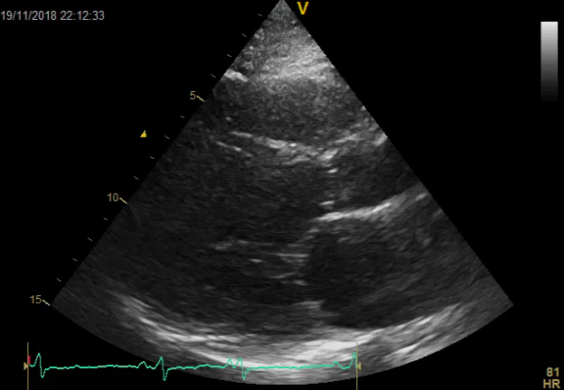
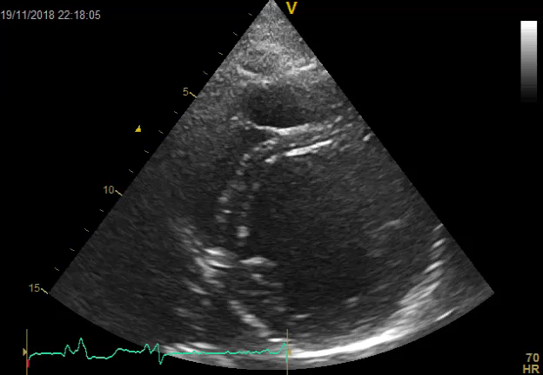
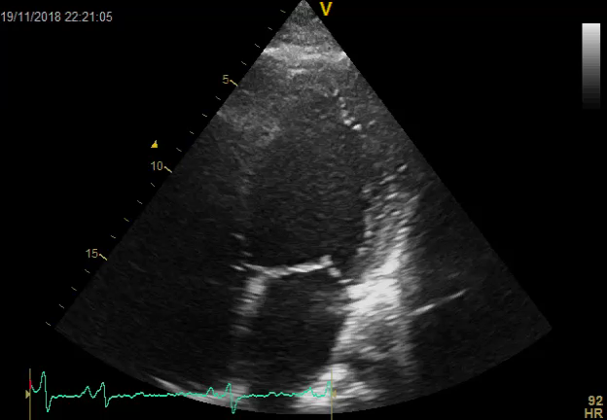
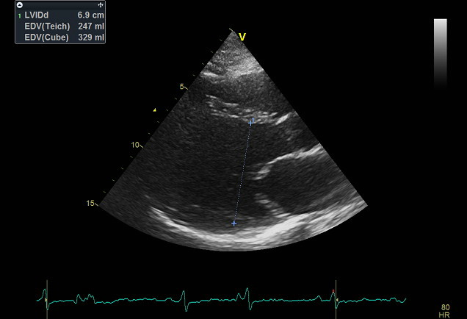
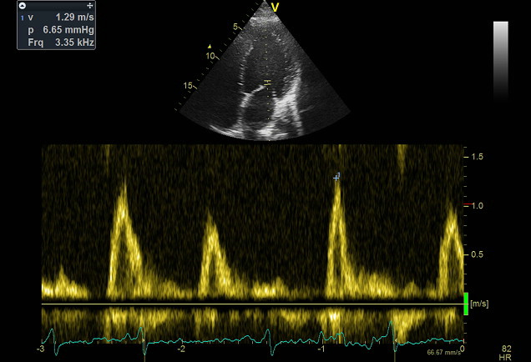
Echo Findings (I)

Slide 9
Differential Diagnosis (I)
DCM (genetic substrate Lamin A/C)
Past myocarditis-DCM
Left dominant arrhythmogenic cardiomyopathy
Else?

Slide 10
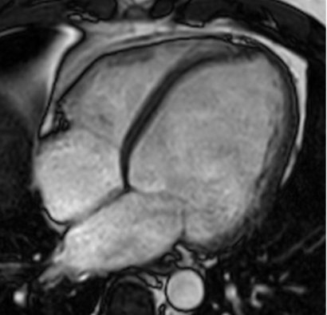
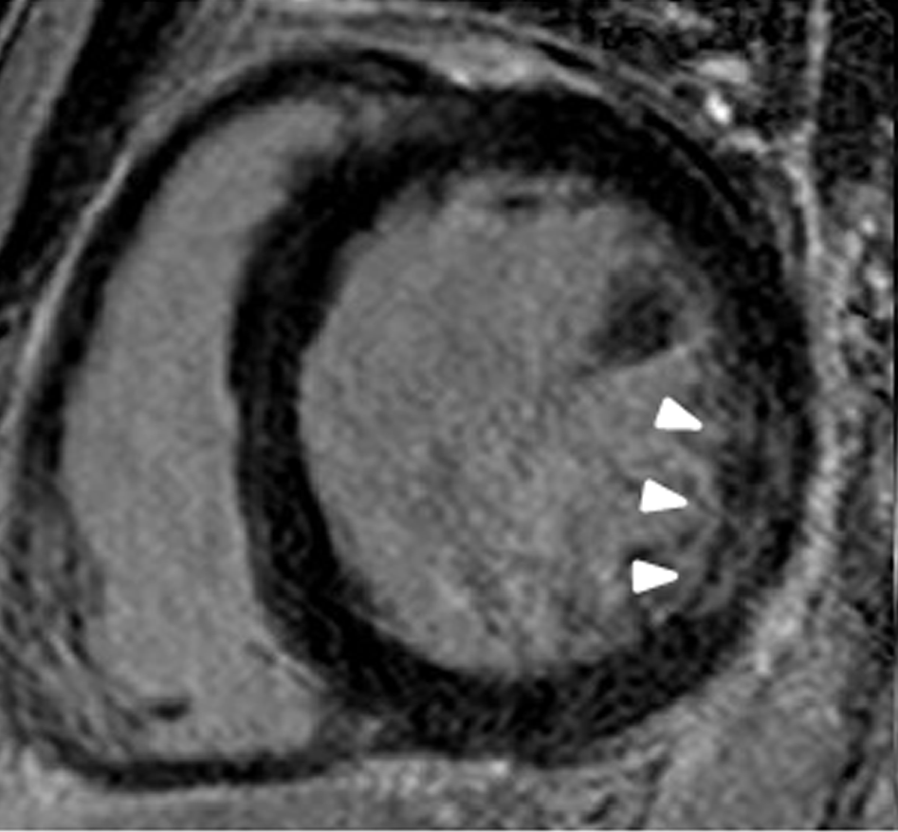
CMR Findings (I)
Dilated cardiomyopathy phenotype with limited midwall LGE (inferolateral wall) non-compatible with myocarditis.

Slide 11
24h-ambulatory-Holter monitoring (I)

Slide 12
24h-ambulatory-Holter monitoring (I)

Slide 13
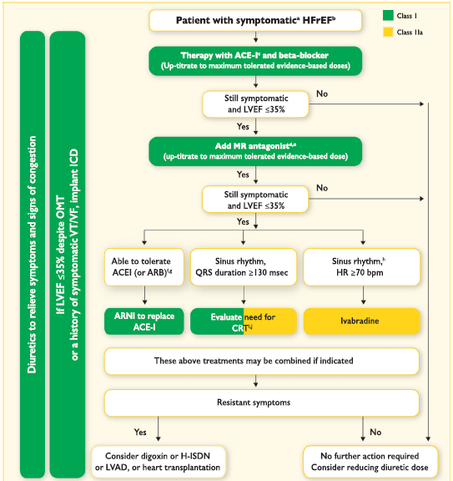
HF Guidelines: What we did
The patient was started on:
ACE inhibitor
B-blocker
MRA (eplerenone)
Small dose of loop diuretic
Ponikowski P, Voors AA, et al.
European Heart Journal (2016) 37, 2129–2200

Slide 14
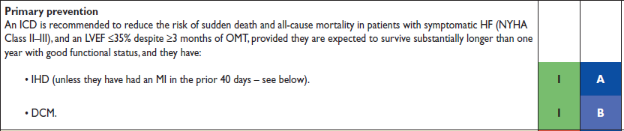
HF Guidelines: What we did
IHD was excluded by means of coronary angiography.
Even though OMT was initiated earlier than a month the patient was referred for an EPS (ICD implantation in mind)
Ponikowski P, Voors AA, et al. European Heart Journal (2016) 37, 2129–2200

Slide 15
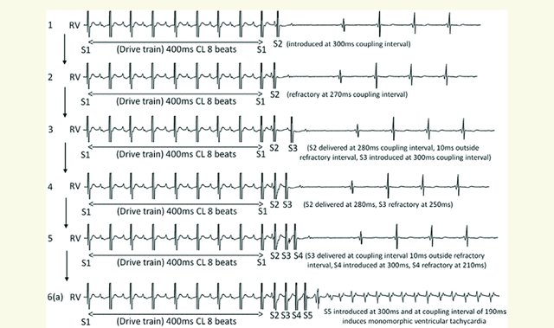
EPS study-PVS
VT non-inducible during PVS

Slide 16
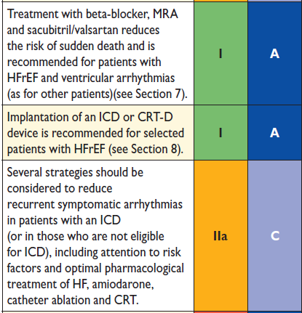
Arrhythmia treatment
The patient was started on: Amiodarone
Ponikowski P, Voors AA, et al. European Heart Journal (2016) 37, 2129–2200

Slide 17
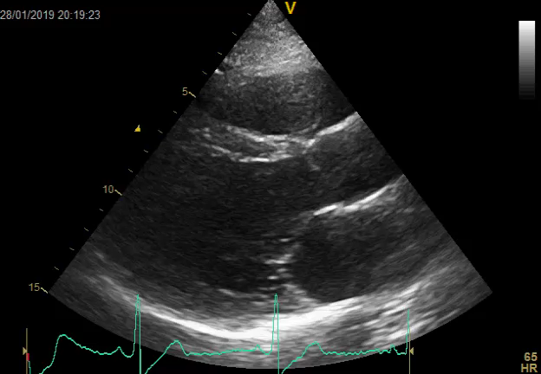
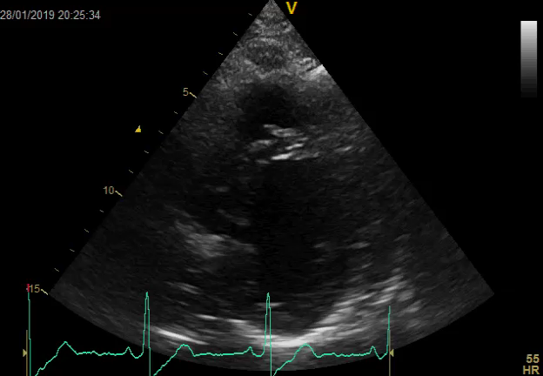
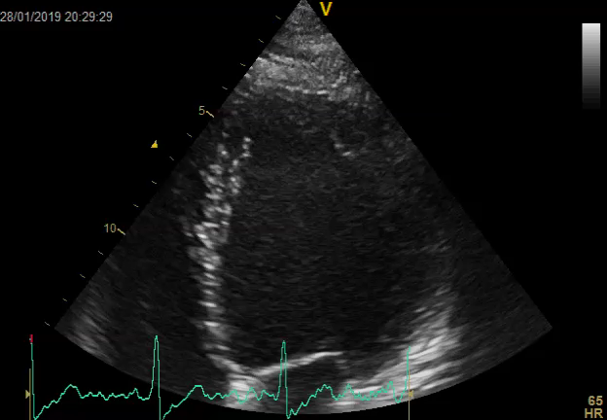
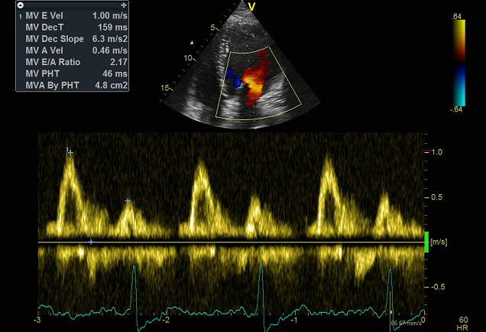
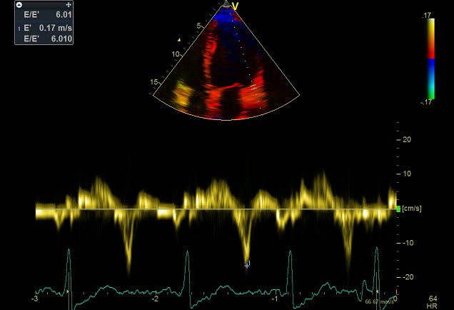
Echo Findings (Three Months)

Slide 18
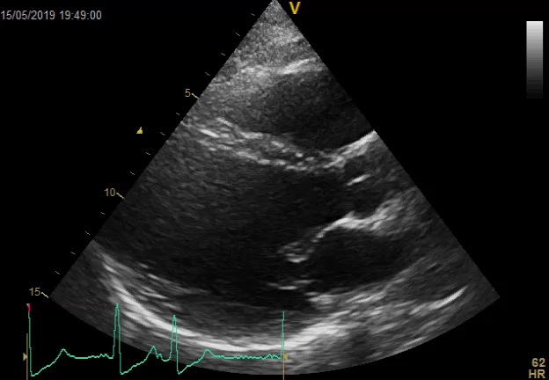
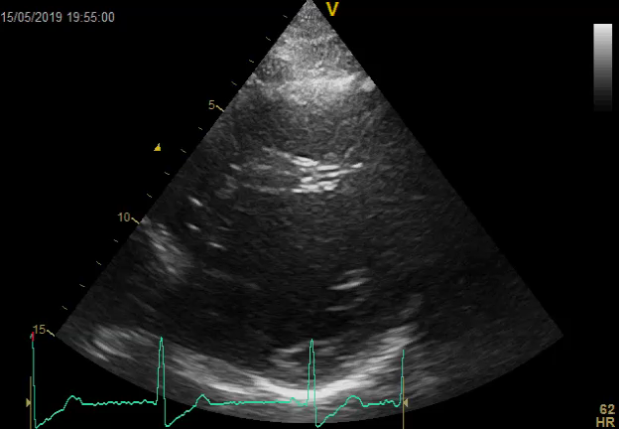
Echo Findings (Six Months)
Baseline
3 Months
6 Months

Slide 19
ECG (6 months)
Amiodarone stopped due to AST, ALT increase

Slide 20
Diagnosis (?)
DCM (genetic substrate Lamin A/C)
Past myocarditis-DCM
Left dominant arrhythmogenic cardiomyopathy
Else?->Tachycardiomyopathy

Slide 21
Tachycardiomyopathy
‘Atrial and/or ventricular dysfunction—secondary to rapid and/or asynchronous/irregular
myocardial contraction, partially or completely reversed after treatment of the causative arrhythmia’
Two categories of the condition exist: 1) arrhythmia-induced and 2) arrhythmia-mediated
Simantirakis EN et al. Europace 2012;14:466–73.
Martin CA, Lambiase PD. Heart 2017;103:1543–1552. doi:10.1136/heartjnl-2016-310391

Slide 22
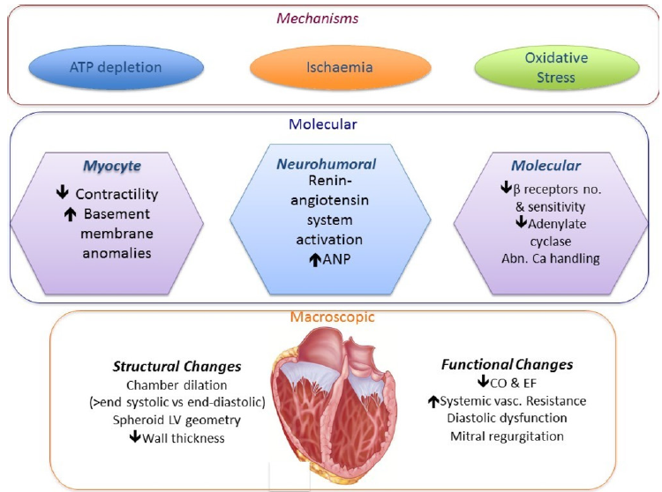
Pathophysiology
It has been suggested that chronic tachycardia that occurs >10%–15% of the day may result in cardiomyopathy (HR>100 bpm).
It is not only a high heart rate (HR), but also asynchronous myocardial contraction, that can lead to LV dysfunction.
Fenelon G, et al. Pacing Clin Electrophysiol 1996;19:95–106.
Martin CA, Lambiase PD. Heart 2017;103:1543–1552. doi:10.1136/heartjnl-2016-310391

Slide 23
Tachycardiomyopathy epidemiology
TCMP may occur at any age, with cases reported in utero and in infants and children, as well as in adults.
The true incidence is unknown as TCMP is a diagnosis of exclusion, and is therefore likely to be under-recognised in clinical practice.
Reported series describe incidences of 8%–28% in focal/ectopic atrial tachycardias and 9%–34% for ventricular ectopy and non-sustained VT.
Ju W, et al. J Cardiovasc Electrophysiol 2014;25:953–7.
Kang KT, et al. Circ Arrhythm Electrophysiol 2014;7:664–70.
Medi C, et al. J Am Coll Cardiol 2009;53:1791–7.

Slide 24
Significance of arrhythmia management
Khan MN et al,. N Engl J Med 2008;359:1778–85.

Slide 25
Significance of arrhythmia management
Ruwald MH, et al. J Am Coll Cardiol 2014;64:971–81.

Slide 26
Τachycardiomyopathy assessment algorithm
Martin CA, Lambiase PD. Heart 2017;103:1543–1552. doi:10.1136/heartjnl-2016-310391

Slide 27
Why is this case special?
Young patient with second “recurrence” of TCMP.
Although the main arrhythmic problem was not solved but “smoothed” there has been a substantial improvement in systolic function.
Important clue: TCMP may be improved by breaking the vicious circle. HF treatment may offer towards that direction.
Atrial Tachycardia ablation may offer a permanent solution.

Slide 28
Thank you for your attention!!

