Slide 1




35ο Πανελλήνιο Ετήσιο Συνέδριο
Ελληνικής Εταιρείας Μελέτης & Εκπαίδευσης για τον Σακχαρώδη Διαβήτη
10 Νοεμβρίου 2022
Πως θα προφυλάξω τον ασθενή μου με σακχαρώδη διαβήτη από ένα νέο εγκεφαλικό́ επεισόδιο;
LDL- χοληστερόλη, αρτηριακή υπέρταση και σακχαρώδης διαβήτης
Δημήτριος Σαγρής
Παθολόγος, Επιμελητής Β’
Πανεπιστημιακή Παθολογική Κλινική, Πανεπιστημιακό Γενικό Νοσοκομείο Λάρισας
Stroke Research Fellow, Liverpool Centre for Cardiovascular Science

Slide 2
Πως θα προφυλάξω τον ασθενή μου από το να μην υποστεί ξανά ισχαιμικό εγκεφαλικό;
Άνδρας 67 χρόνων
Νοσηλεία προ εβδομάδος λόγω ισχαιμικού ΑΕΕ
Ήπια στένωση δεξιάς καρωτίδος 35-40%
Holter 72h αρνητικό για ΚΜ, LA: 35mm
Ηx: Καπνιστής, Αναφερόμενη ΑΥ και ΣΔ ΙΙ

Slide 3
Πως θα προφυλάξω τον ασθενή μου από το να μην υποστεί ξανά ισχαιμικό εγκεφαλικό;
ΒΜΙ 28 kg/m2
ΑΠ στο ιατρείο: 150/90mmHg (M.O. κατ’οίκον: 145/85mmHg)
LDL: 115mg/dl (νοσηλεία)
HbA1c: 7.2% (νοσηλεία)
Υπο αγωγή με
Aspirin 100mg x1
Atorvastatin 20mg x1
Metformin 850mg 1x2 (απο έτους)

Slide 4
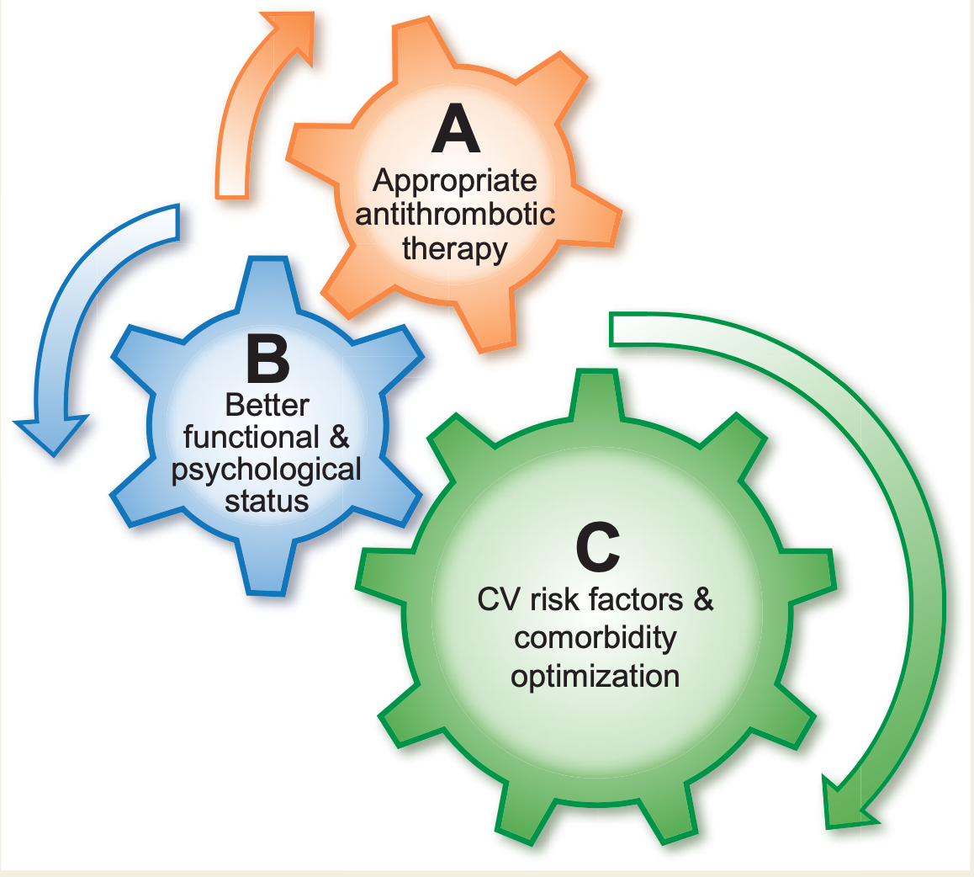
Πως θα προφυλάξω τον ασθενή μου από το να μην υποστεί ξανά ισχαιμικό εγκεφαλικό;
Ολιστική προσέγγιση στη δευτερογενή πρόληψη του αγγειακού εγκεφαλικού
Lip et al. European Heart Journal (2022)

Slide 5
Πως θα προφυλάξω τον ασθενή μου από το να μην υποστεί ξανά ισχαιμικό εγκεφαλικό;
Αντιθρομβωτική αγωγή
ΣΔ
ΑΠ
LDL

Slide 6
Πως θα προφυλάξω τον ασθενή μου από το να μην υποστεί ξανά ισχαιμικό εγκεφαλικό;
Αντιθρομβωτική αγωγή
ΣΔ
ΑΠ
LDL

Slide 7
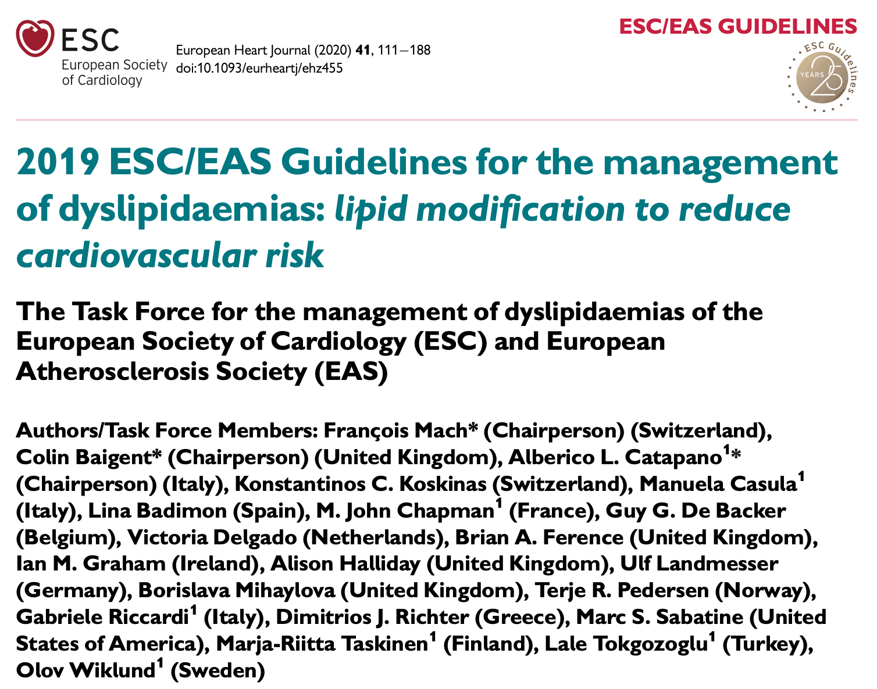
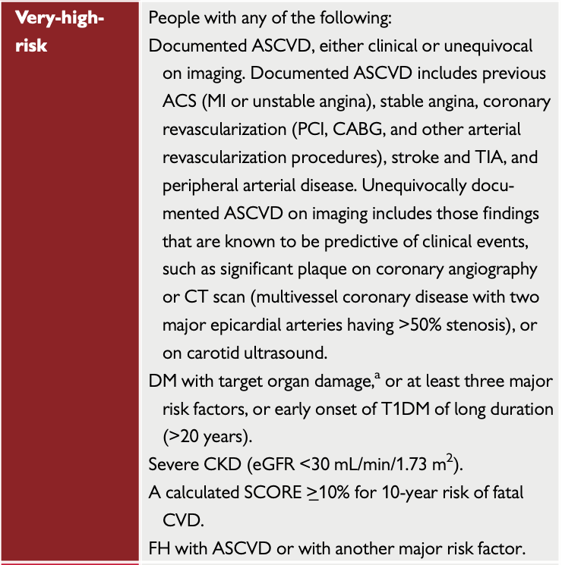
Mach et al; European Heart Journal (2020)

Slide 8



Secondary prevention trials of hypolipidemic therapy including patients with stroke as per protocol
Sagris et al; International Journal of Stroke 2020

Slide 9
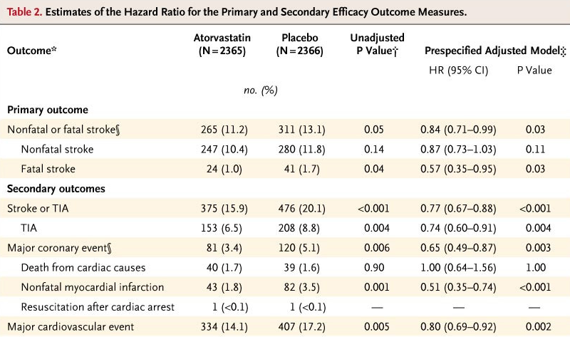
Secondary prevention trials of hypolipidemic therapy including patients with stroke as per protocol
SPARCL:
80mg atorvastatin reduced stroke risk and CV events
Amarenco N Engl J Med 2006; 355:549-559

Slide 10
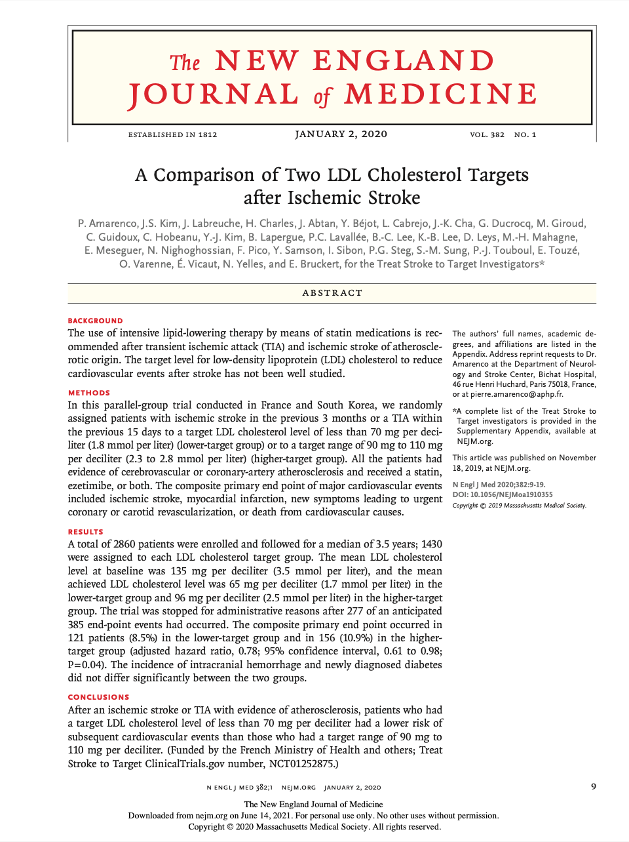
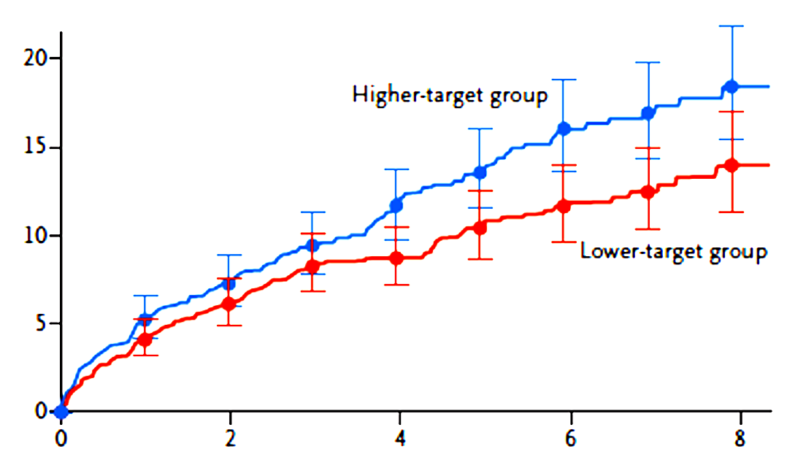
Secondary prevention trials of hypolipidemic therapy including patients with stroke as per protocol
TST study
LDL≤70mg after stroke reduced CV events
HR 0.78 (0.61–0.98)
Amarenco et al ; N Engl J Med, 2020

Slide 11
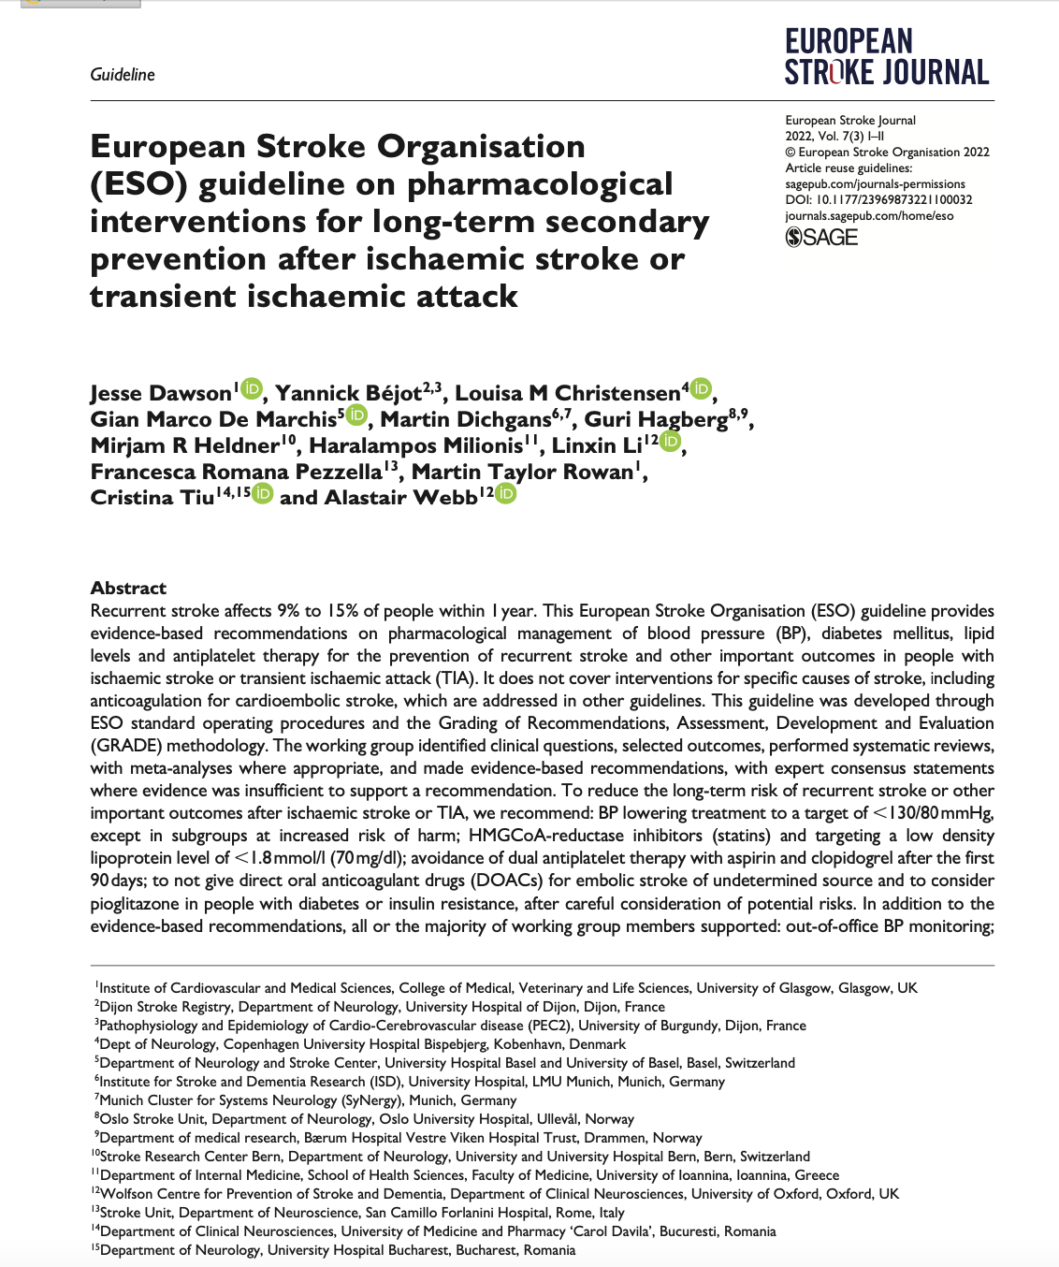
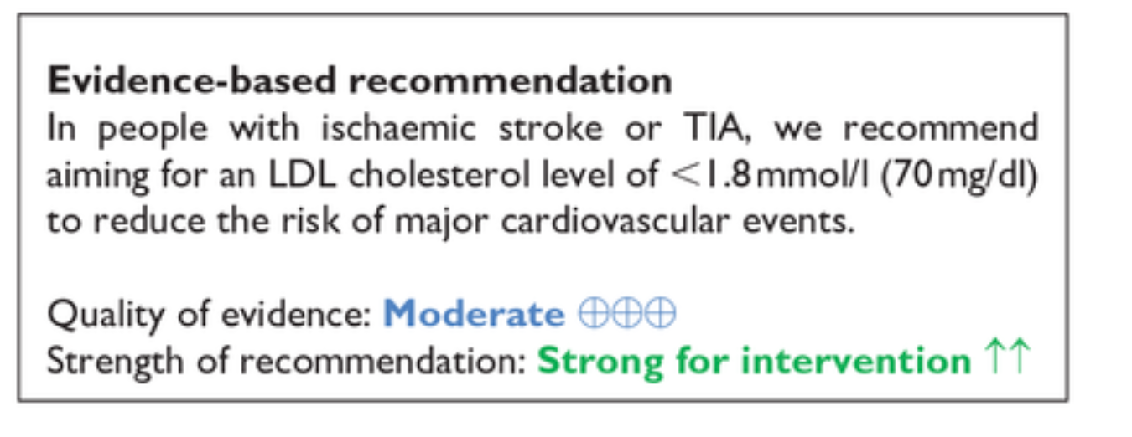
LDL cholesterol treatment goals

Slide 12
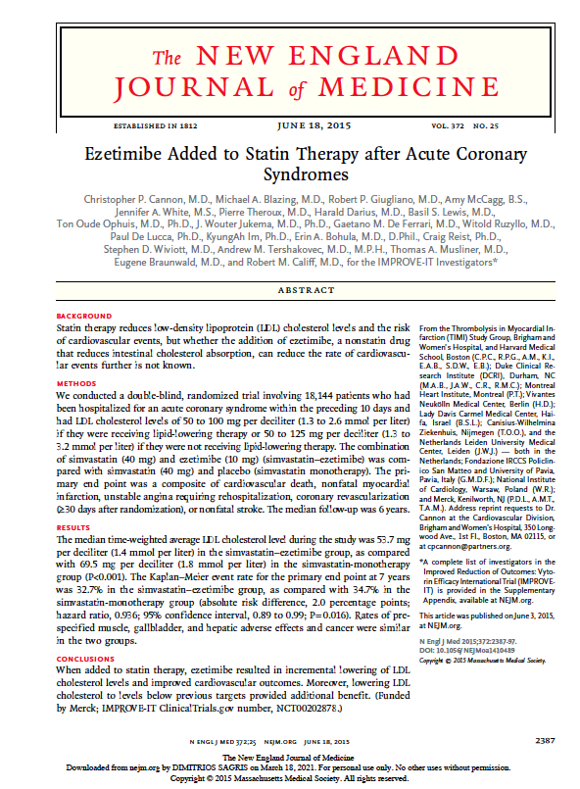
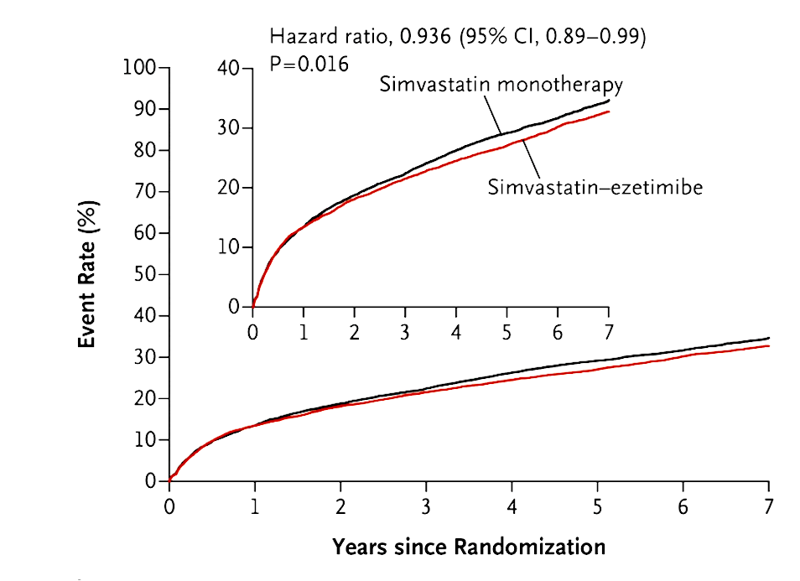
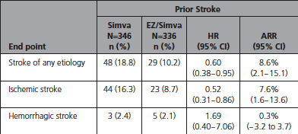

LDL cholesterol treatment goals
IMPROVE-IT trial: Ezetimibe added to simvastatin reduced CV events in patients
median LDL-C = 53.7 mg/dl
NNT=12
Cannon et al; n engl j med 2015; 372;25
Bohula et al; Circulation 2017

Slide 13
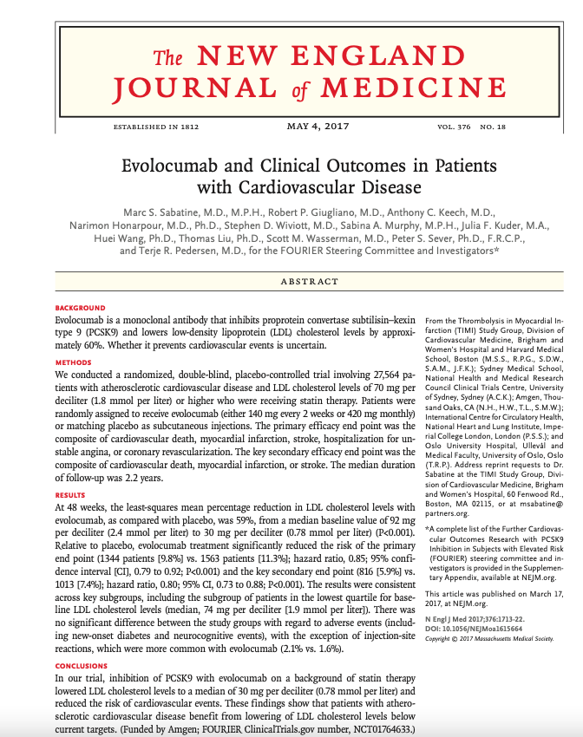
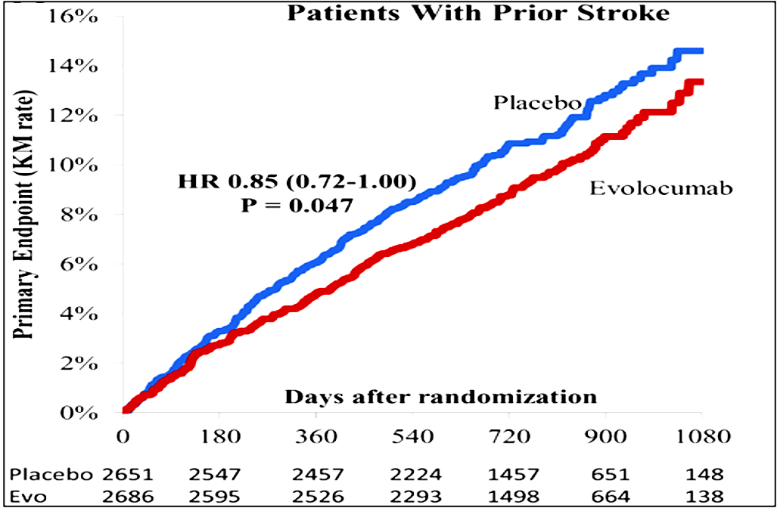
LDL cholesterol treatment goals
LDL-C = 30 mg/dl
Giugliano et al; Stroke 2020

Slide 14
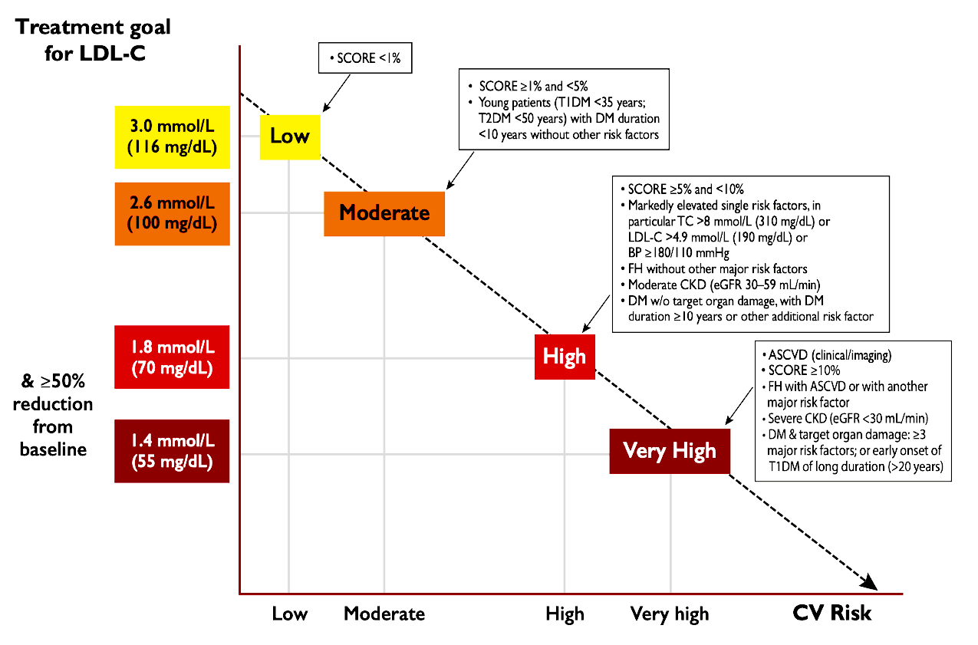
LDL cholesterol treatment goals
Patients at very high risk for CV events should be treated with an LDL-C target < 55mg/dl and at least 50% reduction of baseline LDL-C levels.
Mach et al; European Heart Journal (2020)

Slide 15
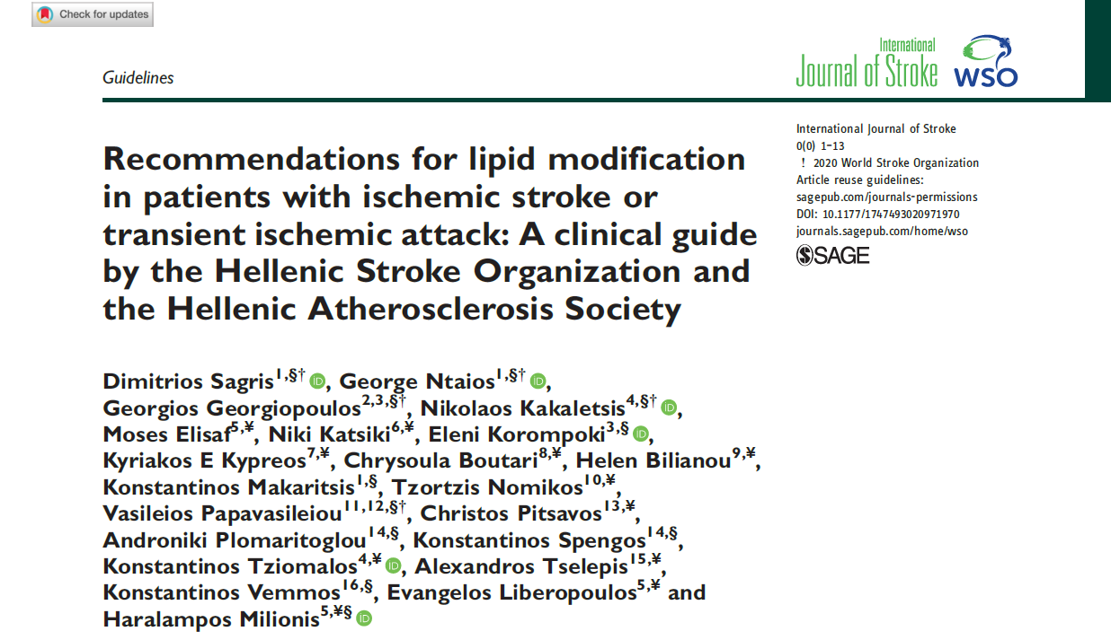
Step by step lipid lowering therapy in patients with ischemic stroke
Ischemic stroke
High intensity statin
Life-style modification
Statin intolerance?
Yes
No
Start a different statin regimen
Statin intolerance?
No
Is LDL-C <55mg/dl ?
Yes
Continue therapy
Yes
No
Alternate day statin as tolerated + ezetimibe
Add ezetimibe
Is LDL-C <55mg/dl ?
Yes
Continue therapy
No
Start PCSK9-inhibitor
Monitor adherence
Sagris D et al. Int J Stroke 2020

Slide 16
Πως θα προφυλάξω τον ασθενή μου από το να μην υποστεί ξανά ισχαιμικό εγκεφαλικό;
Αντιθρομβωτική αγωγή
ΣΔ
ΑΠ
LDL
LDL: 115mg/dl
Rosuvastatin 20mg ή atorvastatin 40mg
+/- ezetimibe

Slide 17
Πως θα προφυλάξω τον ασθενή μου από το να μην υποστεί ξανά ισχαιμικό εγκεφαλικό;
Αντιθρομβωτική αγωγή
ΣΔ
ΑΠ
LDL
LDL: 115mg/dl
Rosuvastatin 20mg ή atorvastatin 40mg
+/- ezetimibe

Slide 18
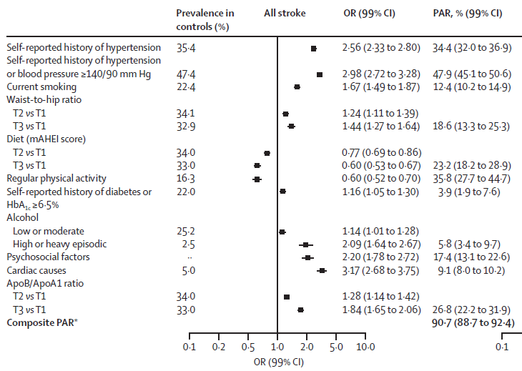
Hypertension is the most important modifiable risk factor
INTERSTROKE 2
O’Donnell M et al. Lancet 2016

Slide 19
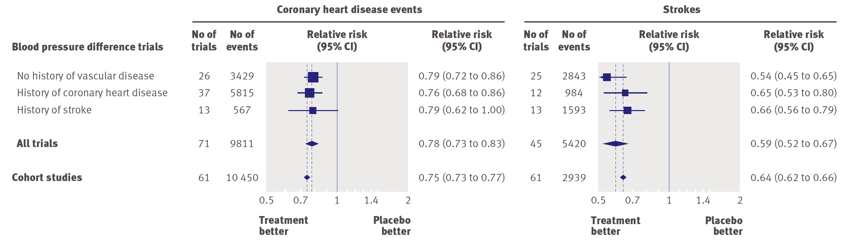
Impact of BP reduction on stroke risk and CHD events in patients with a history of stroke
Law MR et al. BMJ 2009

Slide 20
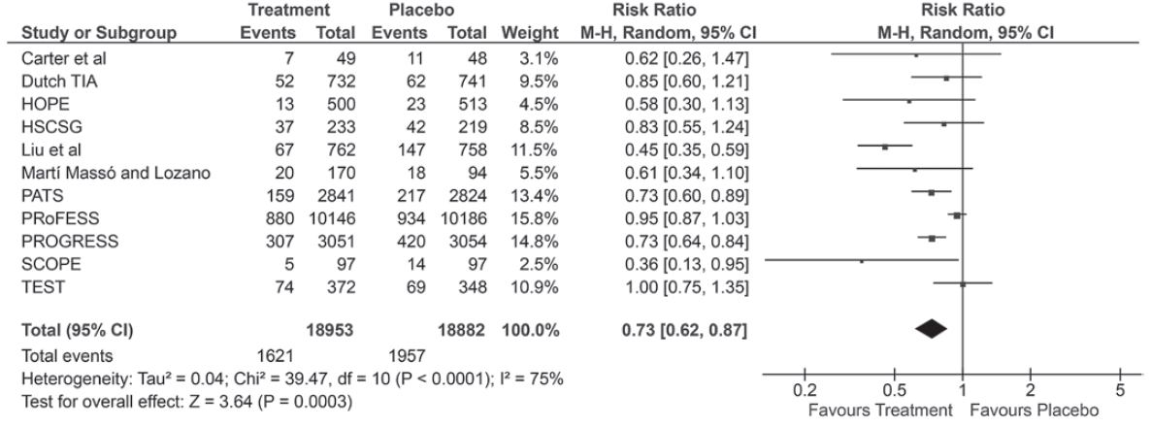
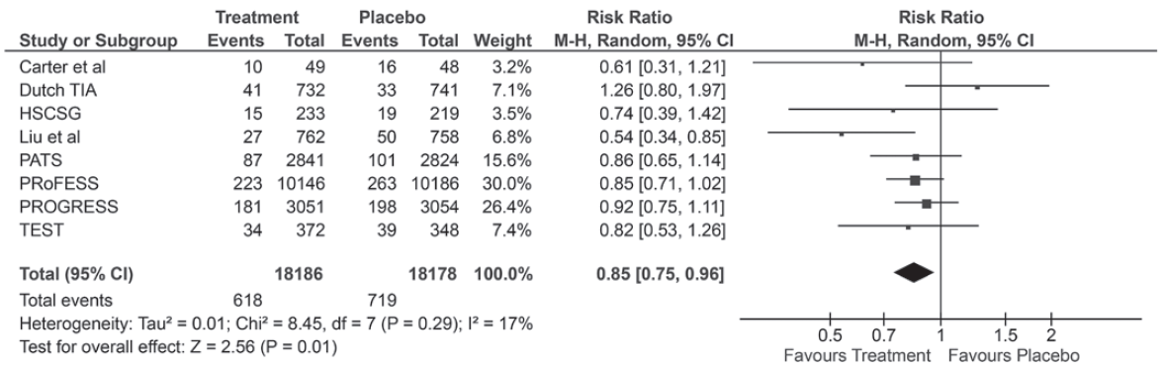
Impact of BP treatment on stroke recurrence and CV death in patients with ischemic stroke
Stroke
recurrence
CV death
Katsanos A et al. Hypertension 2017

Slide 21
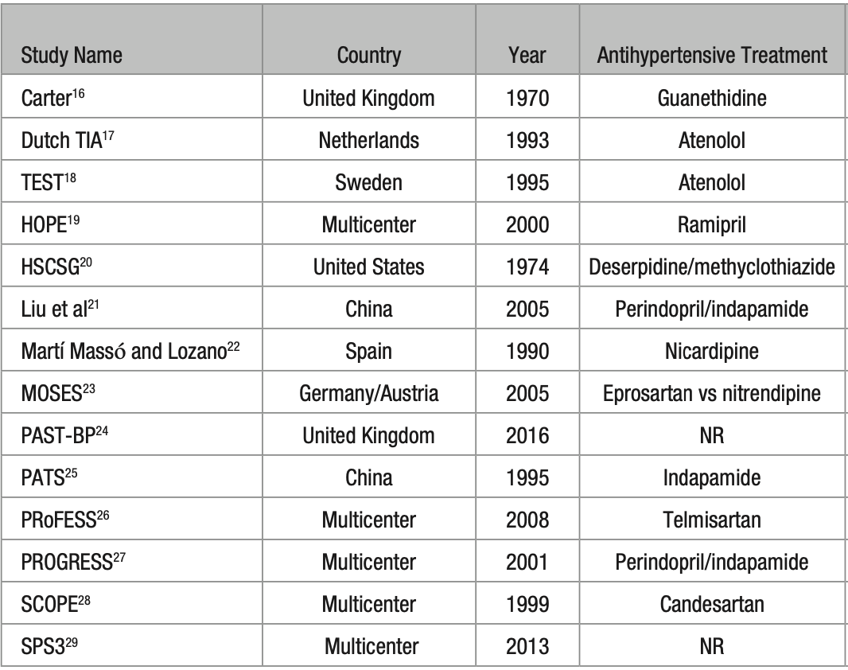
Drug classes effect on recurrent strokes and cardiovascular events
Diuretics
RAS inh
CCBs

Slide 22
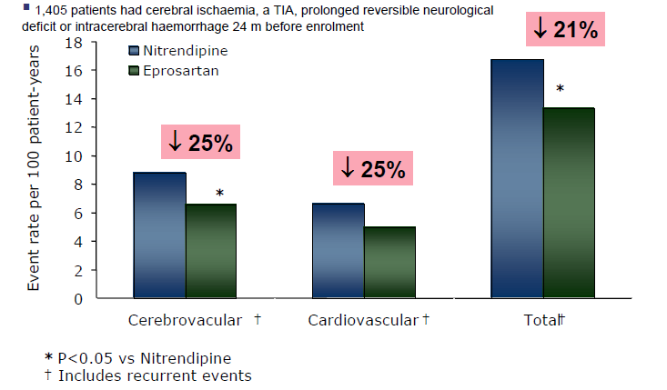
Drug classes effect on recurrent strokes and cardiovascular events
16/7 mmHg
13/3 mmHg
Morbidity and Mortality After Stroke Eprosartan compared to Nitrendipine for secondary prevention
MOSES study
Schrader J et al. Stroke 2005

Slide 23
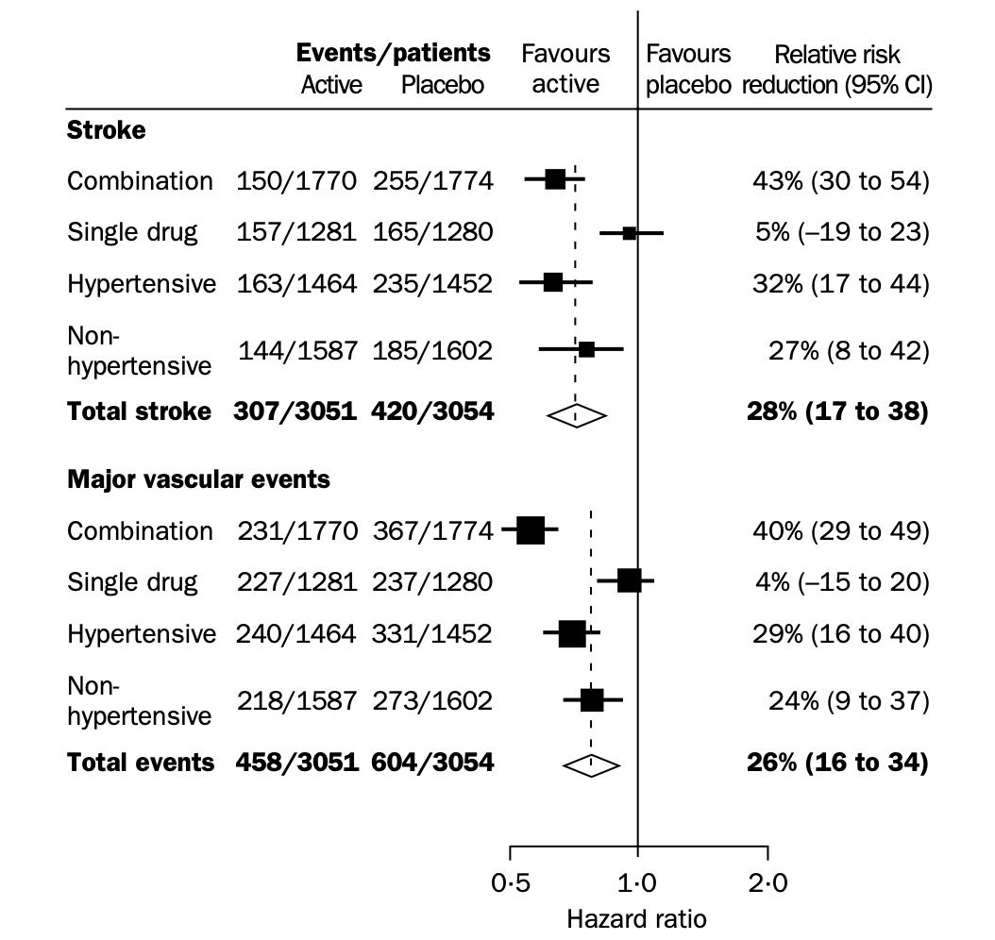
Dual or single post stroke?
Comb: 12/5 mmHg
Single: 5/3 mmHg
The randomized treatment was stratified by the intention to use:
single study tablet
  perindopril
  single placebo
combination study tablets
  perindopril plus indapamide
  double placebo
The Progress Collaborative group, Lancet 2001

Slide 24
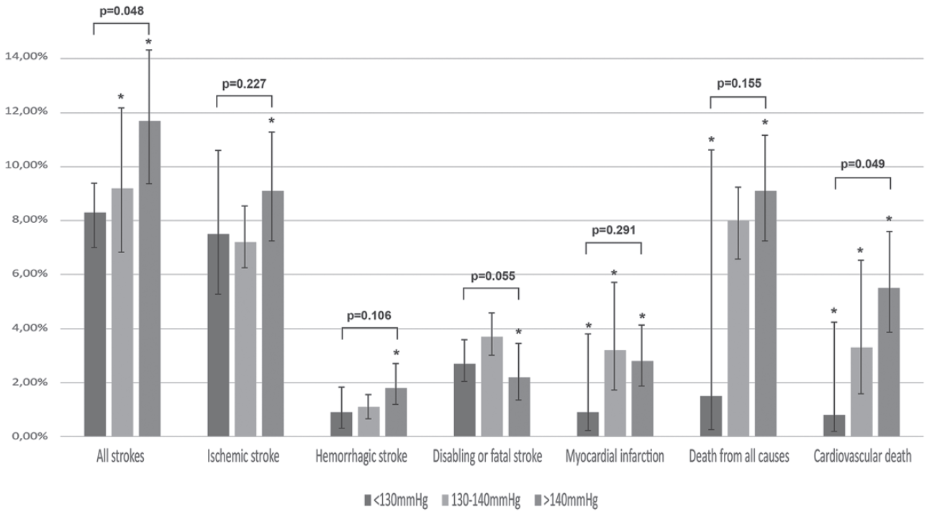
Lower BP targets are more effective for the prevention of recurrent stroke and CV death – meta-analysis
Katsanos A et al. Hypertension 2017

Slide 25
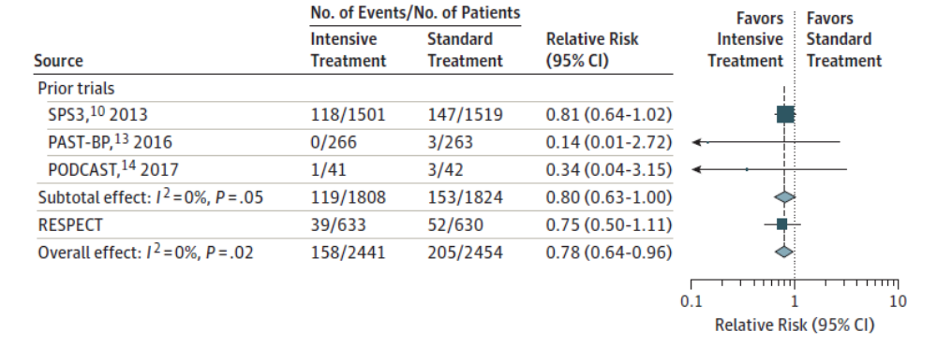
Effects of Intensive Blood Pressure Lowering on Recurrent Stroke
Kitagawa K et al. JAMA Neurol 2019

Slide 26
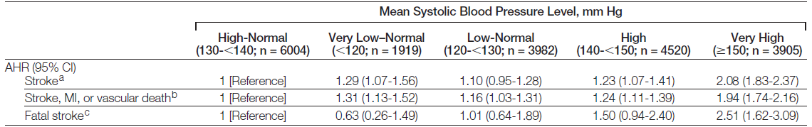
Low and high BP levels are associated with increased risk of recurrent stroke – PRoFESS
Ovbiagele D et al. JAMA 2011

Slide 27
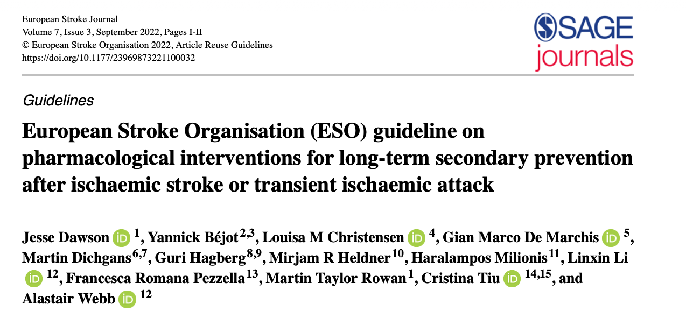
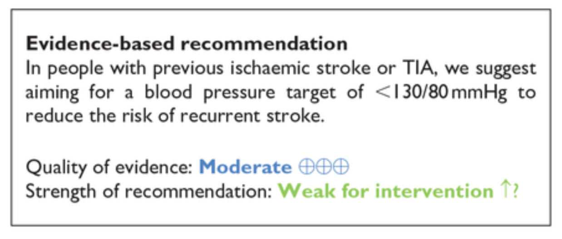
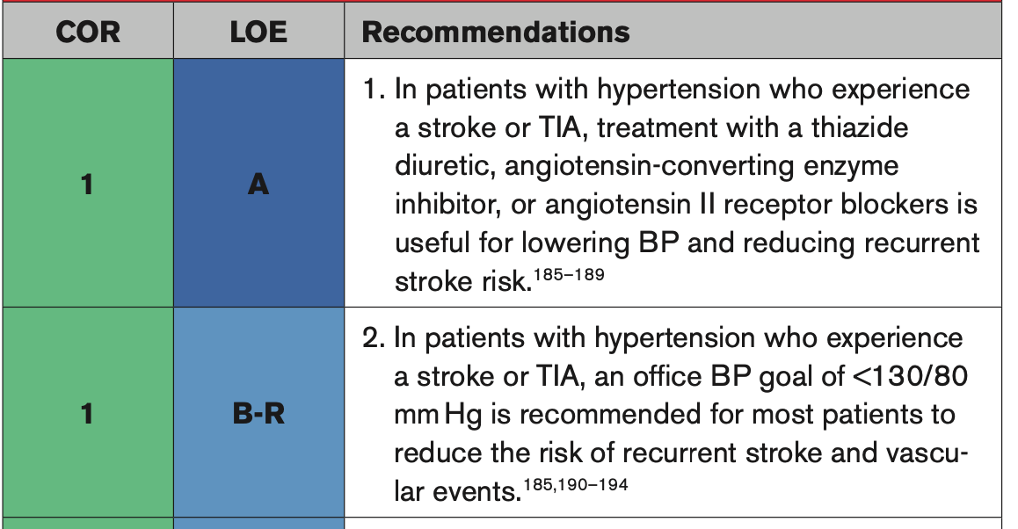
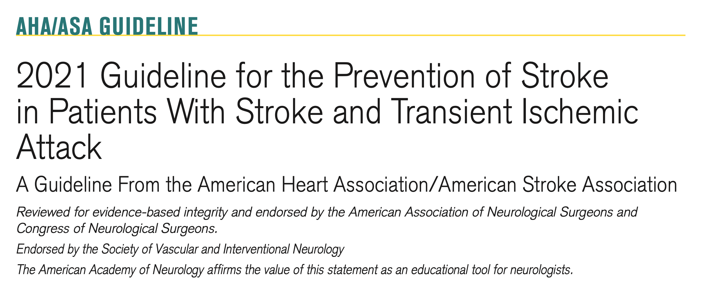

Slide 28
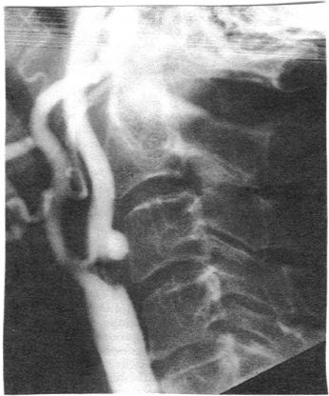
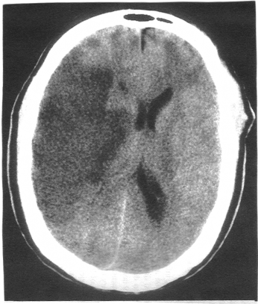
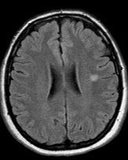
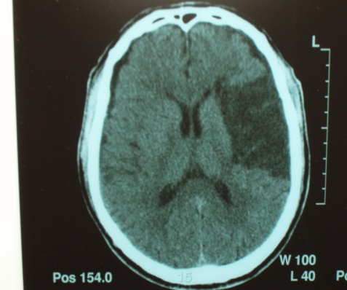
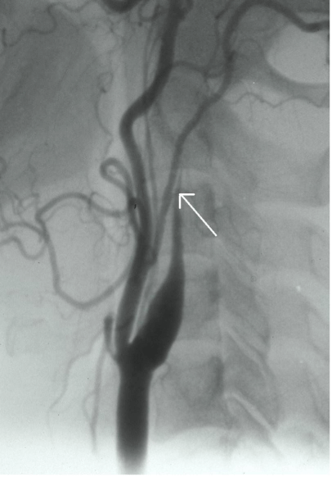
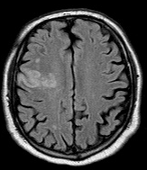
One size can fit all…??
Lacunar
17-25%
Atherosclerotic
15-25%
Cardioembolic
18-33%
Cryptogenic
12-37%
Ischemic
80%
Other causes (e.g. dissection)
5-10%
E S U S
“The Athens Stroke Data Bank”
Courtesy of K. Vemmos

Slide 29
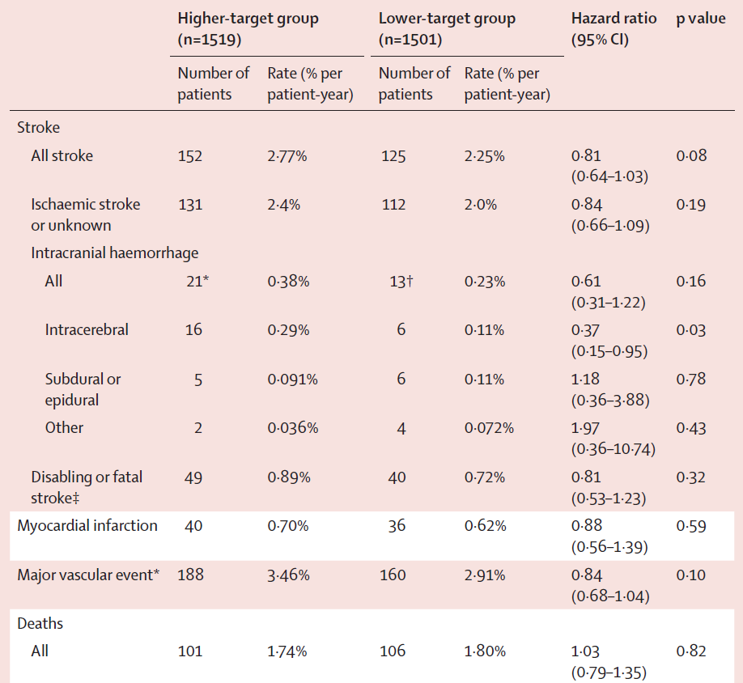
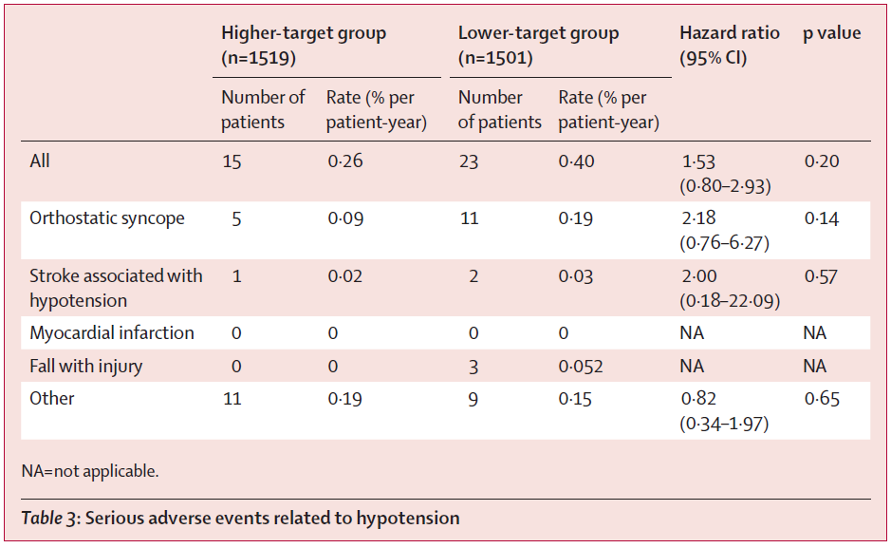
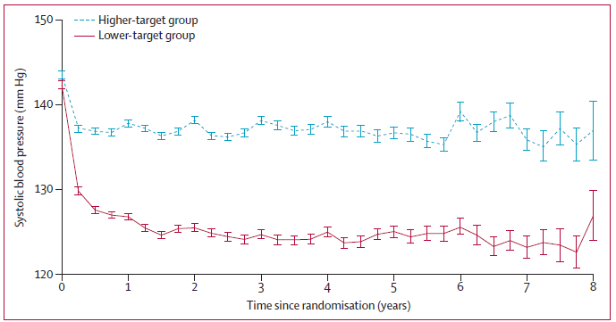
Intensive Blood Pressure Lowering in lacunar stroke – SPS3
3020 patients with recent lacunar strokes (<6m)
SBP =130-149 mmHg versus <130 mm Hg
144mmHg
138mmHg
142mmHg
127mmHg
Benavente OR et al. Lancet 2013

Slide 30
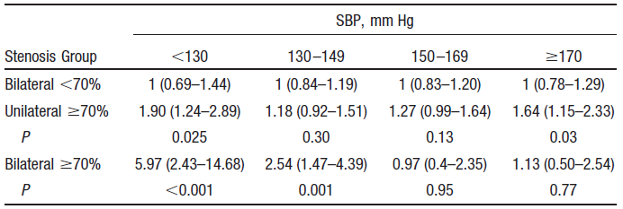
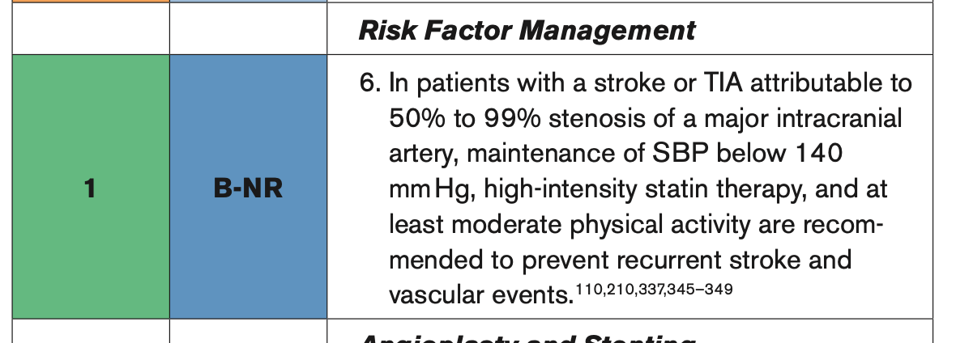
BP and stroke risk in symptomatic carotid / intracranial stenosis
ECST and NASCET: 5903 pts
UK-TIA: 2435 pts
HRs for Risk of Stroke
Rothwell PM et al. Stroke 2003
Kleindorfer et al; Stroke 2021

Slide 31
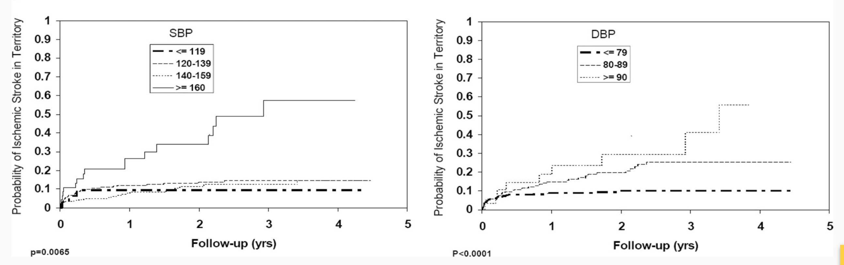
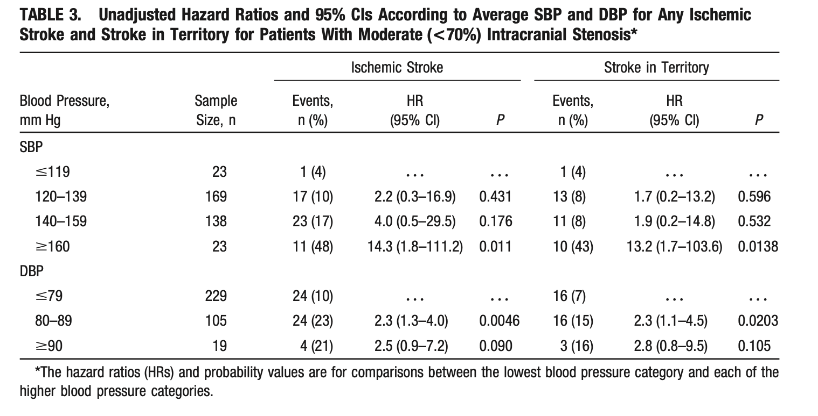
BP and stroke risk in symptomatic carotid / intracranial stenosis
WASID trial
Kleindorfer et al; Stroke 2021

Slide 32
Πως θα προφυλάξω τον ασθενή μου από το να μην υποστεί ξανά ισχαιμικό εγκεφαλικό;
Αντιθρομβωτική αγωγή
ΣΔ
ΑΠ
LDL
LDL: 115mg/dl
Rosuvastatin 20mg ή atorvastatin 40mg
+/- ezetimibe
Συνδυασμός
RAS inh + diuretic /CCB

Slide 33
Πως θα προφυλάξω τον ασθενή μου από το να μην υποστεί ξανά ισχαιμικό εγκεφαλικό;
Αντιθρομβωτική αγωγή
ΣΔ
ΑΠ
LDL
LDL: 115mg/dl
Rosuvastatin 20mg ή atorvastatin 40mg
+/- ezetimibe
Συνδυασμός
RAS inh + diuretic /CCB

Slide 34
Risk of stroke in individuals with diabetes without Hx of vascular disease
Meta-analysis of 102 prospective studies
Adjusted Hazard Ratio
Ischemic stroke 2.27 (1.95–2.65)
Hemorrhagic stroke 1.84 (1.59-2.13)
0.1
0.5
1.0
5
10
50
Reduces risk Increases risk
Data for 698,782 people
(52,765 non-fatal or fatal vascular outcomes
median 10·8 years to first outcome)
Emerging Risk Factors Collaboration. Lancet 2010;375(9733):2215–22

Slide 35
Treat Stroke to Target Trial: MACEs
Lower (<70 mg/dl) target vs. Higher target (90-110 mg/dl)
Diabetes management in stroke
RCTs?
Diabetes mellitus at baseline
Hazard Ratio
Yes 0.60 (0.37–0.96)
No 0.85 (0.64-1.12)
0.1
0.5
1.0
5
10
50
Lower target better Higher target better
Amarenco P et al. N Engl J Med 2020;382:9-19

Slide 36
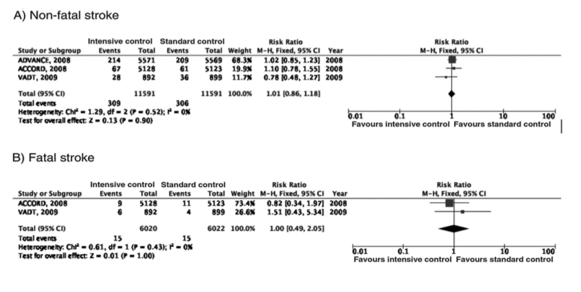
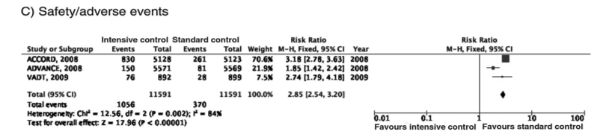
Target - Tight glycaemic control ?
Fuentes et al Neurologia 2020

Slide 37
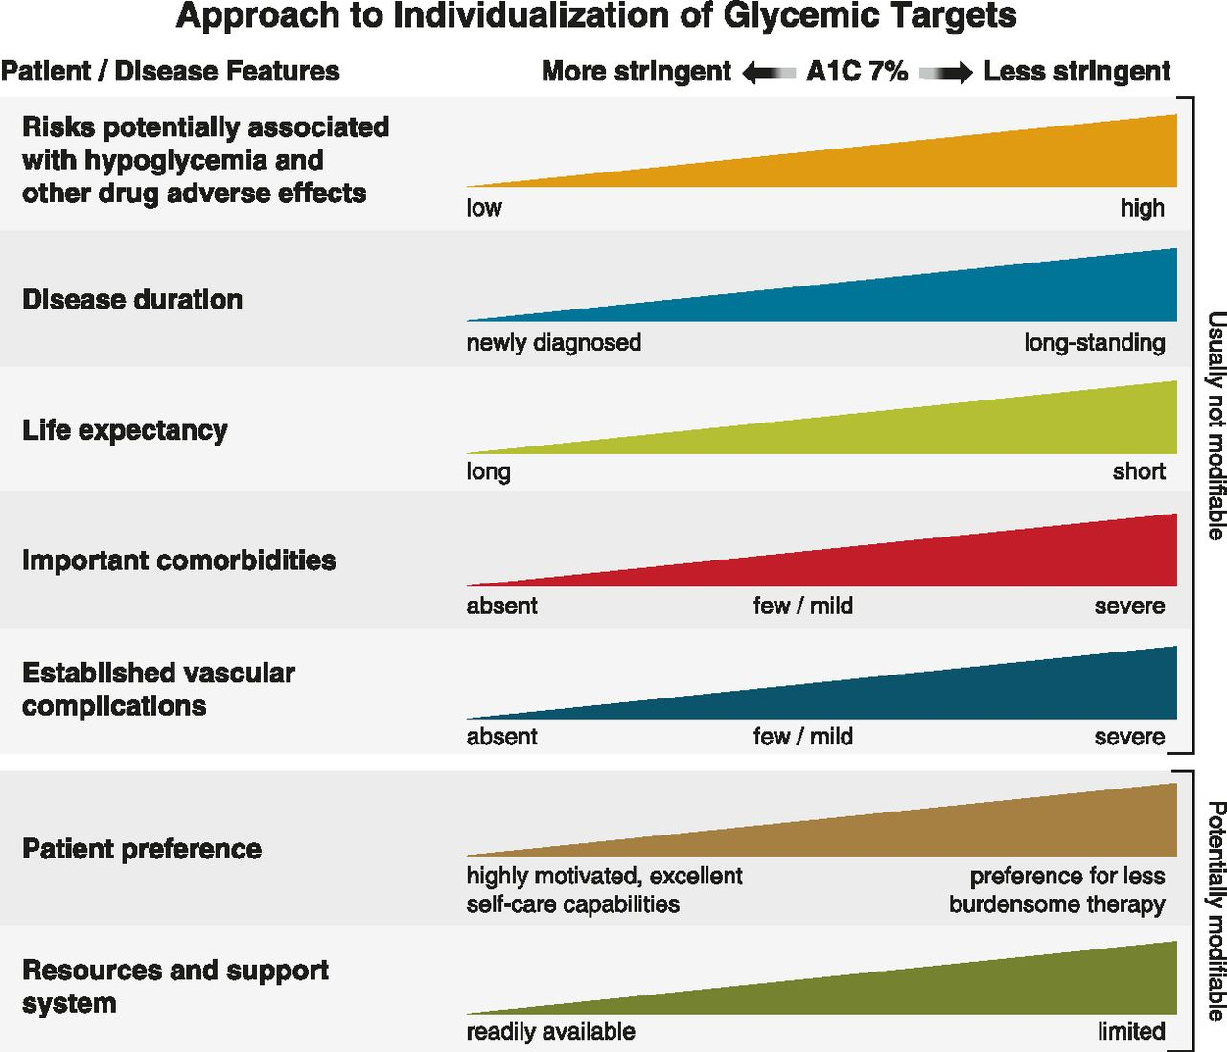
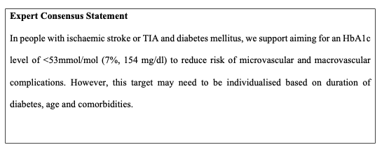
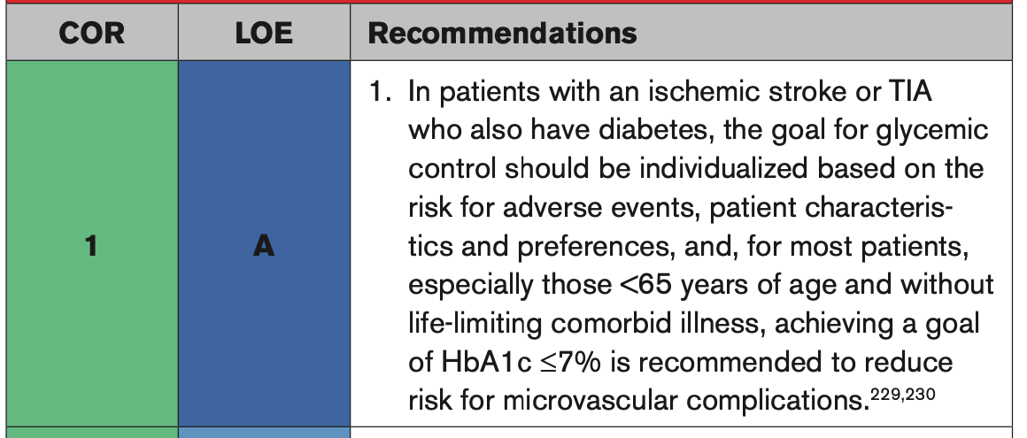
Individualized target
Dawson et al; European Stroke Journal 2022
Diabetes Care. 2020;44(Supplement_1):S73-S84. doi:10.2337/dc21-S006
Kleindorfer et al; 2021 Guideline for the Secondary Prevention of Ischemic Stroke

Slide 38
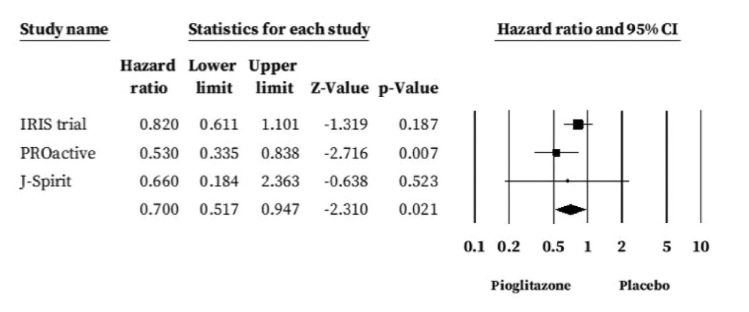
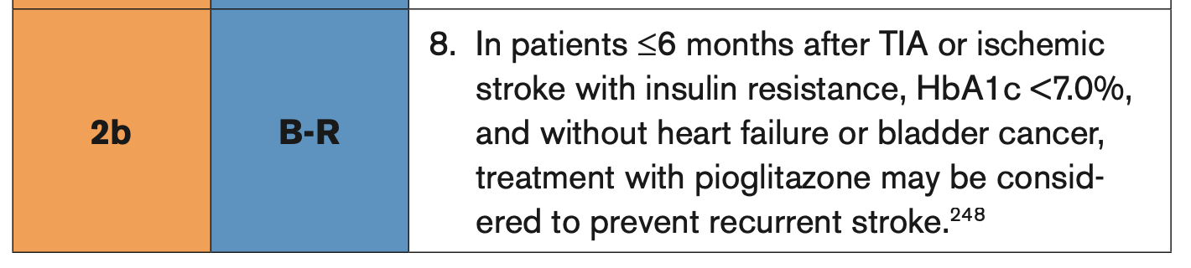
Pioglitazone after Ischemic Stroke or TIA
Higher risk of fractures
Weight gain
Heart failure
2021 Guideline for the Secondary Prevention of Ischemic Stroke, Stroke 2021
Notes:
BACKGROUND
Patients with ischemic stroke or transient ischemic attack (TIA) are at increased risk for future cardiovascular events despite current preventive therapies. The identification of insulin resistance as a risk factor for stroke and myocardial infarction raised the possibility that pioglitazone, which improves insulin sensitivity, might benefit patients with cerebrovascular disease.
METHODS
n this multicenter, double-blind trial, we randomly assigned 3876 patients who had had a recent ischemic stroke or TIA to receive either pioglitazone (target dose, 45 mg daily) or placebo. Eligible patients did not have diabetes but were found to have insulin resistance on the basis of a score of more than 3.0 on the homeostasis model assessment of insulin resistance (HOMA-IR) index. The primary outcome was fatal or nonfatal stroke or myocardial infarction.
RESULTS
By 4.8 years, a primary outcome had occurred in 175 of 1939 patients (9.0%) in the pioglitazone group and in 228 of 1937 (11.8%) in the placebo group (hazard ratio in the pioglitazone group, 0.76; 95% confidence interval [CI], 0.62 to 0.93; P=0.007). Diabetes developed in 73 patients (3.8%) and 149 patients (7.7%), respectively (hazard ratio, 0.48; 95% CI, 0.33 to 0.69; P<0.001). There was no significant between-group difference in all-cause mortality (hazard ratio, 0.93; 95% CI, 0.73 to 1.17; P=0.52). Pioglitazone was associated with a greater frequency of weight gain exceeding 4.5 kg than was placebo (52.2% vs. 33.7%, P<0.001), edema (35.6% vs. 24.9%, P<0.001), and bone fracture requiring surgery or hospitalization (5.1% vs. 3.2%, P=0.003).
CONCLUSIONS
In this trial involving patients without diabetes who had insulin resistance along with a recent history of ischemic stroke or TIA, the risk of stroke or myocardial infarction was lower among patients who received pioglitazone than among those who received placebo. Pioglitazone was also associated with a lower risk of diabetes but with higher risks of weight gain, edema, and fracture.

Slide 39
Antidiabetic drugs and ‘protection’ against stroke
Evidence from RCTs
Odds Ratio
DPP4 inhibitors 0.99 (0.850–1.166)
GLP-1R agonists 0.87 (0.78-0.98)
SGLT2 inhibitors 0.95 (0.77–1.18)
0.1
0.5
1.0
2
4
6
Benefit Harm
Barkas F et al. Diab Metab 2017
Barkas F et al. Eur J Neurol 2019
Barkas F et al. J. Stroke and Cerebrovascular disease 2021
Notes:
People with diabetes mellitus are at higher risk of ischaemic stroke and worse outcomes
thereafter. However, whether it is better to prescribe intensive glucoselowering
treatment compared with conventional treatment in people with diabetes to
prevent recurrent stroke is debated. It is also crucial to consider whether specific antidiabetic
agents are more efficacious and safer than others for prevention of stroke. In
this review, we provide an overview of the efficacy of intensive and conventional
glucose-lowering treatment in post-stroke management. Our conclusion is that the
overall evidence for a beneficial effect of intensive glycaemic control on risk of
stroke is limited. We also discuss evidence from recent large clinical trials of
thiazolidinediones and new antidiabetic medications, including dipeptidyl peptidase-4
inhibitors, glucagon-like peptide-1 receptor agonists (GLP-1RAs), and sodium-glucose
co-transporter-2 inhibitors. On the basis of the findings of these trials, our conclusion
is that pioglitazone and the GLP-1RA class (other than short-acting lixisenatide) are
likely to lessen the occurrence of cerebrovascular disease (by mechanisms not dependent
on glucose-lowering per se), whereas there is no consistent evidence for other
drug classes.

Slide 40
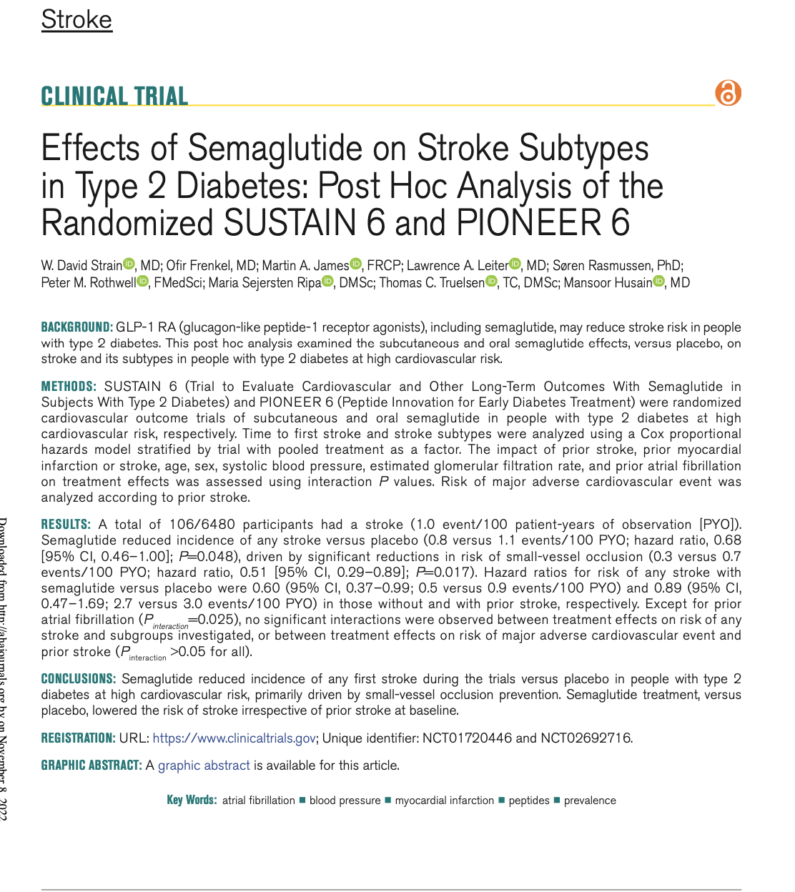

Antidiabetic drugs and ‘protection’ against stroke
Evidence from RCTs
SUSTAIN 6 and PIONEER 6 included 6480
(semaglutide, n=3239; placebo, n=3241)
0.8 Vs. 1.1 strokes /p-y
Strain et al, Stroke 2022

Slide 41

Antidiabetic drugs and ‘protection’ against stroke
Evidence from RCTs
SUSTAIN 6 and PIONEER 6 included 6480
(semaglutide, n=3239; placebo, n=3241)
Strain et al, Stroke 2022

Slide 42

Antidiabetic drugs and ‘protection’ against stroke
Evidence from RCTs
NNT 120
REWIND
135 strokes in dulaglutide
175 strokes in placebo
5.4y
Goldenberg et al, Stroke 2022

Slide 43

What about SGLT2i?
SGLT2i vs. GLP-1RA in real world population-based cohort
1:1 propensity score-matched T2D patients
156,824 patients with baseline CVD
82,625 with SGLT2i
74,200 with GLP-1RA
HR, 0.90 [CI, 0.82 to 0.98]
SGLT2i are still on
Patorno et al, Ann Intern Med. 2021

Slide 44

Diabetes Care 2022;45(Suppl. 1):S125–S143

Slide 45
Πως θα προφυλάξω τον ασθενή μου από το να μην υποστεί ξανά ισχαιμικό εγκεφαλικό;
Αντιθρομβωτική αγωγή
Εξατομίκευση
HbA1c ≤ 7%
Metformin
GLP-1
SGLT2i
ΣΔ
ΑΠ
LDL
LDL: 115mg/dl
Rosuvastatin 20mg ή atorvastatin 40mg
+/- ezetimibe
Συνδυασμός
RAS inh + diuretic /CCB

Slide 46


Πως θα προφυλάξω τον ασθενή μου από το να μην υποστεί ξανά ισχαιμικό εγκεφαλικό;
LDL <55mg/dl και μείωση 50%
(έλεγχος μετά από 6-8 εβδομάδες)
ΑΠ: 130/80 mmHg (αποφυγή μείωσης ΣΑΠ <120mmHg)
  Lacunar: ΣΑΠ <130mmHg
  Intracranial stenosis: ΣΑΠ 140mmhg
ΣΔ: HbA1c <7%
  Εξατομίκευση
  Αθηροσκληρωτική νόσος: GLP-1RA / SGLT2i
  Καρδιακή / Νεφρική Νόσος: SGLT-2i

