Slide 1

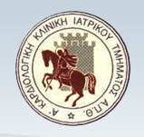
ΒΗΜΑΤΟΔΟΤΕΣ ΧΩΡΙΣ ΗΛΕΚΤΡΟΔΙΑ
(LEADLESS PACEMAKERS)
ΣΤΕΛΙΟΣ ΠΑΡΑΣΚΕΥΑÏΔΗΣ
ΔΙΕΥΘΥΝΤΗΣ ΕΣΥ
Α΄ Καρδιολογική Κλινική ΑΠΘ,
Νοσοκομείο ΑΧΕΠΑ, Θεσσαλονίκη

Slide 2
NO CONFLICT OF INTEREST

Slide 3
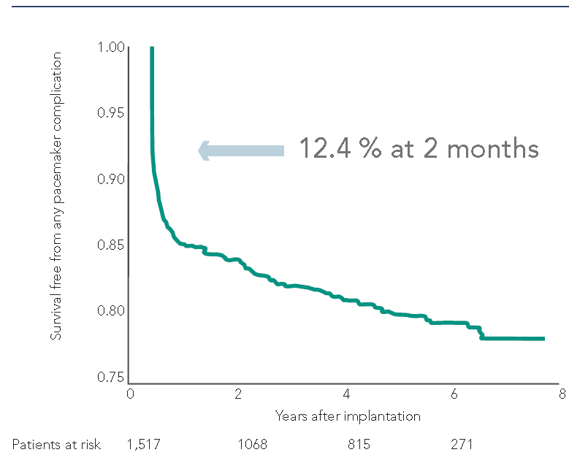
Pacemakers implants (2022)
> 1.500.000 /year worldwide, > 200.000 in USΑ
pacemaker-related complications
Acute (2 months): 12 %
Chronic
lead or surgical pocket related: 10 %
The transvenous lead is a critical component of conventional cardiac pacemakers, but it is also their Achilles heel
Udo E et al. Heart Rhythm 2012;9:728-735

Slide 4
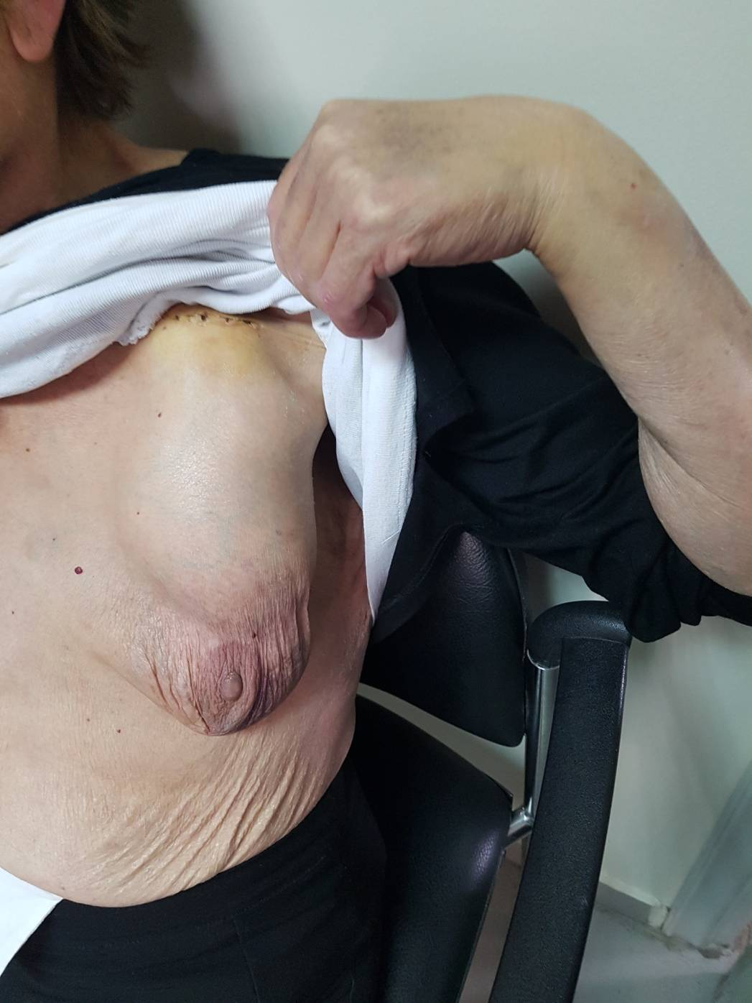
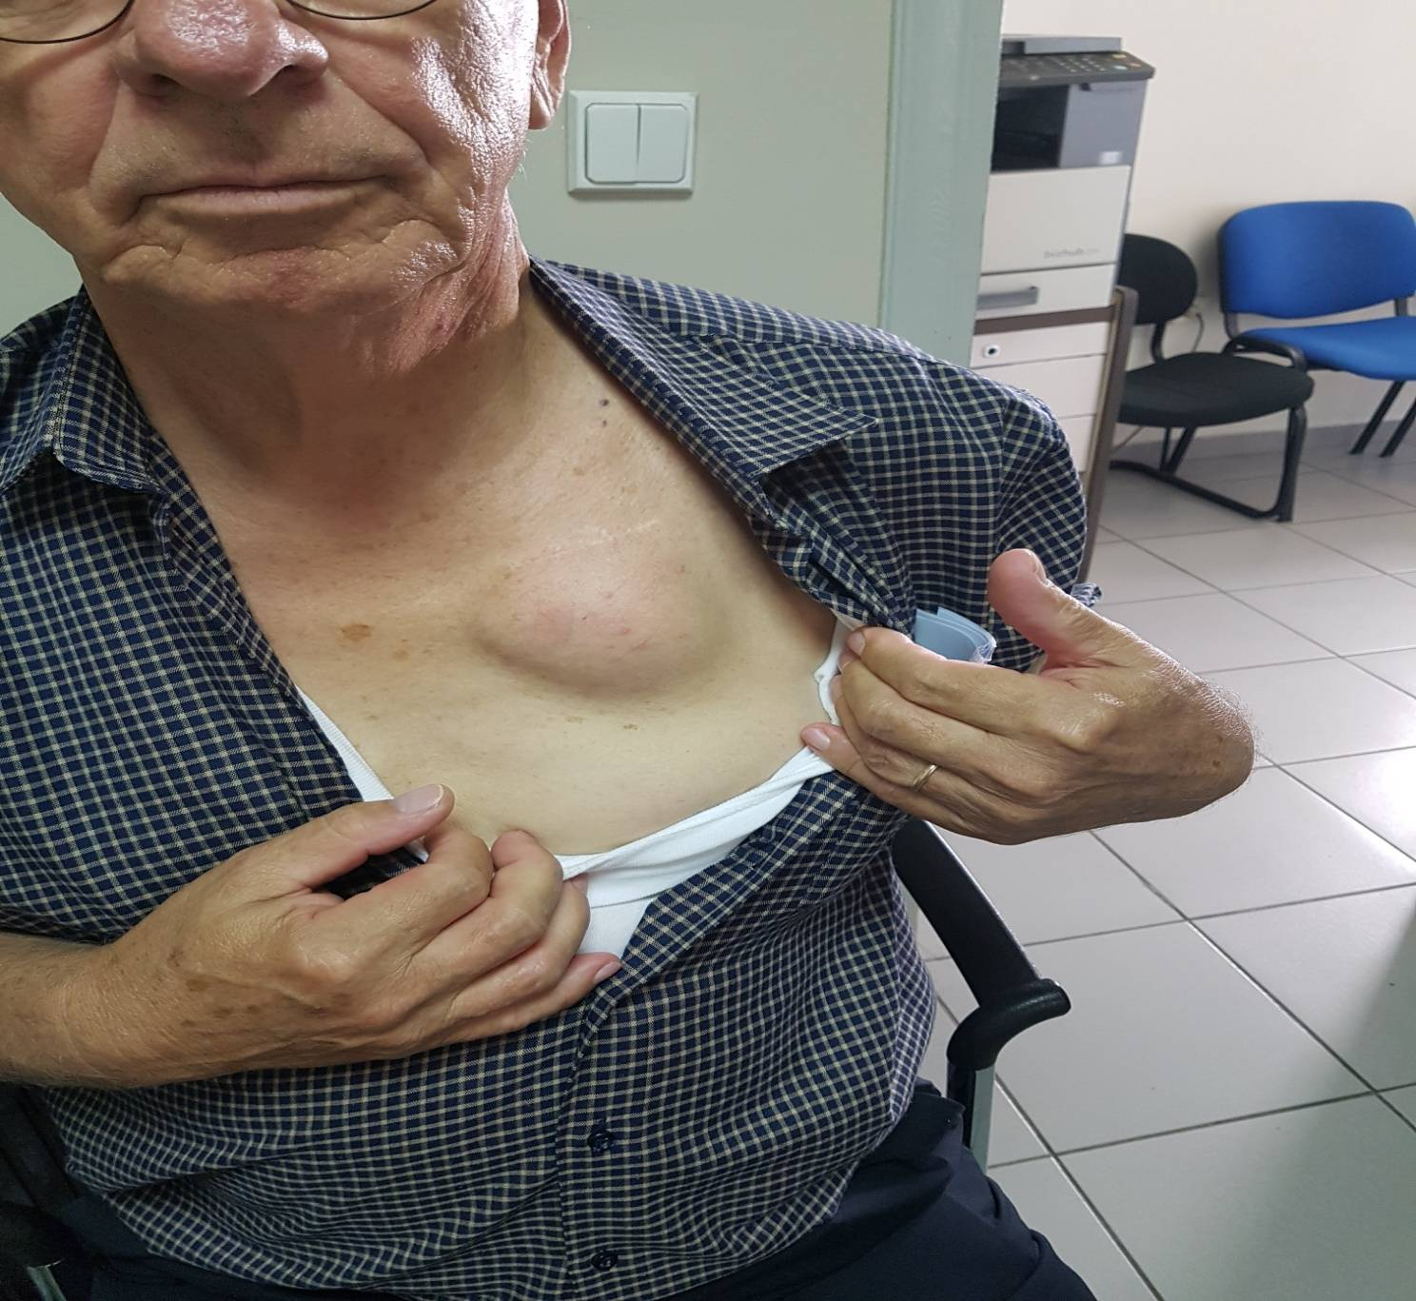

Slide 5
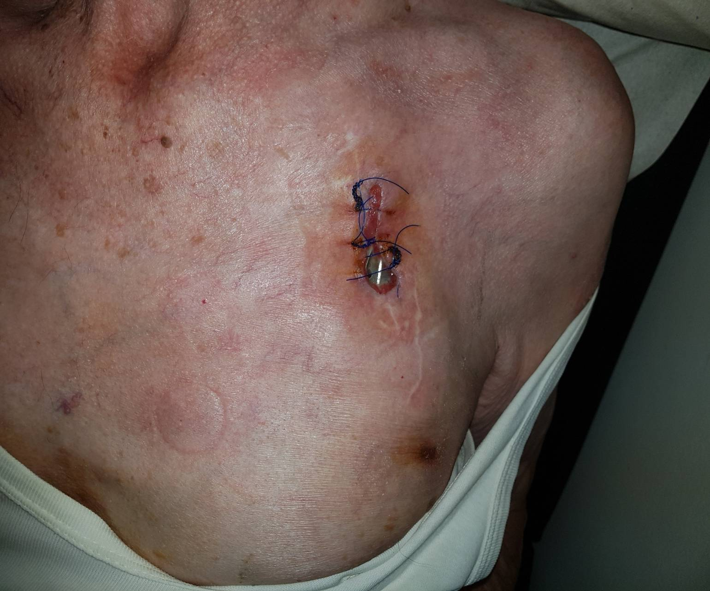
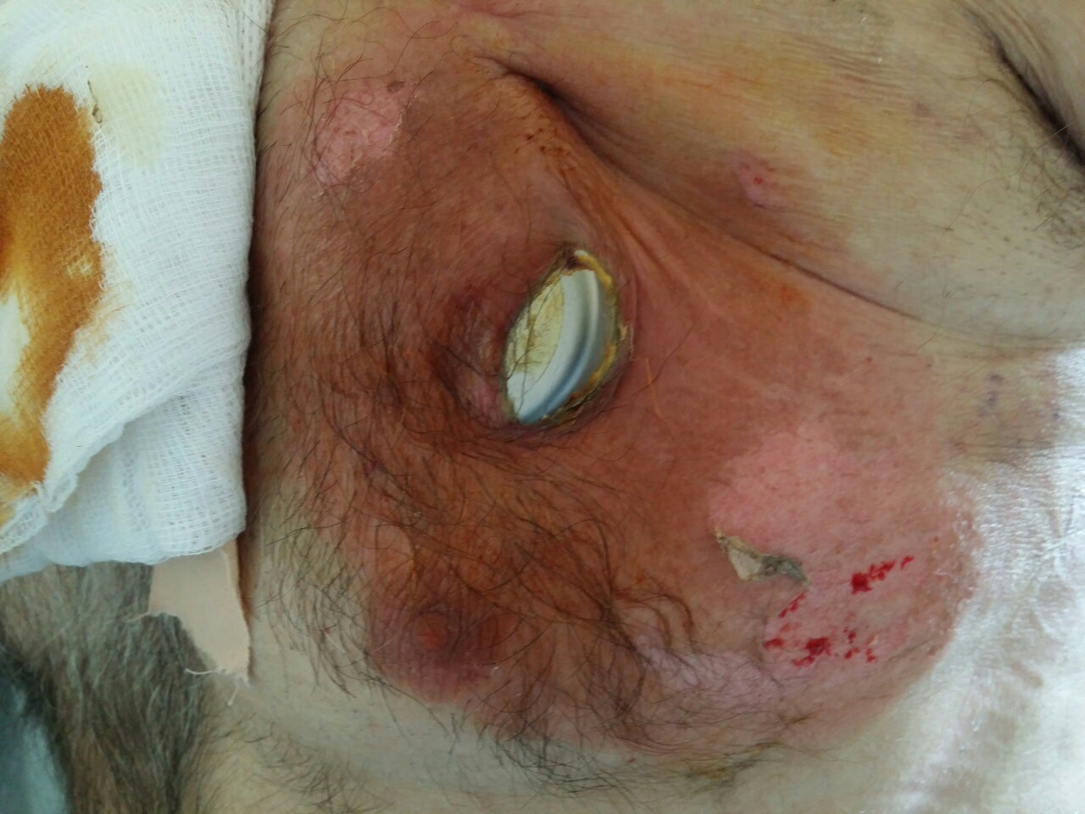

Slide 6
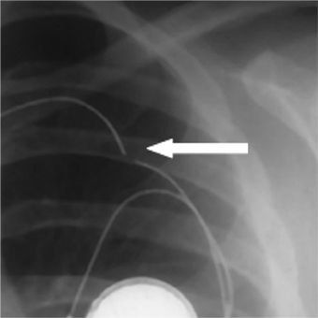
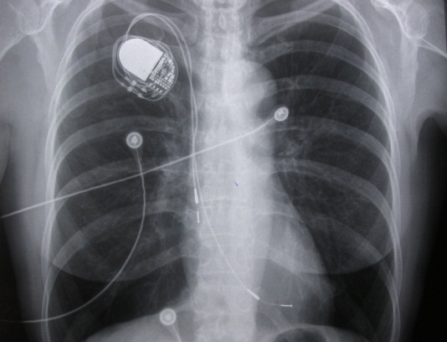
Lead fracture
Lead dislodgement

Slide 7
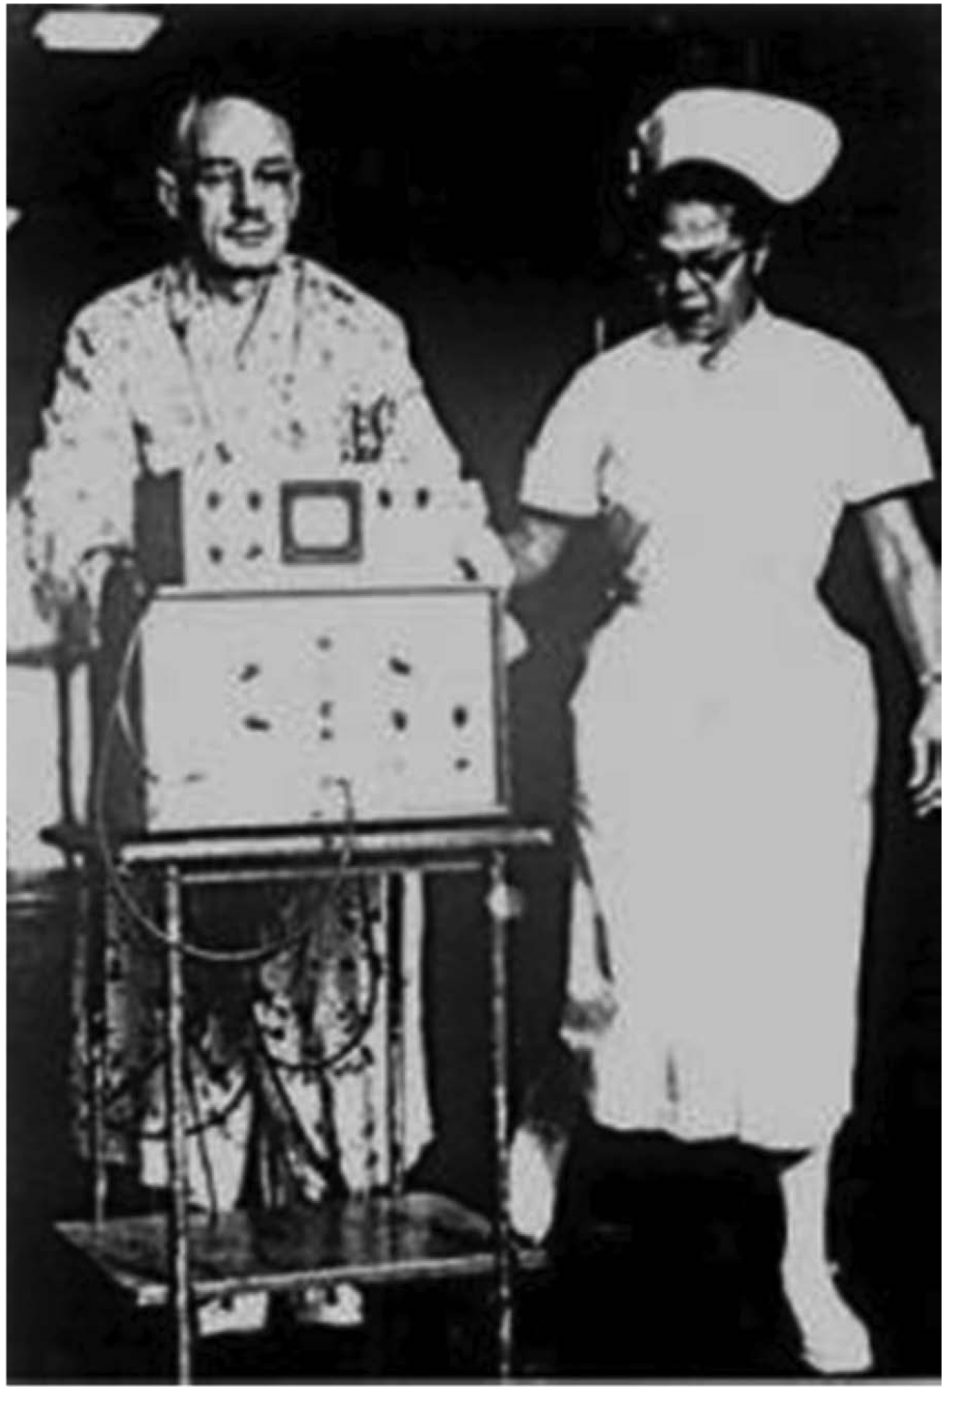
1952, epicardial,
Paul Zoll

Slide 8
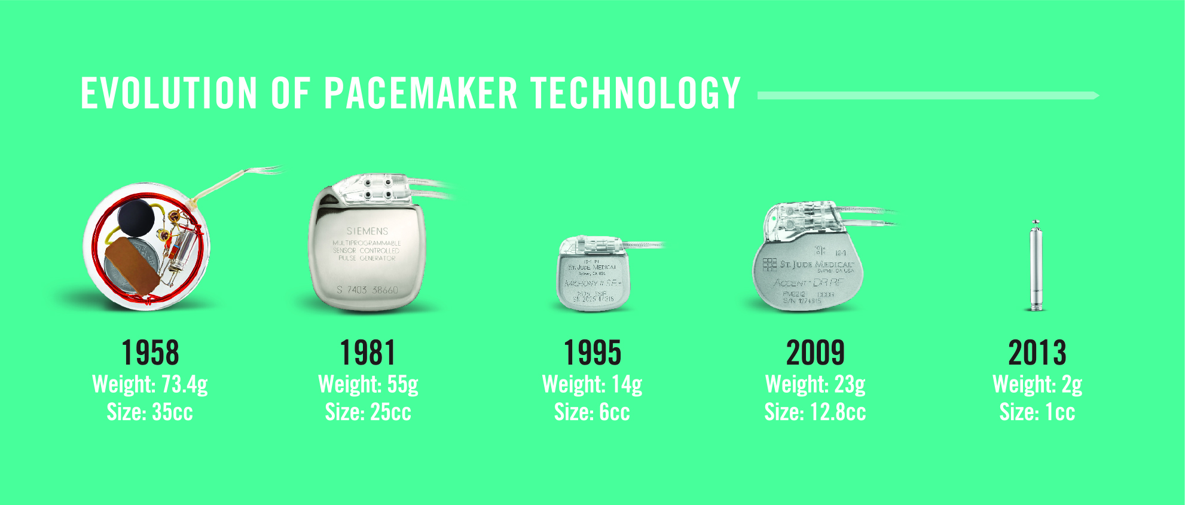

Slide 9
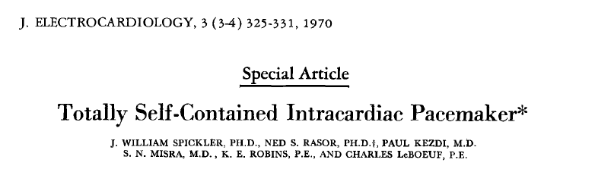
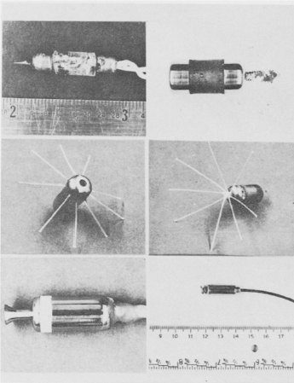
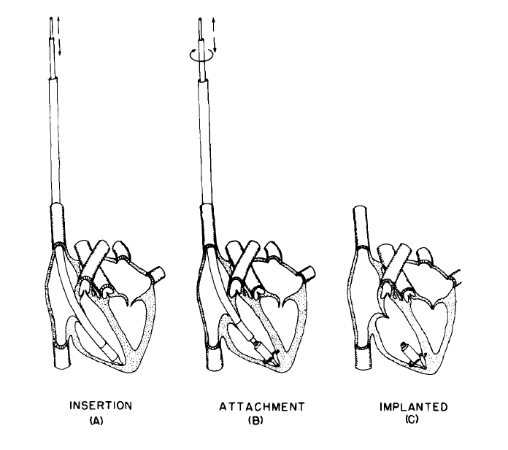
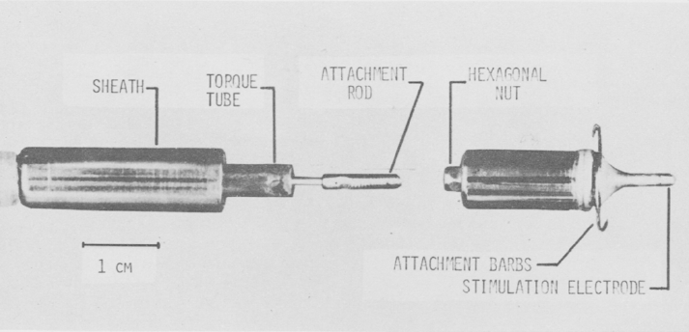
History of Leadless Pacing: Idea proposed in 1970
1st self-contained leadless cardiac pacemaker (18 x 8 mm). Unreliable battery lasting weeks
Notes:
The first totally self-contained leadless pacemaker system was proposed by Spickler back in 1970 using a device powered by mercury-zinc and nuclear power that was successfully tested in animals.
Source:
Spickler, William J., et al. Totally Self-Contained Intracardiac Pacemaker. J. Electrocardiology. 1970; 3 (3-4): 325-331.

Slide 10
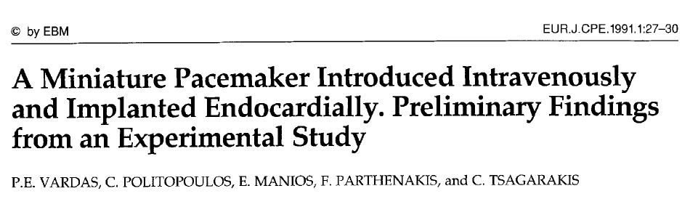
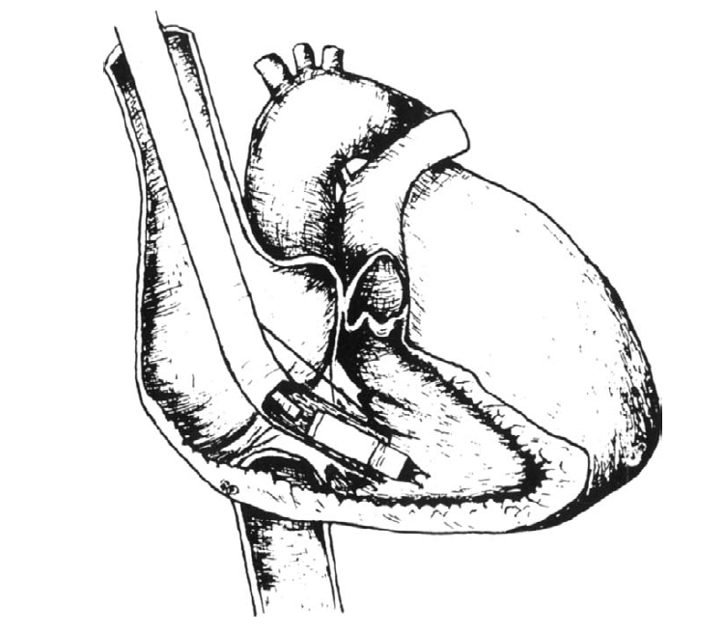
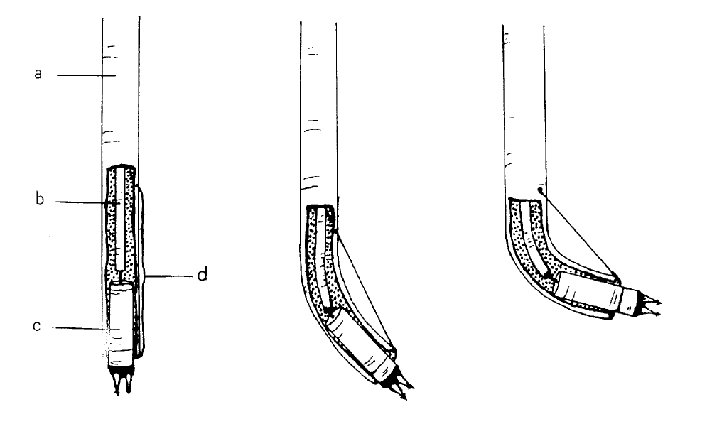
History of Leadless Pacing: Miniature Pacemaker Tested in 1991
a: Guiding catheter
b: Pusher catheter
c: Miniature pacemaker
d: Steering arm
5.8 x 23 mm
Notes:
In 1991, Vardas et al created a cylindrical VOO pacing device specifically for an animal study. The device measured 5.8mm in diameter and 23 mm in length, and it consisted of three batteries and a CMOS timer. The authors stated that “if [a miniature pacing device] can be made programmable without an unreasonable increase in size, if the battery can be made sufficiently long lasting or externally rechargeable, if technology can rise to meet these challenges, then such a miniature device might one day take its place among regularly used pacemakers and, eventually, even supercede them.”
Source:
Vardas P et al, A miniature pacemaker introduced intravenously and implanted endocardially – preliminary findings from an experimental study. Eur.J.CPE. 1991. 1:27-30.

Slide 11
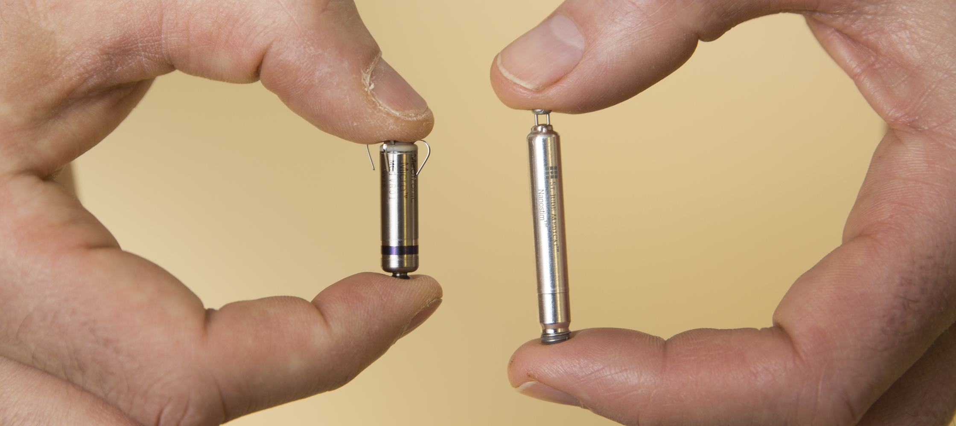
LEADLESS PACEMAKER

Slide 12
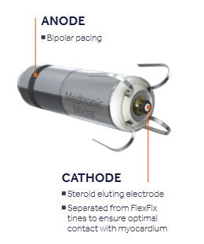
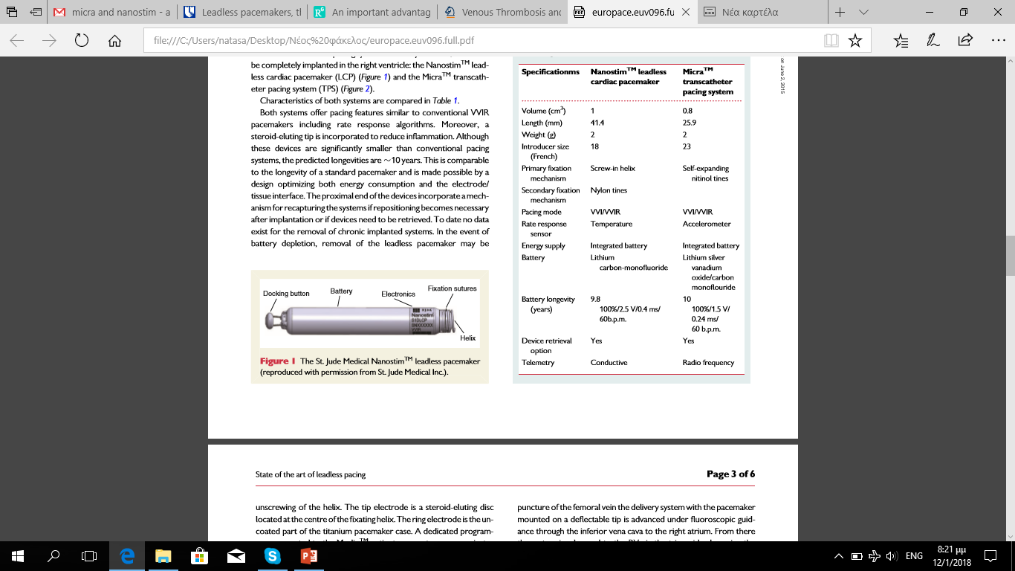
LEADLESS PACEMAKER
MICRA TPS-27 Fr sheath
NANOSTIM LCP- 18 Fr sheath
FDA APPROVAL 2022
CE Mark 2015 / FDA APPROVAL 2016

Slide 13
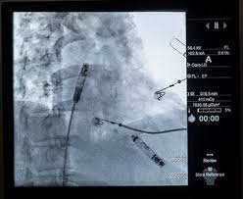
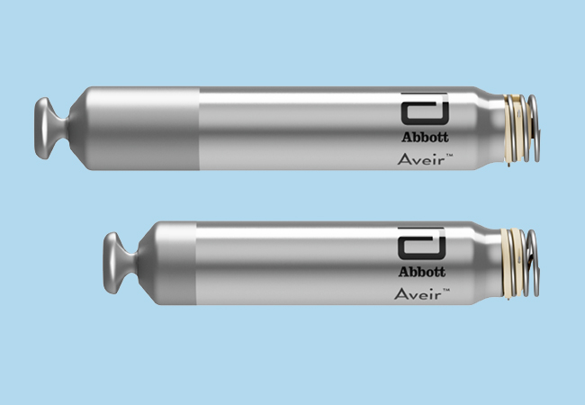
Aveir DR i2i Study (ongoing)
RA
RV

Slide 14
ESC GUIDELINES 2021

Slide 15
αντενδειξεισ (fda)
μηχανική τριγλώχινα βαλβίδα
άλλες εμφυτευμένες καρδιακές συσκευές
νοσογόνος παχυσαρκία ( δυσχερής τηλεμετρία )
αλλεργία σε τιτάνιο, νιτινόλη, σκιαστικά-
ηπαρίνη / δυσανεξία στη δεξαμεθαζόνη
φίλτρα κάτω κοίλης φλέβας
ακατάλληλη ανατομία μηριαίας φλέβας
(διάμετρος, στένωση, απόφραξη, ελίκωση )
( Micra Transcatheter Pacing system – PRODUCT SPECIFICATION 2016 )

Slide 16
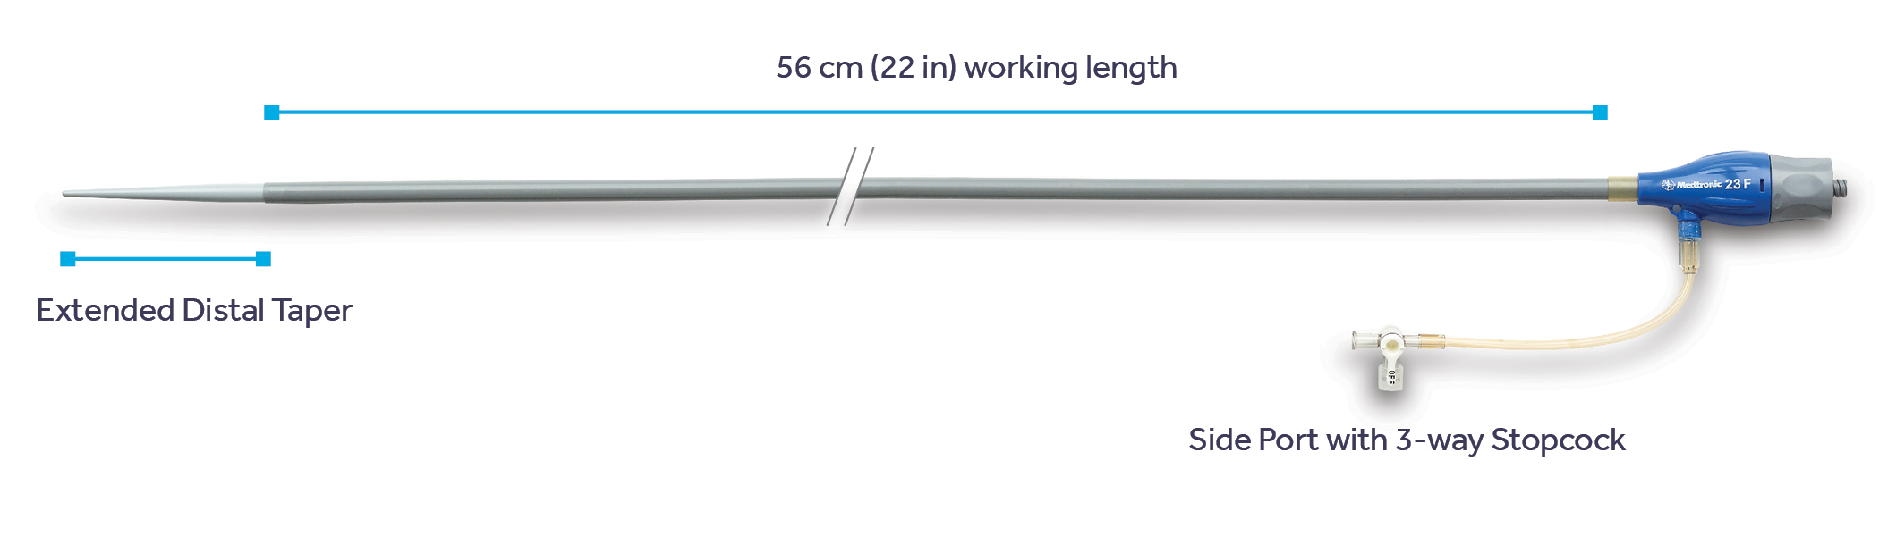
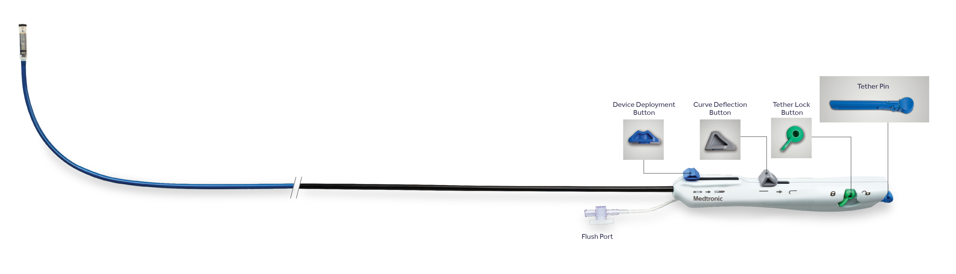
SAME, STREAMLINED procedure
Implant tools
Smooth Vessel Navigation with the Micra™ Introducer
Lubricious hydrophilic coating
23 Fr inner diameter (27 Fr outer diameter)
Silicone oil-coated dilator tip
> 99%
Implant success^{3,4}
Micra Integrated Delivery Catheter
105 cm long catheter system with a handle that controls deflection and deployment of the Micra pacing capsule¹¹

Slide 18
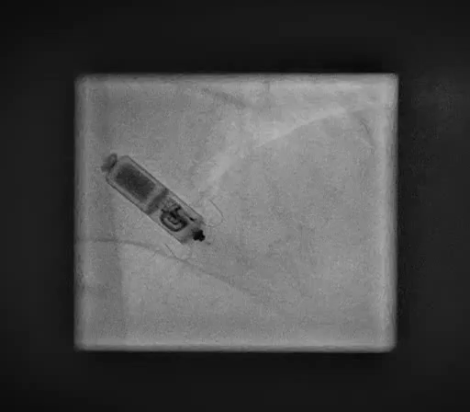
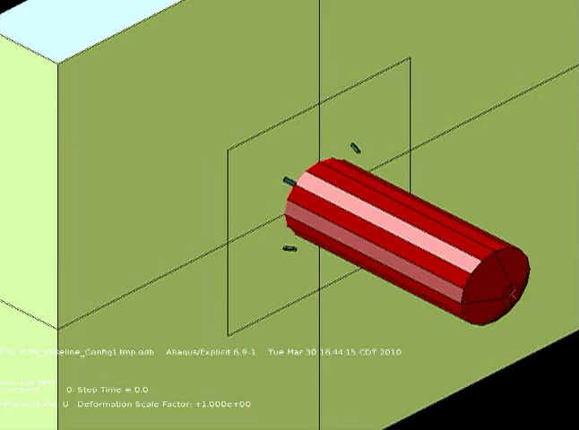
Testing fixation
“Pull and hold” test
2 tines have 15x the holding force necessary to hold the device in place.¹⁹

Slide 21
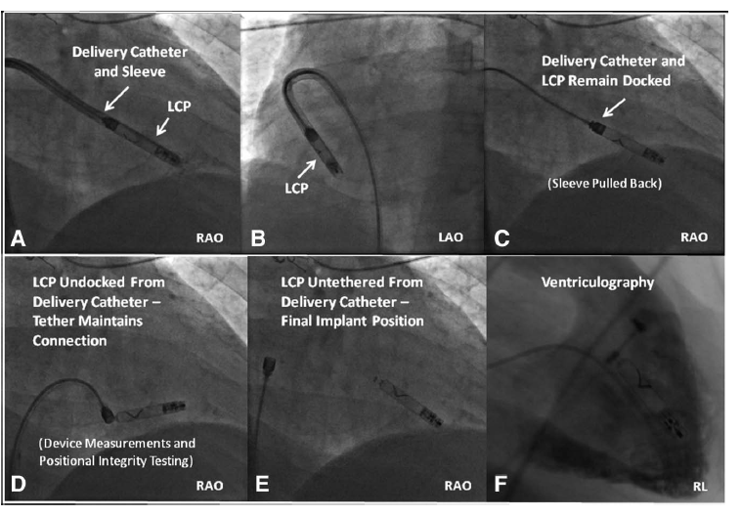
LEADLESS PACEMAKER ΙΜPLΑΝΤΑΤΙΟΝ

Slide 22
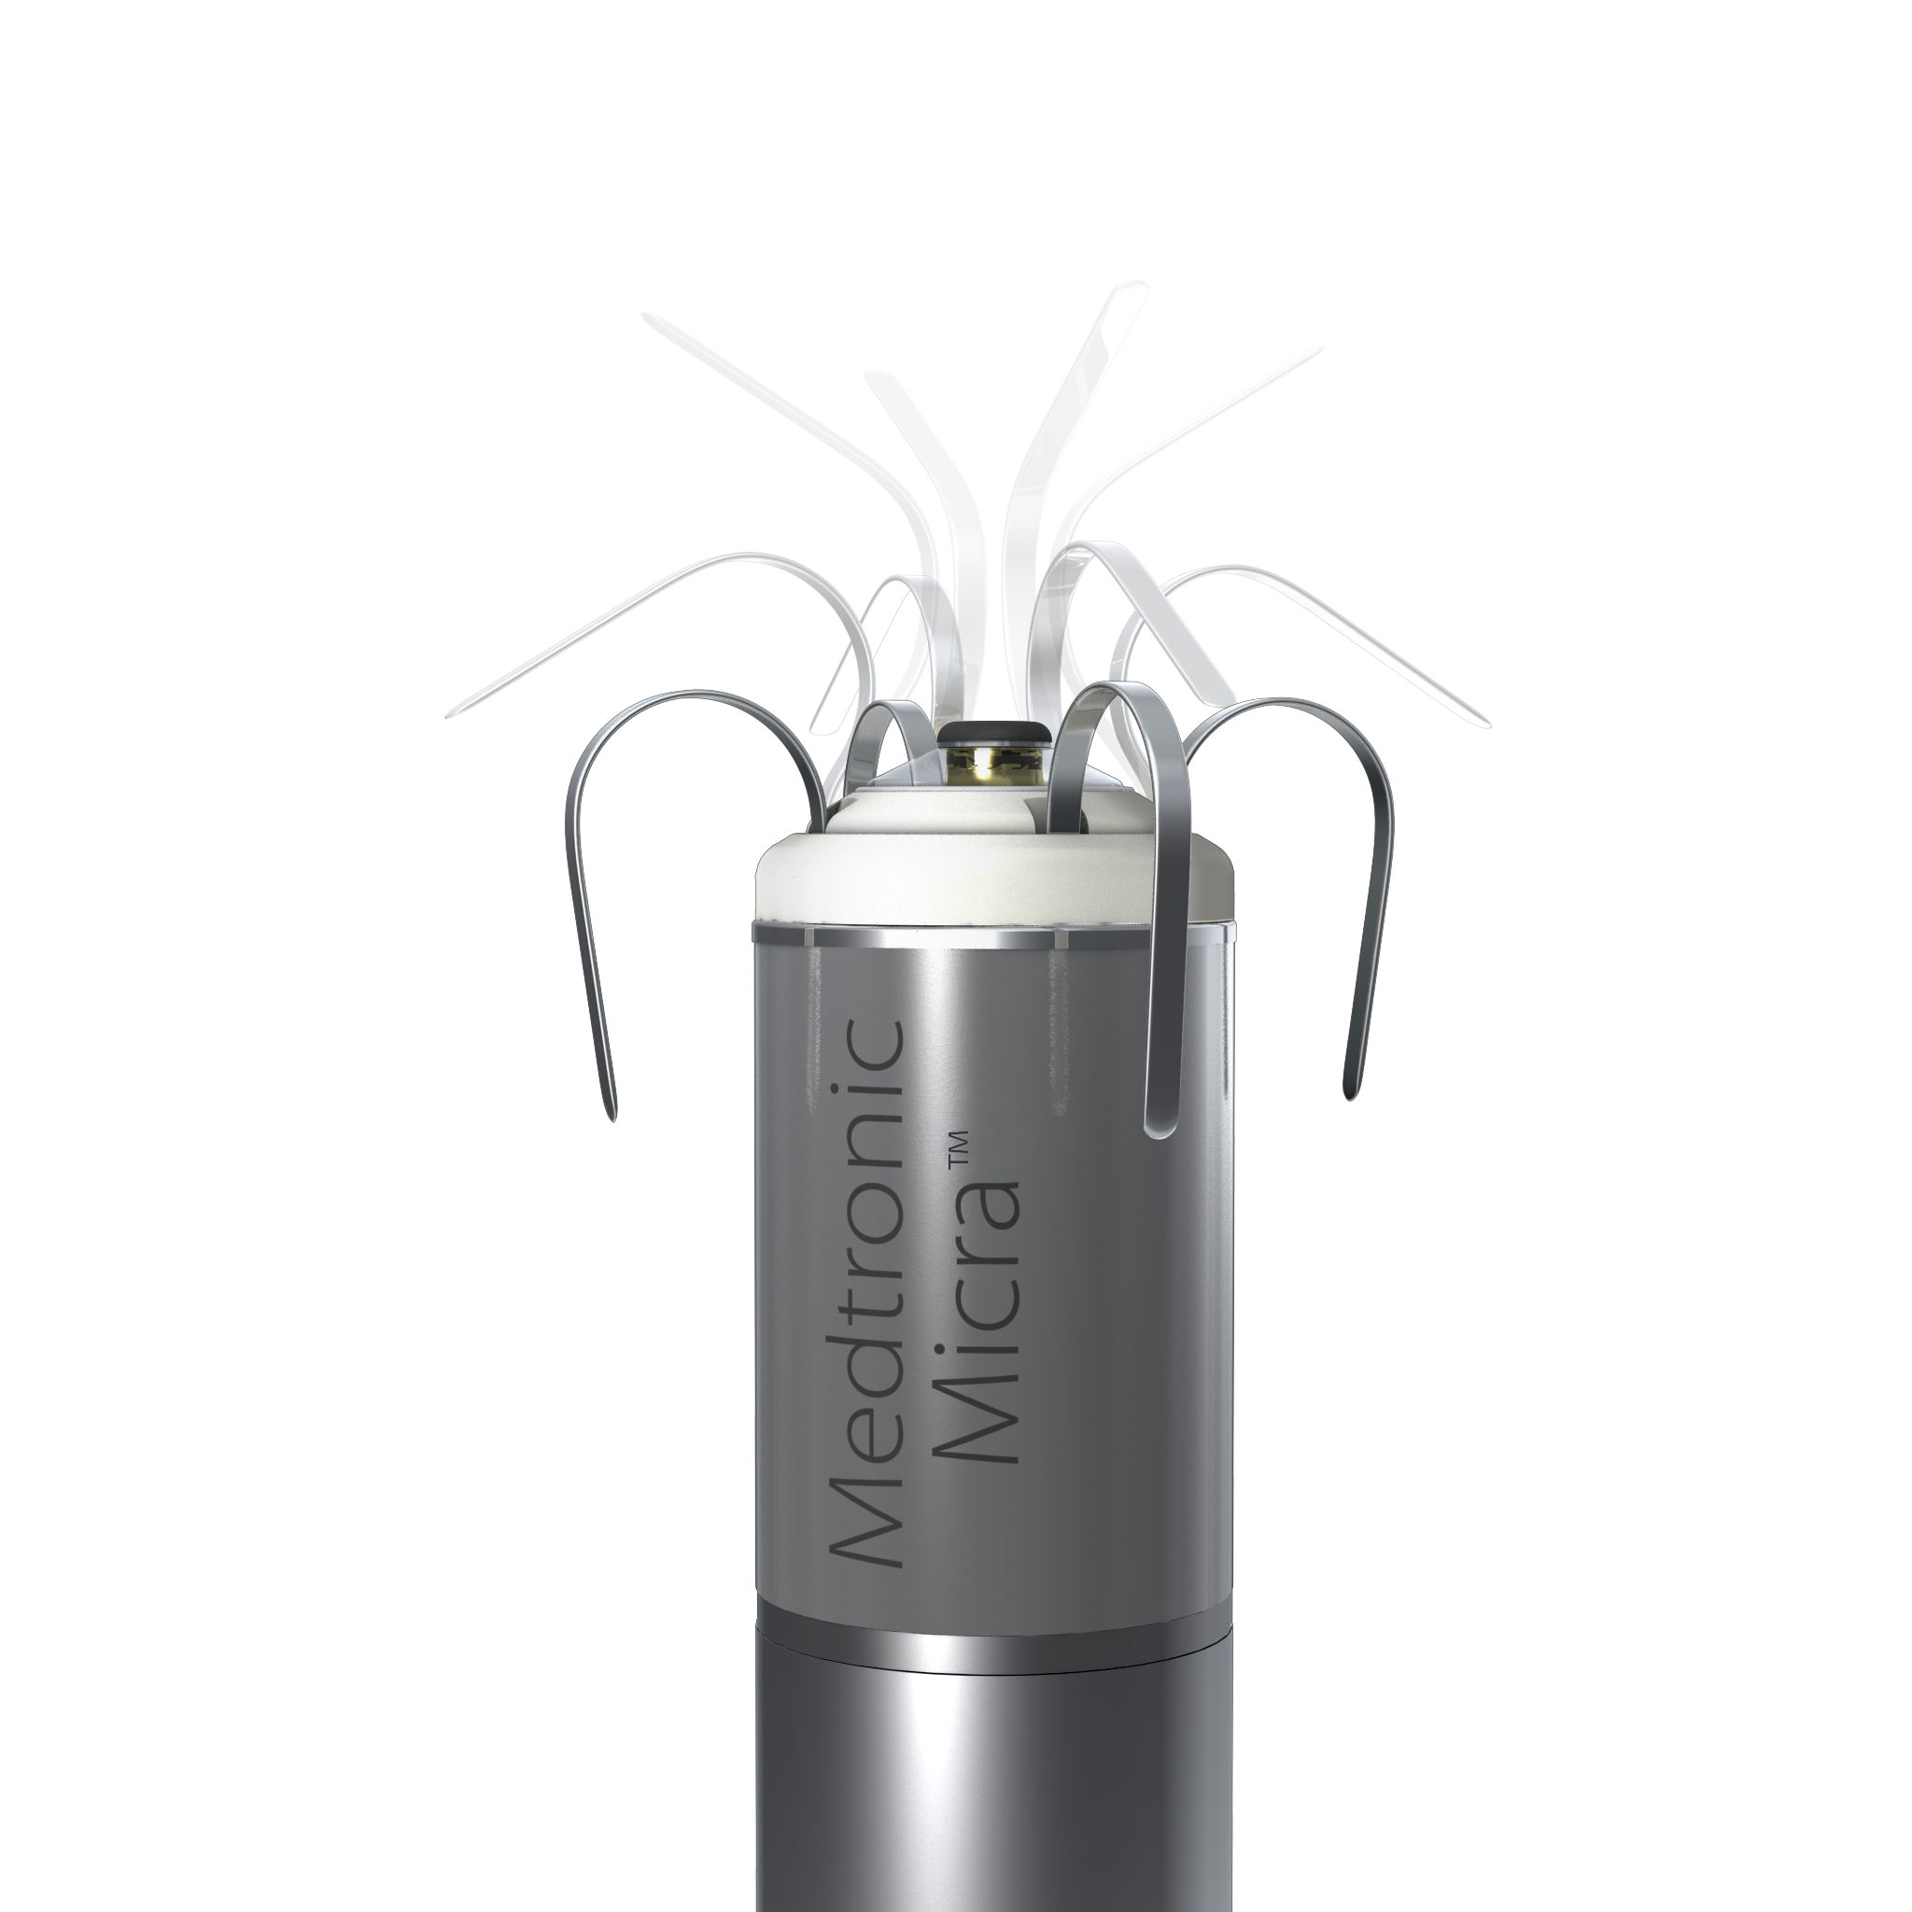

FLEXFIX NITINOL TINES
Multidimensional redundancy: Two tines have 15x the holding force necessary to hold the device in place¹⁹
Designed to minimize tissue trauma during deployment, repositioning, and retrieval²¹
Optimal electrode-tissue interface allows for low and stable chronic thresholds²²
Low dislodgement rate (0.00-0.06%)^{3,4}

Slide 23
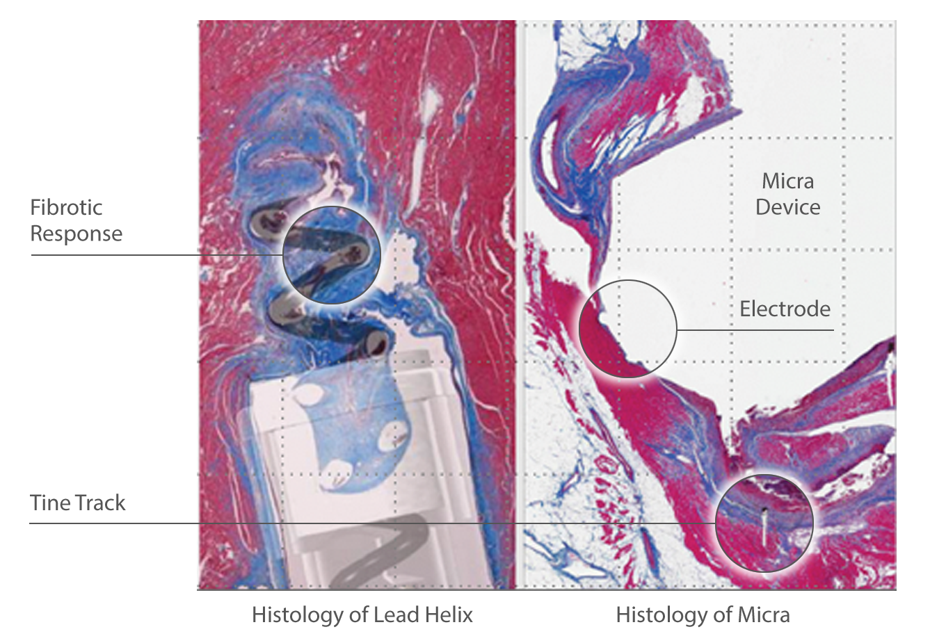
Testing electricals
Optimal electrode tissue interface allows for low and stable chronic thresholds.²³

Slide 24
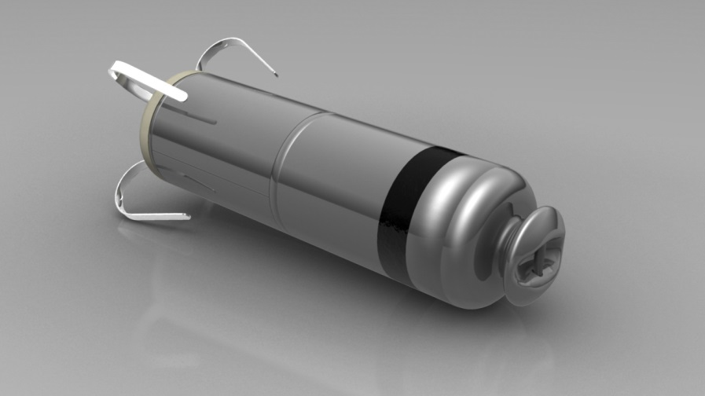
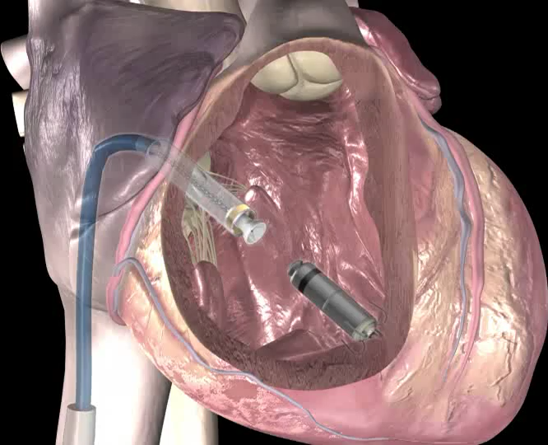
Device lifecycle management options
Options
Micra™ transcatheter pacing systems can be turned OFF and additional Micra devices can be added.
      A Micra device takes up < 1% of the volume of a normal right ventricle.
Micra transcatheter pacing systems can be turned OFF and a traditional system or upgrade can be implanted.
The Micra design incorporates a proximal retrieval feature to enable acute retrieval.
Successful retrieval demonstrated after 4 years.
Proximal
Retrieval
Feature

Slide 25
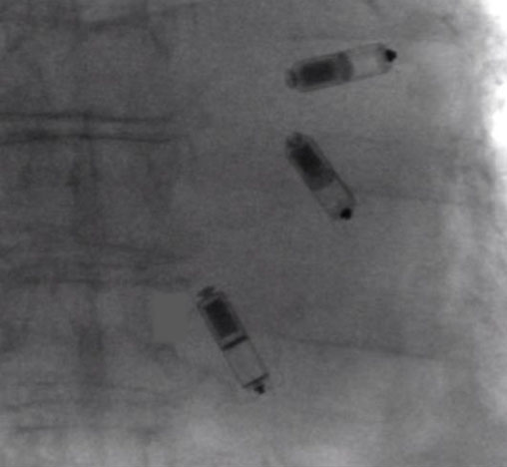
Multiple Micra™ Devices Can Be Implanted in the RV
Notes:
Slide Notes:
The right ventricle can accommodate multiple Micra devices utilizing traditional pacing locations.

Slide 26
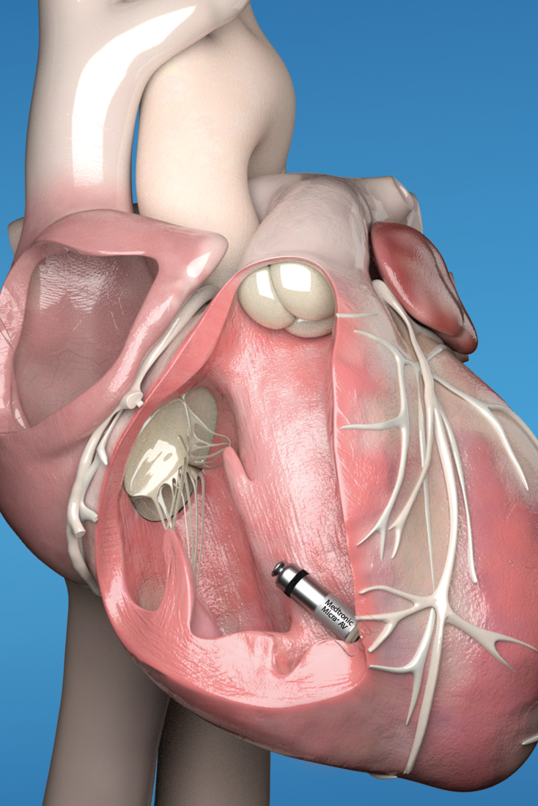
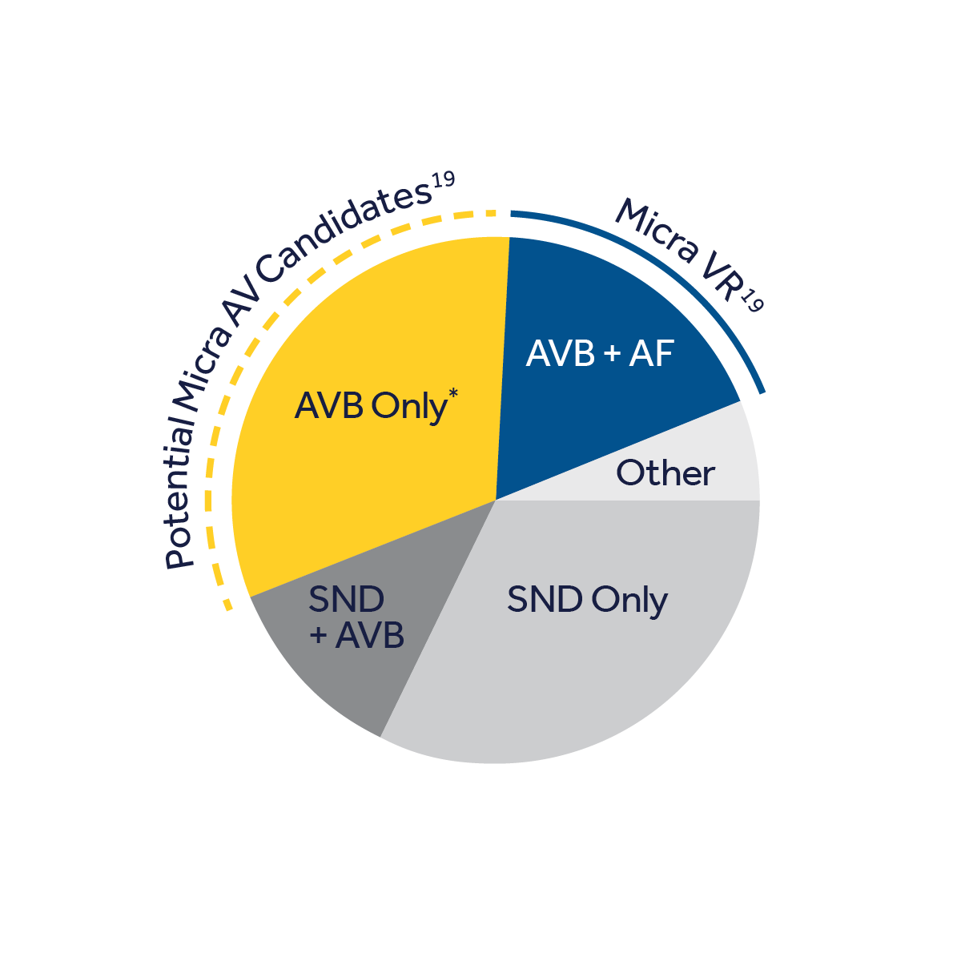
Micra™ AV Transcatheter Pacing System
VDD mode
The world’s smallest pacemaker, now with AV synchrony¹⁶
Micra AV’s accelerometer detects mechanical atrial activity and uses this information to deliver AV synchronous ventricular pacing.
New, integrated circuitry capable of sustaining new AV synchrony functionality.
Estimated average battery longevity of 8-13 years, dependent on the patient’s degree of AV block.
17
17
*AVB-only patients who would benefit from leadless pacing per the indications for use.

Slide 27
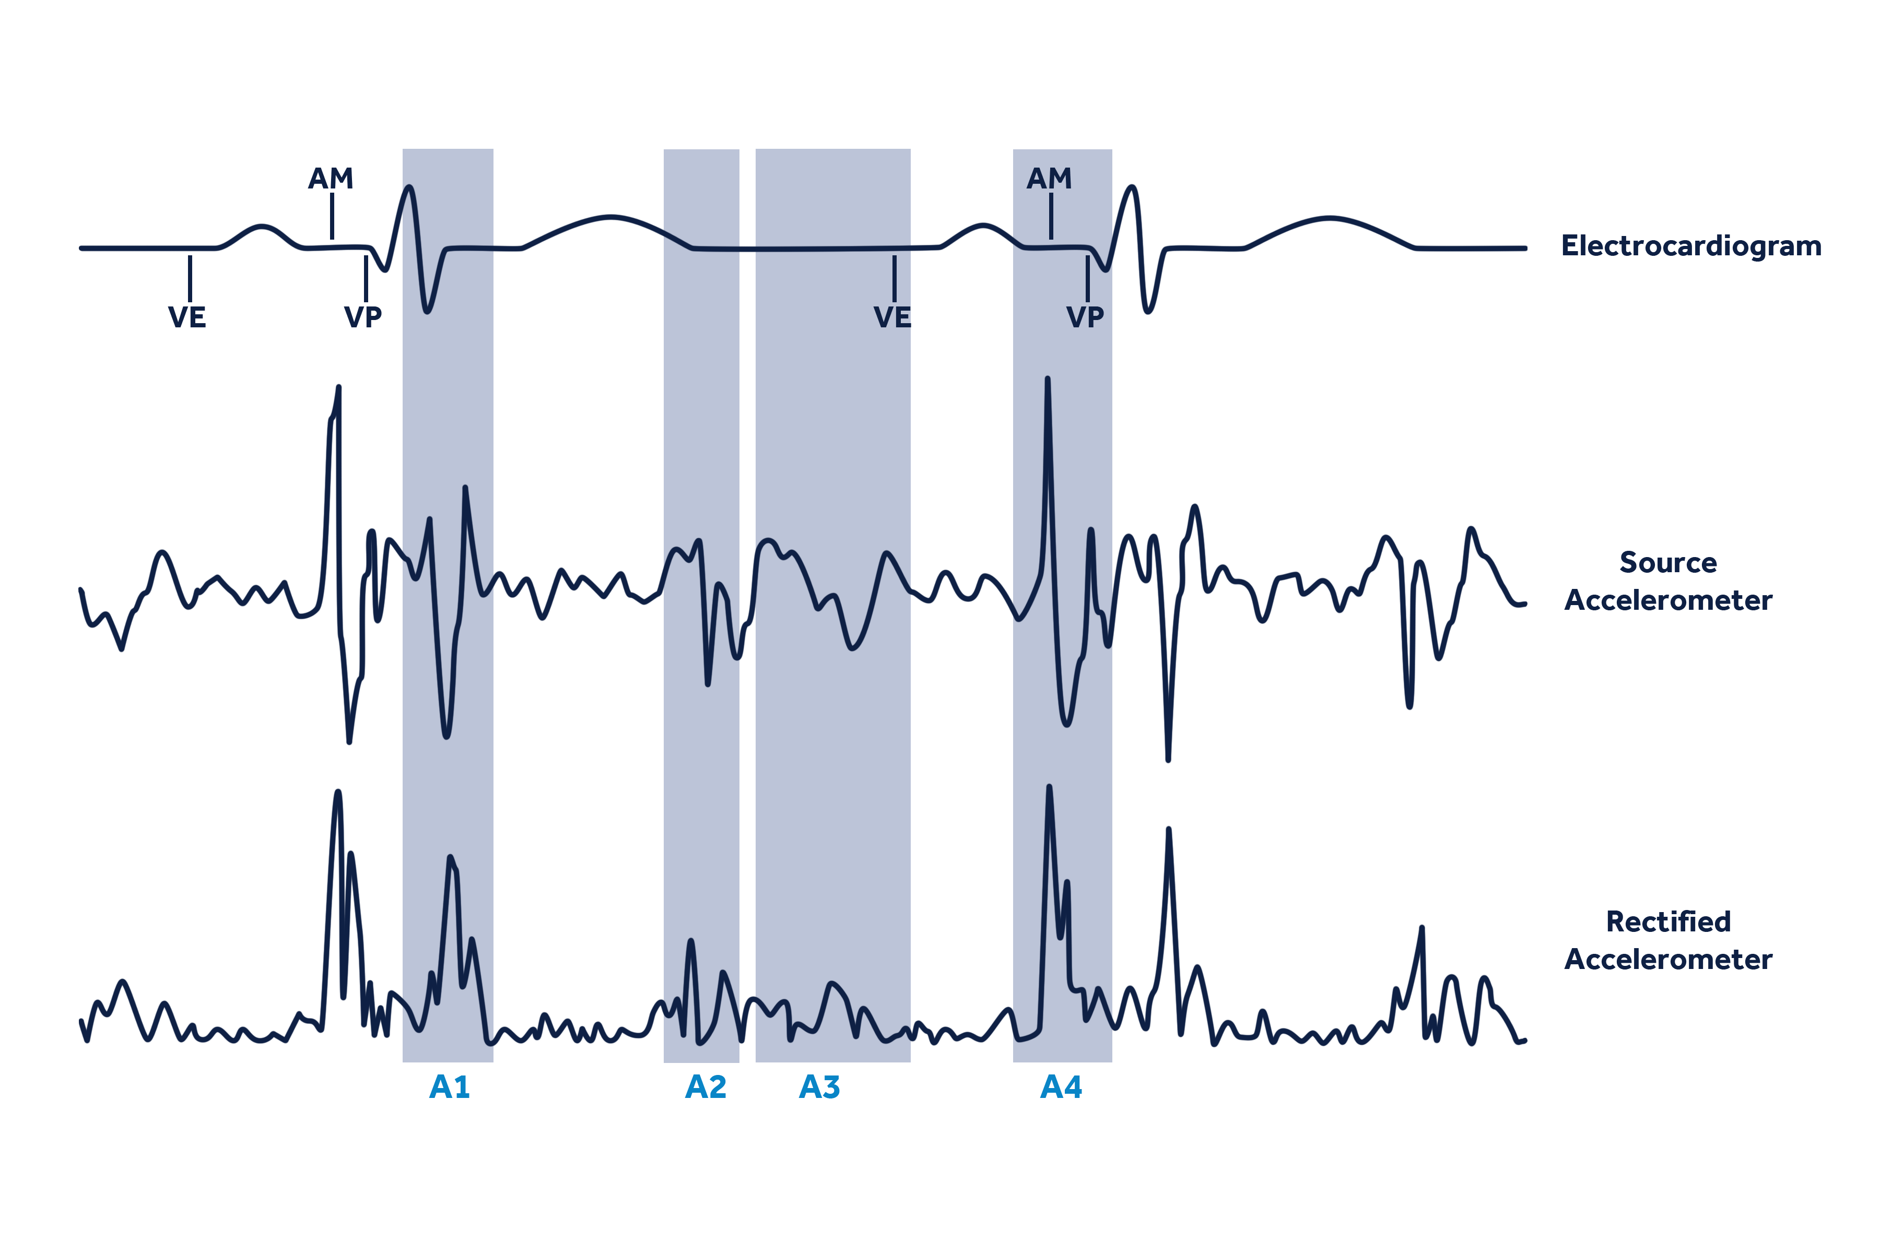
Micra™ AV
ACCELEROMETER SIGNALS
Atrial mechanical (AM) marker
Marker that indicates the device detected the atrial mechanical contraction or A4.
Ventricular end (VE) marker
The end of the A1–A3 ventricular-event signals.
A1
Start of ventricular systole, mitral and tricuspid valves close.
A2
End of ventricular systole, aortic and pulmonic valves close.
A3
Diastole, passive blood flow from A to V, corresponds to E-wave on Doppler echo.
A4
Atrial systole, blood pushed into ventricles, 100 ms electromechanical delay, corresponds to A-wave on Doppler echo.

Slide 28

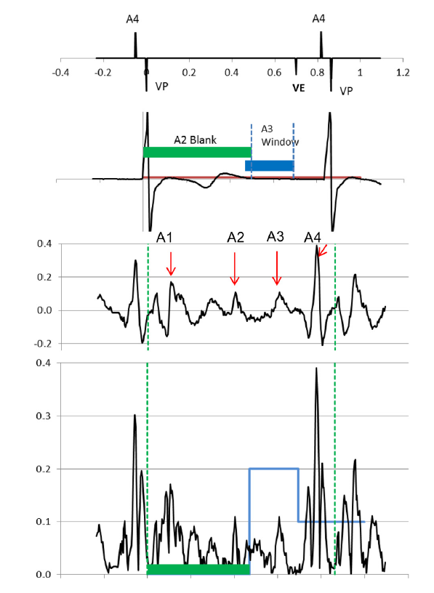
MARVEL study- Micra Atrial TRacking Using A Ventricular
AccELerometer. VDD mode n=64
Heart Rhythm 2018
atrioventricular synchrony: 87%

Slide 29
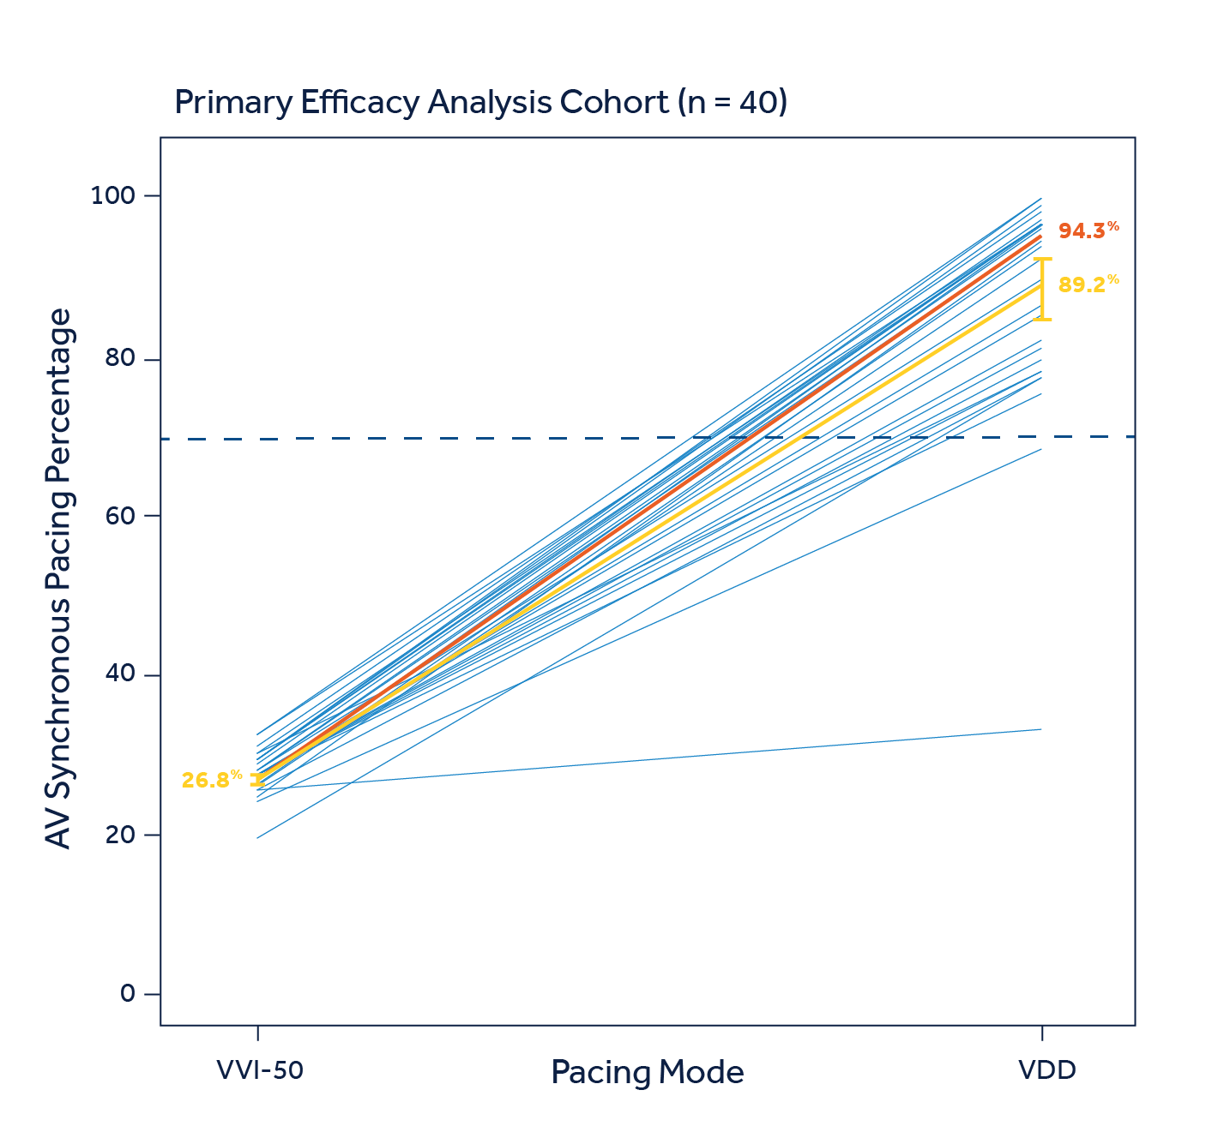
MICRA™ AV ALGORITHM PERFORMANCE JACC 2020
Results from the marvel 2 study
94.3%
Median AV synchrony at rest in complete AV block patients with normal sinus rhythm (n = 40).

Slide 30
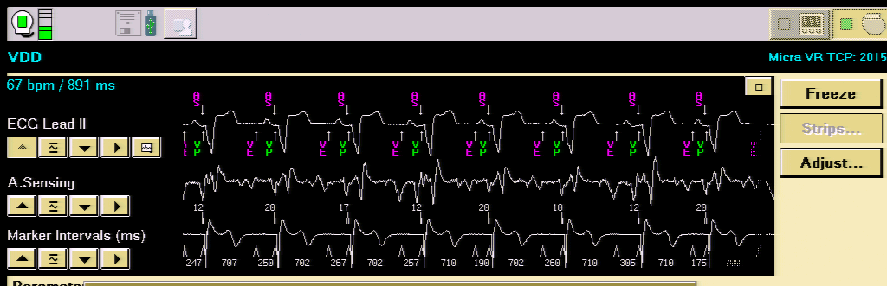
Primary results from the marvel 2 study¹⁸
MARVEL 2 in AV BLOCK PATIENT¹⁸
Note: MARVEL 2 clinical data slides were presented at AHA 2019.²⁷

Slide 31
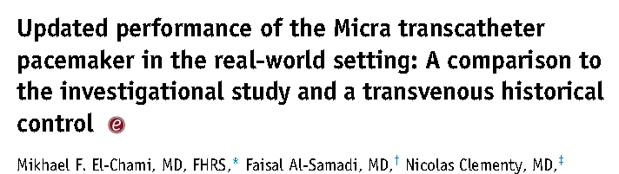
MICRA TP study- Heart Rhythm 2018
n=1817 enrolled, 1801 (99%)successful implantations , 179 centers, 23 countries
follow up: 6.8 ± 6.9 months
3 cases of infection associated with the procedure, but none required device removal and there were no battery or telemetry issues

Slide 32

Globally Diverse Patient Population
Two clinical studies spanning the globe⁴¹
2,543 patients, > 300 implanters, 208 centers, 31 countries
As of April 2018 data freeze

Slide 33
Micra™ VR patients OLDER, MORE COMORBIDITIES⁴¹
 | Micra VR | Historical Control
 | (N = 726) | (N = 2,667) | p-value*
Age (years) | 75.9 ± 11.0 | 71.1 ± 12.1 | < 0.001
Female | 41.2% | 44.9% | 0.08
Hypertension | 78.7% | 67.2% | < 0.001
AF | 72.6% | 36.6% | < 0.001
Valvular Disease | 43.3% | 19.2% | < 0.001
Diabetes | 28.5% | 21.9%† | < 0.001
CAD | 28.2% | 38.4% | < 0.001
CHF | 18.0% | 15.0% | 0.050
COPD | 12.7% | 7.2%† | 0.001
Vascular Disease | 7.6% | 10.1% | 0.06
*P-value from T-test (continuous variables) or Fisher’s Exact test (categorical variables).
†Data parameter not collected across all 6 trials.

Slide 34
Indications for pacing (N = 726)⁴
Other
4%
Reasons for selecting VVIR
Infrequent pacing expected
Advanced age
Sedentary lifestyle
Anatomical limitations
Comorbidities increasing complication risk
AVB 15%
Bradycardia
with permanent or persistent
AT/AF 64%
SND 18%
Consistent with Guideline Recommendations for VVI Pacing⁵¹

Slide 35
Conditions That Precluded Use of a Transvenous System
Condition that Precluded Use of Transvenous System* | IDE Patients⁴¹ (N = 45) | PAR Patients⁴¹ (N = 435)
Compromised venous access | 34 | 134
Need to preserve veins for hemodialysis | 18 | 102
Thrombosis | 12 | 39
History of infection | 4 | 171
Cancer | 6 | 39
Other† | 6 | 138
*Not mutually exclusive.
†Including valve issues and prior issues with transvenous system.

Slide 36
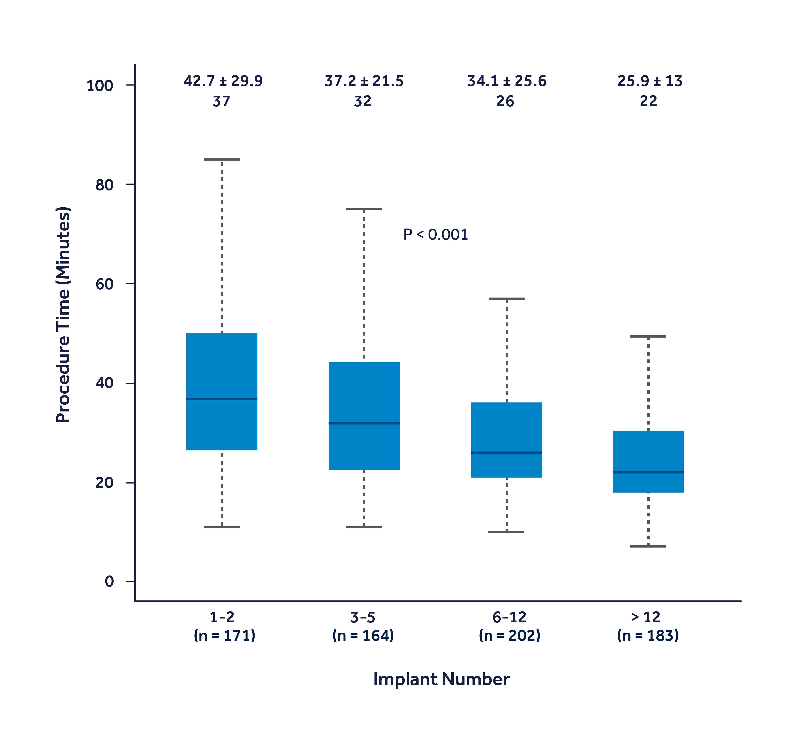
Procedure Times Reduced with Experience⁵⁴
After 12 implants,
median implant time reduced to 25.9 minutes.

Slide 37
Implant site placement
IDE Site Placement (N = 720)⁴¹
Post-approval Site Placement (N = 1,801)⁴¹
Other
1%
RVOT
1%
Other
< 1%
RVOT
1%
NR
1%
Septum
33%
Apex
32%
Apex
66%
Septum
64%

Slide 38
MAJOR COMPLICATIONS THROUGH 12 MONTHS Heart Rhythm 2018

Slide 39
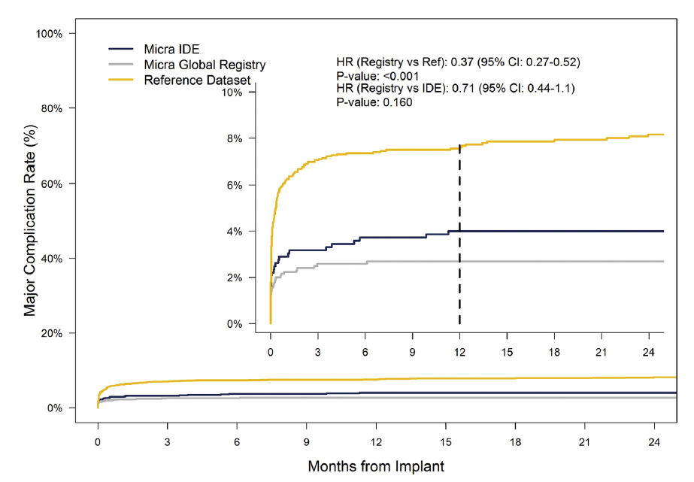
major complication rate: 2.7 %
Transvenous
Micra
The risk of major complications for Micra PAR (Post Approval Registry) pts was 63% lower compared with transvenous pacemakers through 12 months F/U

Slide 40
Micra™ VR major complications (N = 726)¹³
 | Within 30 days | 30 days– 6 months | > 6 months | Events (patients, %)
Total | 24 | 6 | 2 | 32 (29, 4.0%)
Cardiac Perforation/Effusion | 10 | 1 | 0 | 11 (11, 1.5%)
AV Fistula/Pseudoaneurysm | 5 | 0 | 0 | 5 (5, 0.7%)
Cardiac Failure | 0 | 4 | 2 | 6 (6, 0.8%)
Elevated Thresholds | 2 | 0 | 0 | 2 (2, 0.3%)
Pacemaker Syndrome | 1 | 1 | 0 | 2 (2, 0.3%)
Acute MI | 1 | 0 | 0 | 1 (1, 0.1%)
Deep Vein Thrombosis | 1 | 0 | 0 | 1 (1, 0.1%)
Metabolic Acidosis | 1 | 0 | 0 | 1 (1, 0.1%)
Presyncope | 1 | 0 | 0 | 1 (1, 0.1%)
Pulmonary Embolism | 1 | 0 | 0 | 1 (1, 0.1%)
Syncope | 1 | 0 | 0 | 1 (1, 0.1%)

Slide 41
Low and stable pacing thresholds¹³
Battery Longevity Estimate
Based on use conditions at 12 months, median battery longevity estimate is 12.1 years.*
Mean ± standard deviation
*Use conditions included: median pacing 53.5%, median pacing threshold 0.50 V, median impedance 543 Ω; 89% of patients with > 10-year projected longevity; 99% of patients with > 5-year longevity.¹⁸

Slide 42
Micra™ VR electrical performance¹³
Mean ± standard deviation
Mean ± standard deviation

Slide 43
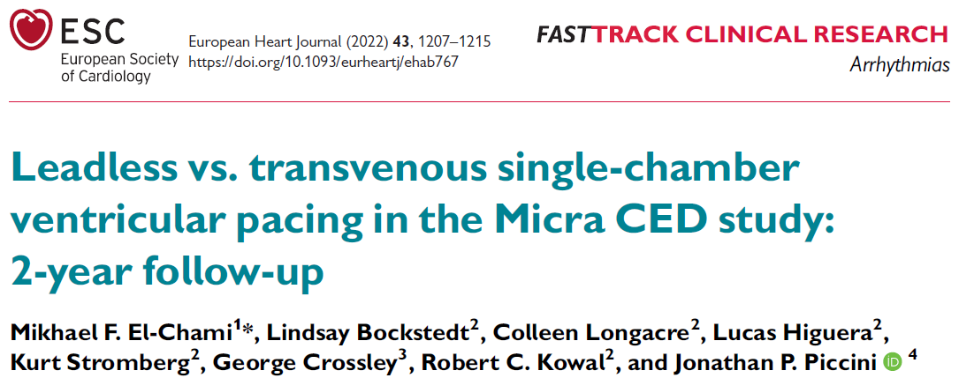
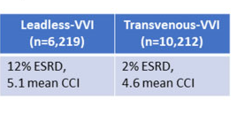
EHJ 2022
n=16,431
Observational
ESRD: end-stage renal disease
CCI: Charlson comorbidity index

Slide 44
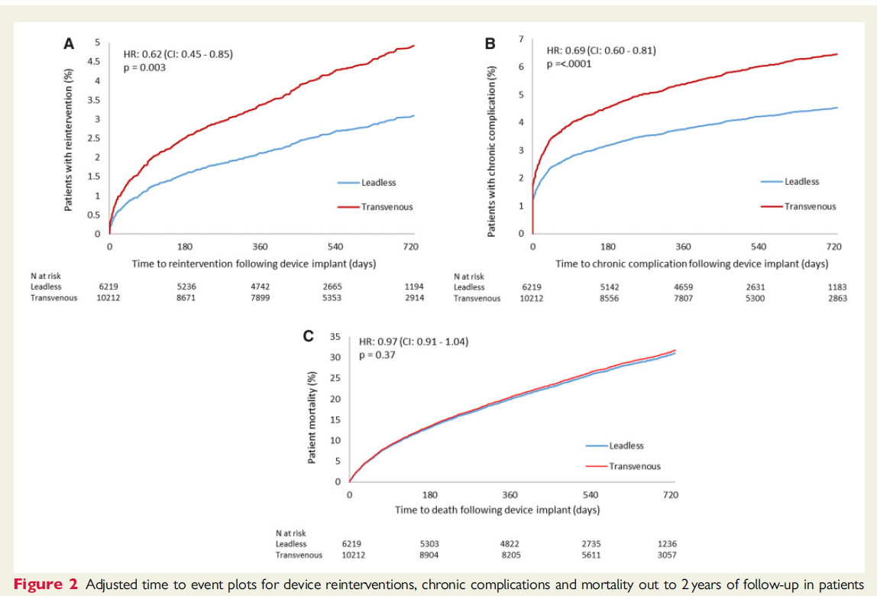
TRANSVENOUS
TRANSVENOUS
MICRA
MICRA
reinterventions
chronic complications
all-cause mortality

Slide 45
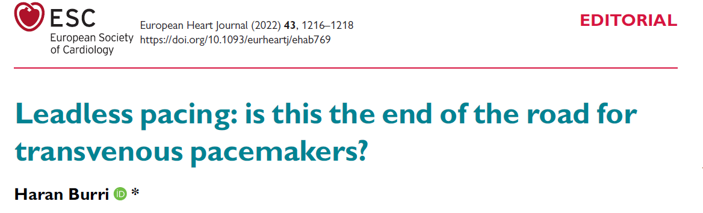
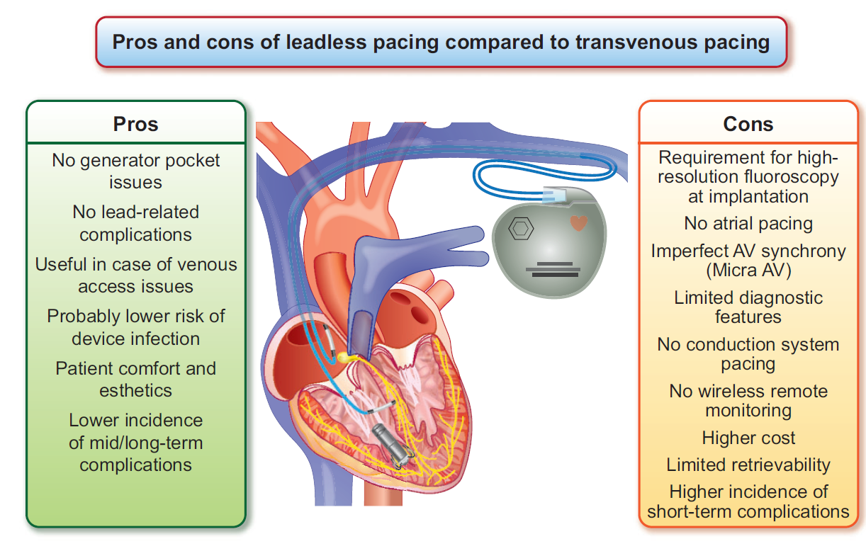
EHJ 2022
+
-

Slide 46
Lead-related Complications
Fractures
Insulation breaches
Venous thrombosis and obstruction
Tricuspid regurgitation

Slide 47
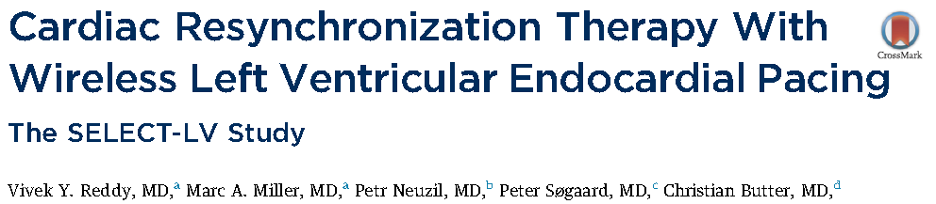
JACC 2107
n=35, failed CRT, F/U: 6 months
n=12 with prior failed attempt for coronary sinus lead implantation
n=10 non responders to a previous CRT device
n=5, high CS pacing threshold or phrenic nerve capture

Slide 48
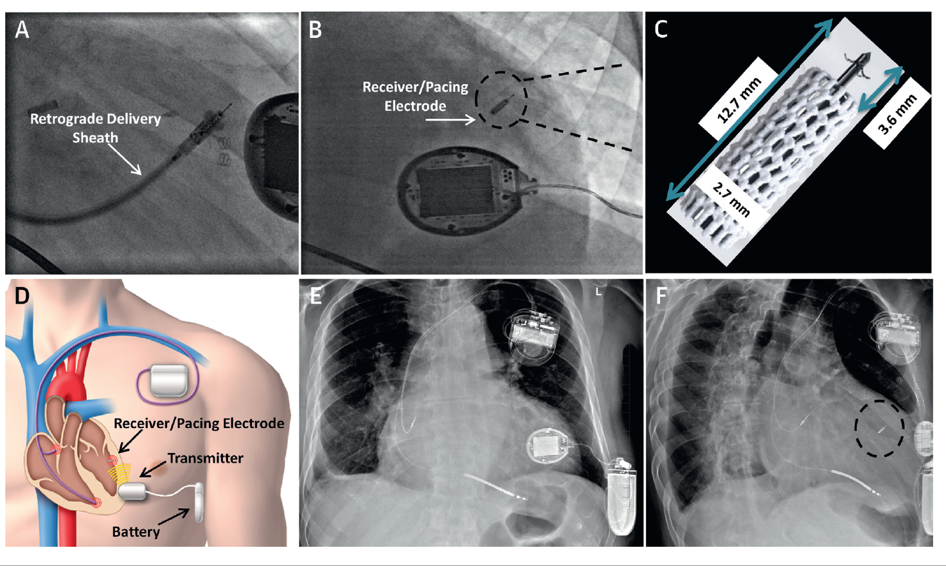
WiSE-crt system – wireless LV endocardial pacing electrode

Slide 49
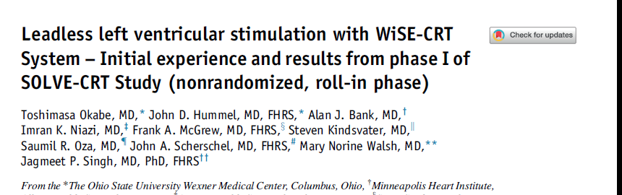
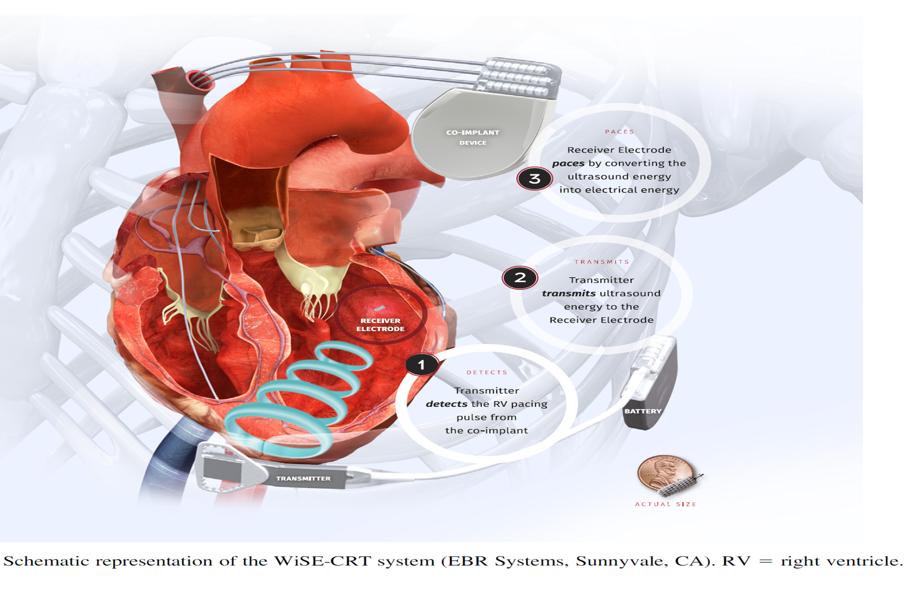
HEART RHYTHΜ 2021

Slide 50

2021
MICRA + WiSE system

Slide 51


Slide 52

Πριν
ΜΕΤΑ

Slide 53


2018
MICRA + S-ICD

Slide 54
ΑΧΕΠΑ- ΒΗΜΑΤΟΔΟΤΕΣ ΧΩΡΙΣ
ΗΛΕΚΤΡΟΔΙΑ – (LEADLESS PACEMAKERS)
Aυγουστος 2017- Δεκέμβριος 2022
20 εμφυτευσεις leadless pacemaker - 13 άνδρες, 7 γυναίκες
ηλικία: 60-87 (75 ± 6.3)

Slide 55
HKΓ ΕΝΔΕΙΞΗ

Slide 56
ΚΛΙΝΙΚΗ ΕΝΔΕΙΞΗ

Slide 57
ΑΧΕΠΑ- ΒΗΜΑΤΟΔΟΤΕΣ ΧΩΡΙΣ ΗΛΕΚΤΡΟΔΙΑ
ΠΡΟΣΠΕΛΑΣΗ : δεξιά μηριαία φλέβα (100% )
ΘΕΣΗ ΕΜΦΥΤΕΥΣΗΣ ΣΥΣΚΕΥΗΣ : κορυφή δεξιάς κοιλίας n=12
μεσοκοιλιακό διάφραγμα, n=8
επανατοποθέτηση της συσκευής κατά την εμφύτευση : n=5, 25%)
- σε 3 ασθενείς απαιτήθηκε 1 επανατοποθέτηση
- σε 2 ασθενείς απαιτήθηκαν 2 επανατοποθετήσεις
ΜΕΣΗ ΔΙΑΡΚΕΙΑ ΕΠΕΜΒΑΣΗΣ : 80 ± 15 min → 50 ± 8 min
ΜΕΣΟΣ ΧΡΟΝΟΣ ΑΚΤΙΝΟΣΚΟΠΗΣΗΣ : 8,3 ± 1,8 min → 6 ± 1,2 min

Slide 58
R WAVE
mean R wave ( implantation ) : 9 (±3,79) mV
mean R wave ( 30 days ) : 15,1 (±4,38) mV
ΟΥΔΟΣ ΒΗΜΑΤΟΔΟΤΗΣΗΣ
mean Capture Threshold ( implantation ) : 0,81 ± 0,48) V
mean Capture Threshold ( 30 days ) : 0,47 ±0,24 V
ΒΗΜΑΤΟΔΟΤΙΚΗ ΑΝΤΙΣΤΑΣΗ
mean Pacing Impedance ( implantation ) : 931 ±244 Ohm
mean Pacing Impedance ( 30 days ) : 680 ± 130 Ohm
ΕΠΙΠΛΟΚΕΣ
επιπωματισμός : 1 κατά την εμφύτευση

Slide 59


παροδική κατακράτηση σκιαστικού ενδομυοκαρδιακά

Slide 60

ΠΕΡΙΠΤΩΣΗ
διάβρωση θήκης βηματοδότη-εξωτερίκευση συσκευής

Slide 61
ΠΕΡΙΠΤΩΣΗ
Άνδρας 60 ετών
Συγγενής πλήρης ΚΚΑ
Εμφύτευση DDDR βηματοδότη- 1993 ( σε ηλικία 36 ετών )
Αντικατάσταση βηματοδότη ( 1996- 2003- 2010 )
Αρτηριακή υπέρταση (υπό αγωγή με μετοπρολόλη- φουροσεμίδη)
Υπερουριχαιμία

Slide 62
ECHO
Φυσιολογικές διαστάσεις καρδιακών κοιλοτήτων και ανιούσης αορτής
LVEF 50%, RV με διατηρημένη συστολική λειτουργία
Μικρού βαθμού MR, AR, TR
SPECT μυοκαρδίου- TC99m SESTAMIBI : φυσιολογικό
Αιματολογικες εξετάσεις
Αρνητικοί δείκτες φλεγμονής

Slide 63


Slide 64
απύρετος
ΤΟΕ : χωρίς εκβλαστήσεις
καλλιέργειες αίματος και ούρων ( αρνητικες )
έναρξη εμπειρικής αντιβιοτικής αγωγής
βανκομυκίνη 1gr x 2 iv ( 4 εβδομάδες )
σιπροφλοξασίνη 400mg x 2 iv ( 4 εβδομάδες )
ριφαμπικίνη 300mg x 3 per os ( 2 εβδομάδες )

Slide 65
αφαίρεση βηματοδότη και εξωαγγειακού τμήματος
ηλεκτροδίων
καθαρισμός θήκης και νεαροποίηση χειλέων θήκης
καλλιέργειες ( επίχρισμα, ιστοτεμάχια, καλώδια ):
αρνητικές
στόχος: εμφύτευση DDDR βηματοδότη δεξιά (γεννήτρια
και 2 νέα ηλεκτρόδια)

Slide 66


Slide 67

ΑΠΟΦΡΑΞΗ ΑΝΩ ΚΟΙΛΗΣ ΦΛΕΒΑΣ
ΑΖΥΓΟΣ

Slide 68
Venous Thrombosis and Stenosis After Implantation of Pacemakers and Defibrillators
Venous thrombosis and stenosis (early or late ) 30- 50% of patients
1- 3% symptomatic ( including SVC syndrome )
Rozmus, et al. J Interv Card Electrophysiol (2005) 13: 9

Slide 69
θεραπευτικές επιλογές
χειρουργική αφαίρεση καλωδίων και εμφύτευση
επικαρδιακού βηματοδότη
βηματοδότης χωρίς ηλεκτρόδια - (leadless
pacemaker)

Slide 70



Slide 71



Slide 72

ΤΟ ΜΕΛΛΟΝ ΘA EINAI ΑΣΥΡΜΑΤΟ ?

Slide 73
ΕΥΧΑΡΙΣΤΩ ΓΙΑ ΤΗΝ ΠΡΟΣΟΧΗ ΣΑΣ

