Slide 1


ΜΥΟΚΑΡΔΙΑΚΉ ΙΝΩΣΗ ΚΑΙ ΚΟΙΛΙΑΚΈΣ ΑΡΡΥΘΜΊΕΣ ΣΕ ΔΙΑΤΑΤΙΚΉ ΜΥΟΚΑΡΔΙΟΠΆΘΕΙΑ
Γ.ΣΤΑΥΡΟΠΟΥΛΟΣ
Β΄ΚΚ

Slide 2
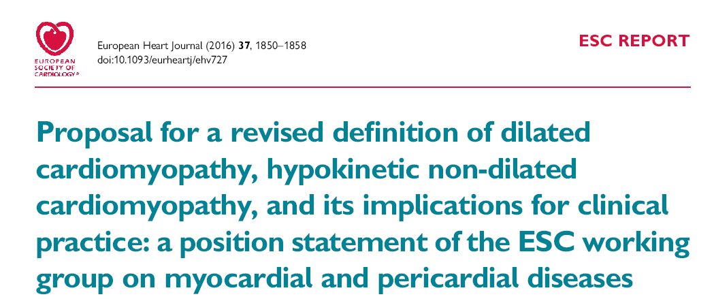
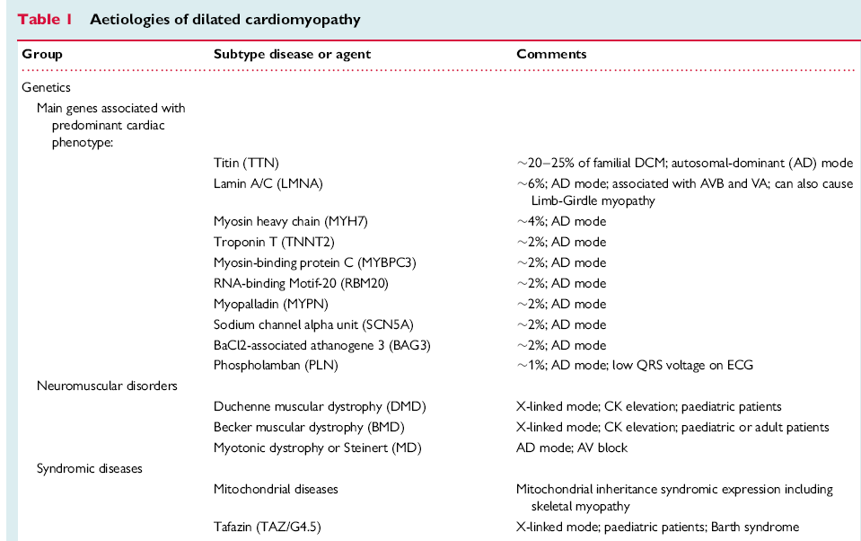

Slide 3
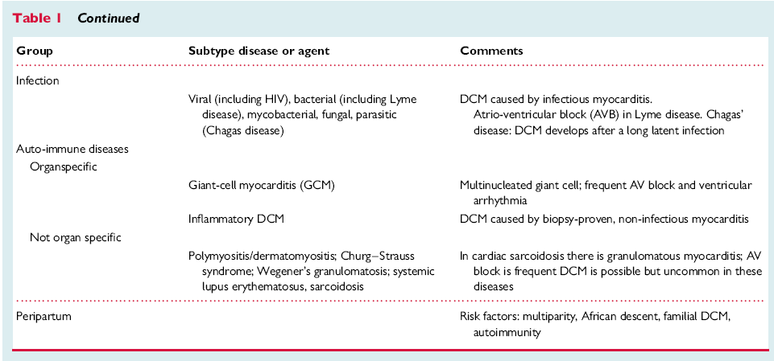

Slide 4
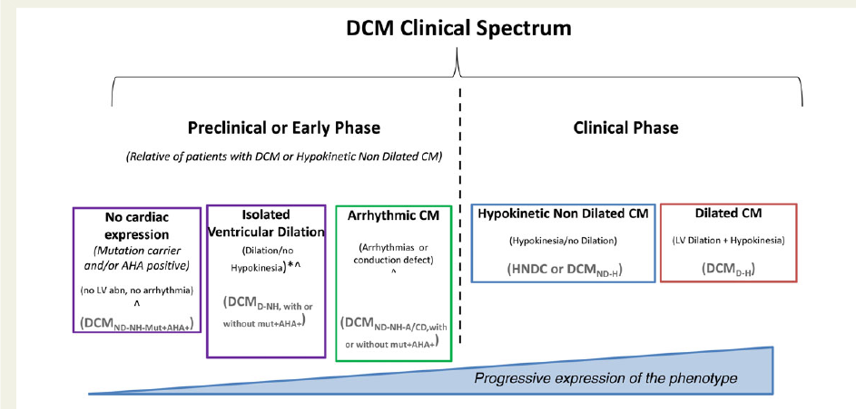

Slide 5
Hypertrophied and atrophic myocytes
Myofiber disarray
Nuclear changes
Cytoskeletal disorganization
Replacement fibrosis in sections of the right and left ventricles

Slide 6
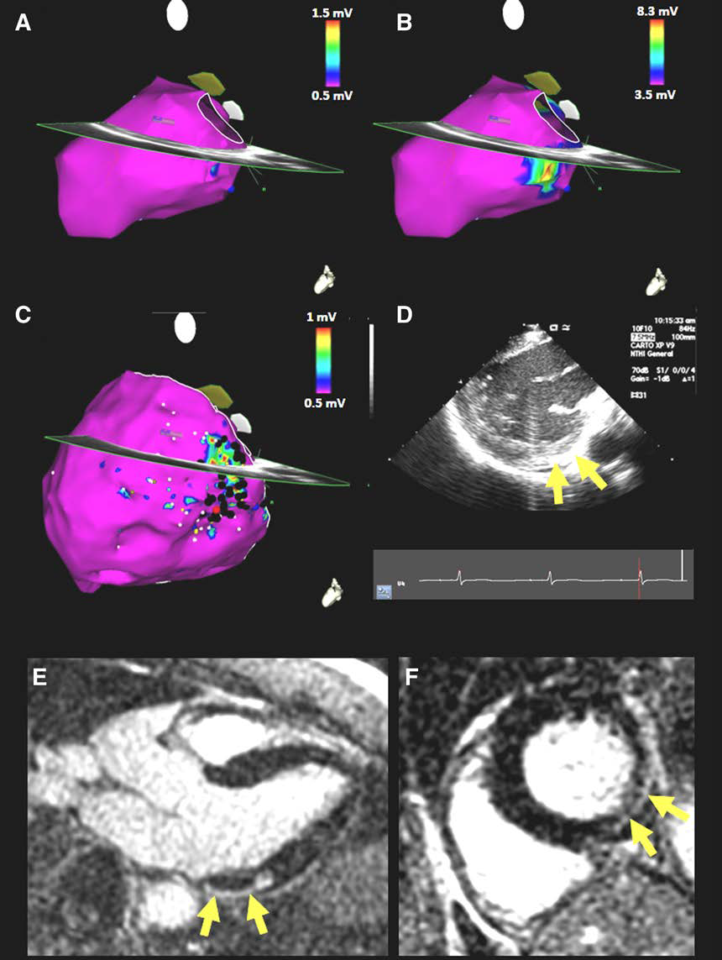
FOCAL WALL MOTION ABNORMALITIES
INCREASED ECHOGENICITY/WALL THINING (ECHO-CT)
FIXED NUCLEAR IMAGING DEFCTS
LATE GADOLINIUM ENHANCEMENT CMR

Slide 7
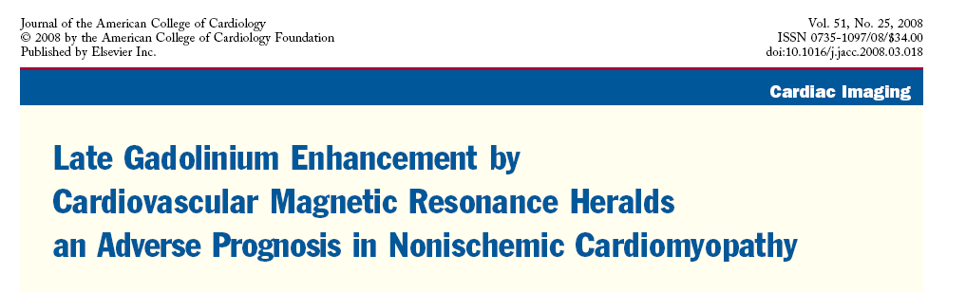
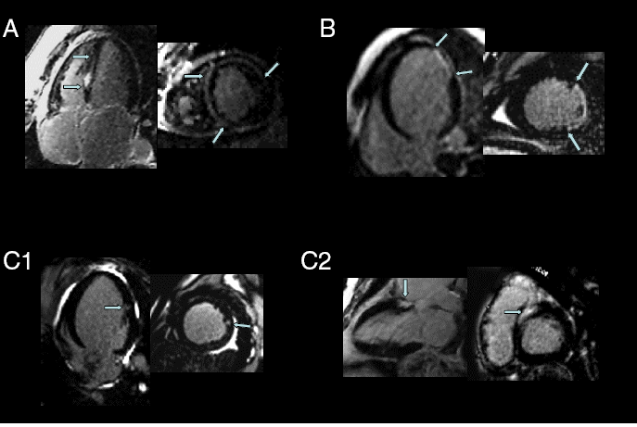
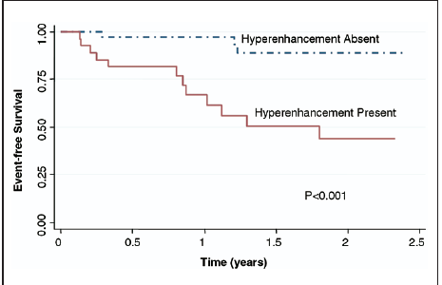
SCAR
FOCAL WALL MOTION ABNORMALITIES
INCREASED ECHOGENICITY/WALL THINING (ECHO-CT)
FIXED NUCLEAR IMAGING DEFCTS
LATE GADOLINIUM ENHANCEMENT CMR

Slide 8
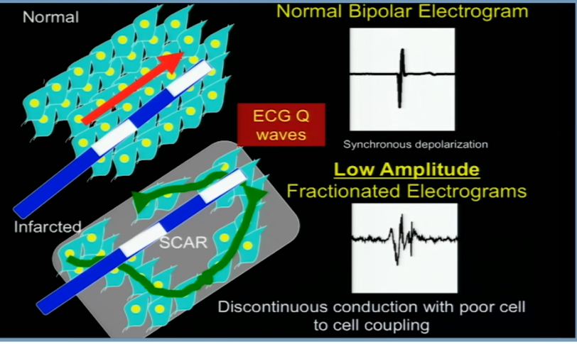
ELECTROPHYSIOLOGY

Slide 9
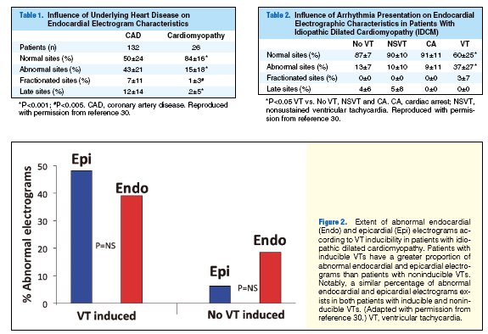
Circulation Journal Vol.77, August 2013

Slide 10
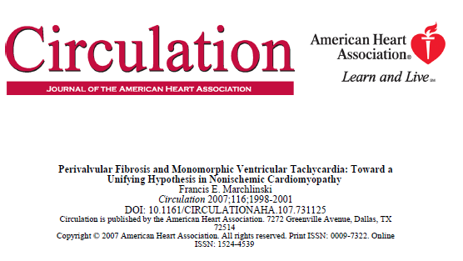
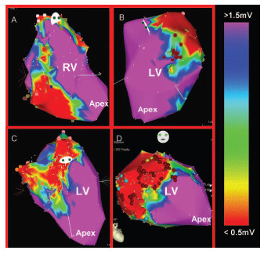
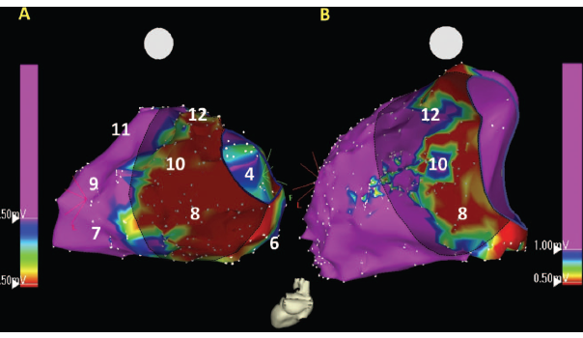
Scar distribution: Near a valve structure regardless of type of cardiomyopathy process

Slide 11
Scar distribution: Near a valve structure regardless of type of cardiomyopathy process
Overexpression of a healing response to a more generalized inflammatory response- mechanical stress?
Fibroblasts more available in proximity to the valve structures?
Similar manifest pathogenesis with apical aneurysm and perimitral valve endocardial and epicardial scar as the substrate for monomorphic VT in the setting of chronic Chagasic heart disease

Slide 12
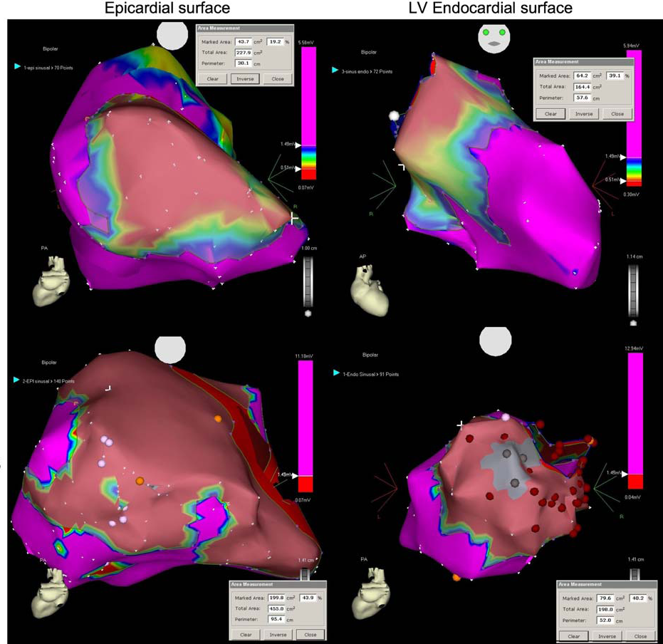
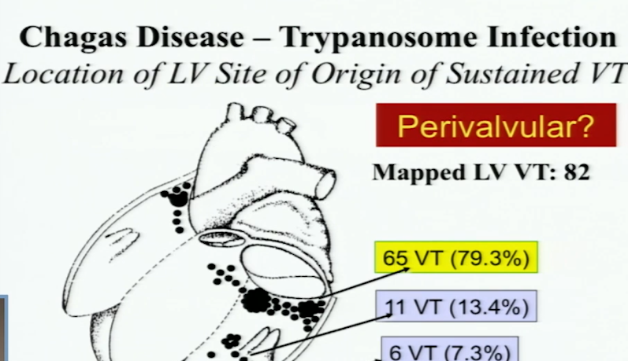
Scar distribution
J Interv Card Electrophysiol (2009) 26:195–205

Slide 13
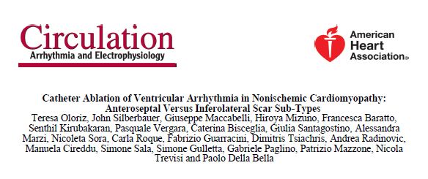
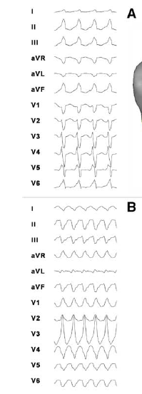
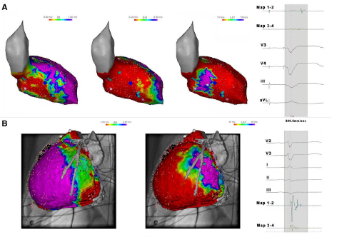

Slide 14
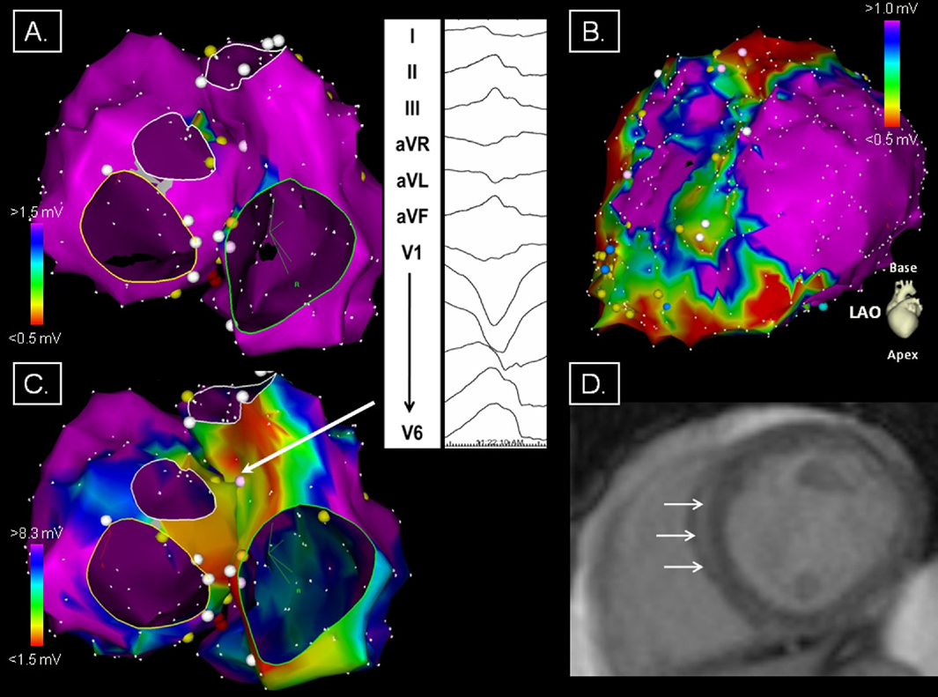
Haqqani et al Septal Substrate for VT in Dilated Cardiomyopathy

Slide 15
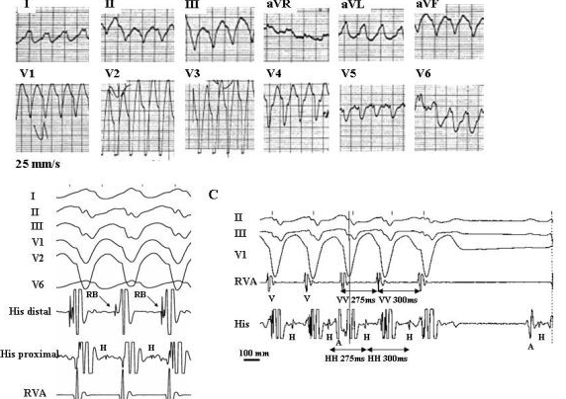
Bundle Branch Reentry

Slide 16
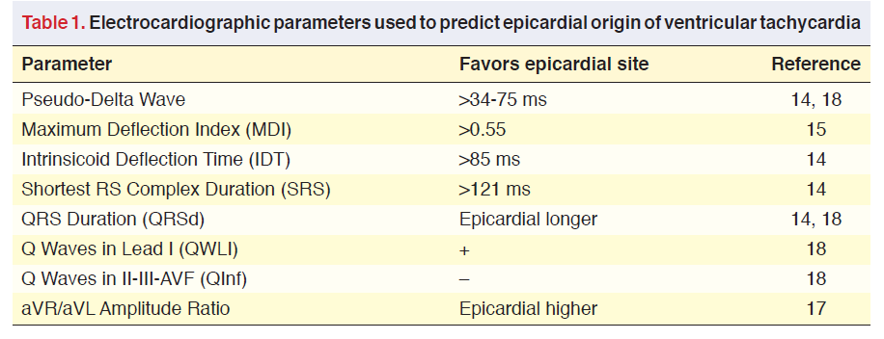
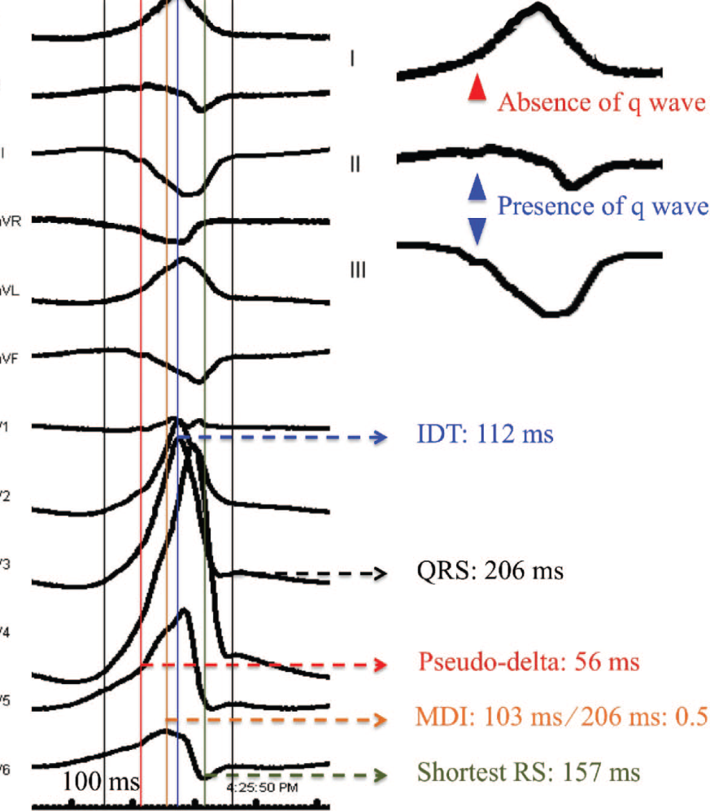
EPICARDIAL ORIGIN!

Slide 17
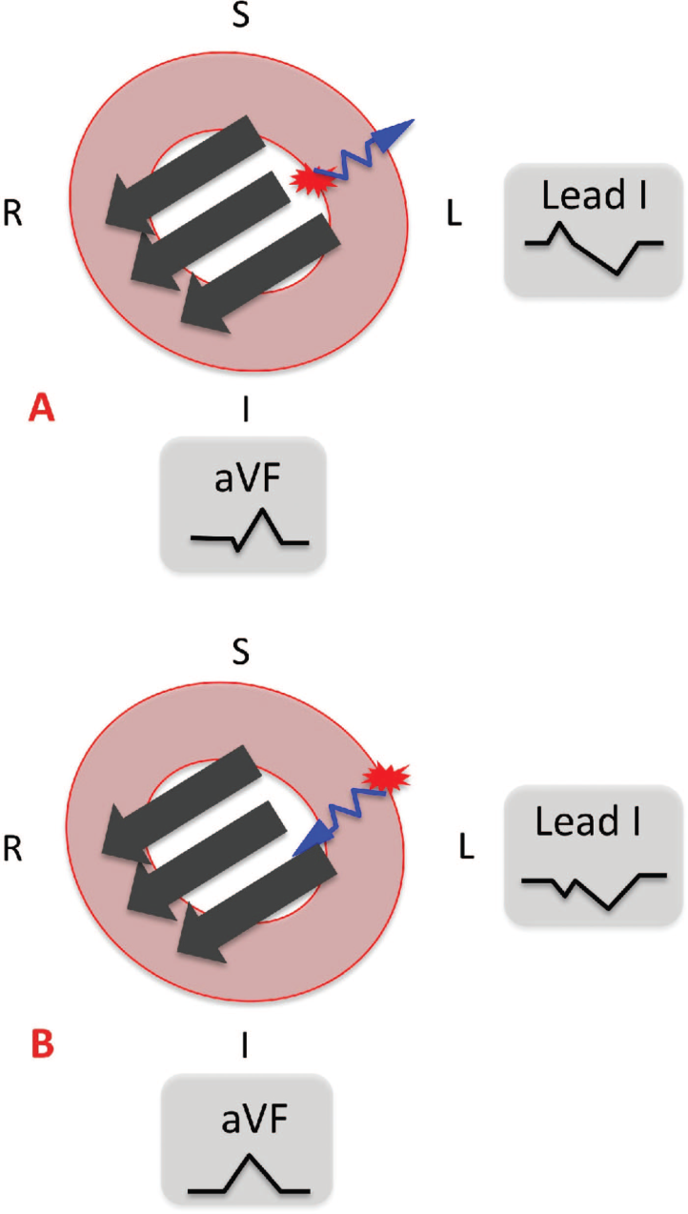
EPICARDIAL ORIGIN !
Rapidly conducting His Purkinje system is not used immediately Intra-myocardial delay slurred initial component of the QRS complex slow rate of rise in voltage before it reaches the intrinsicoid deflection.

Slide 18
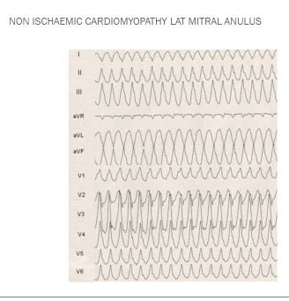
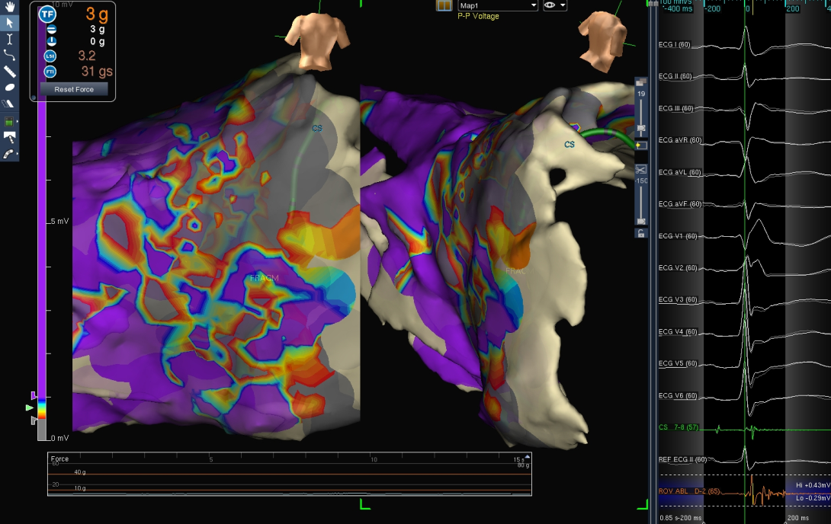

Slide 19
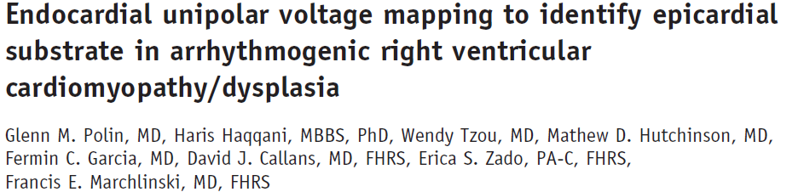
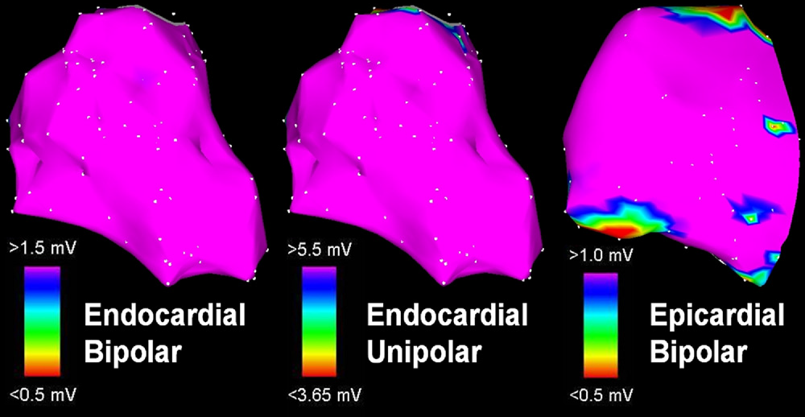
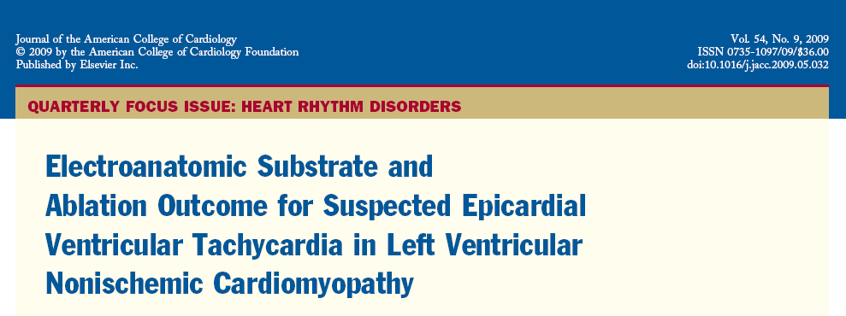
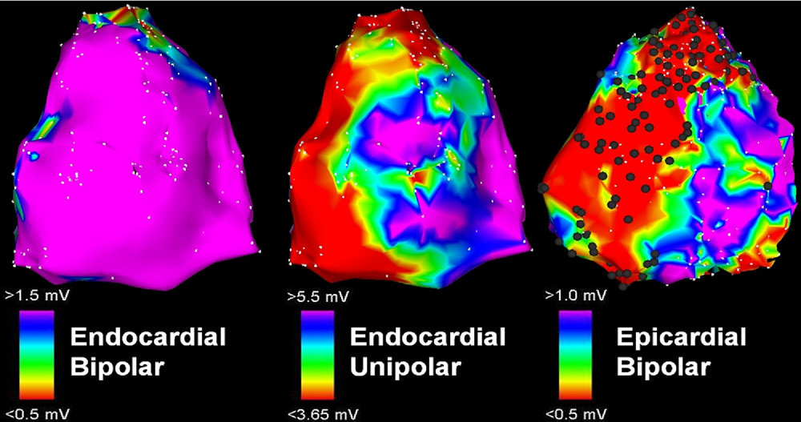
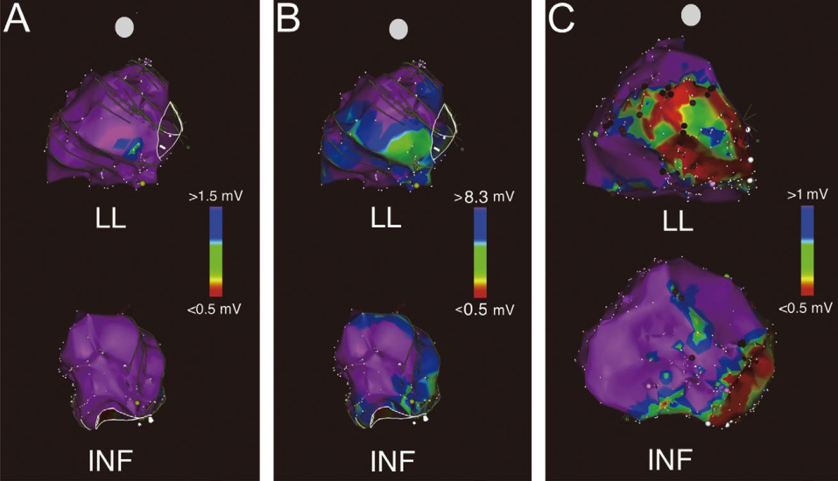
Heart Rhythm, Vol 8, No 1, January 2011

Slide 20
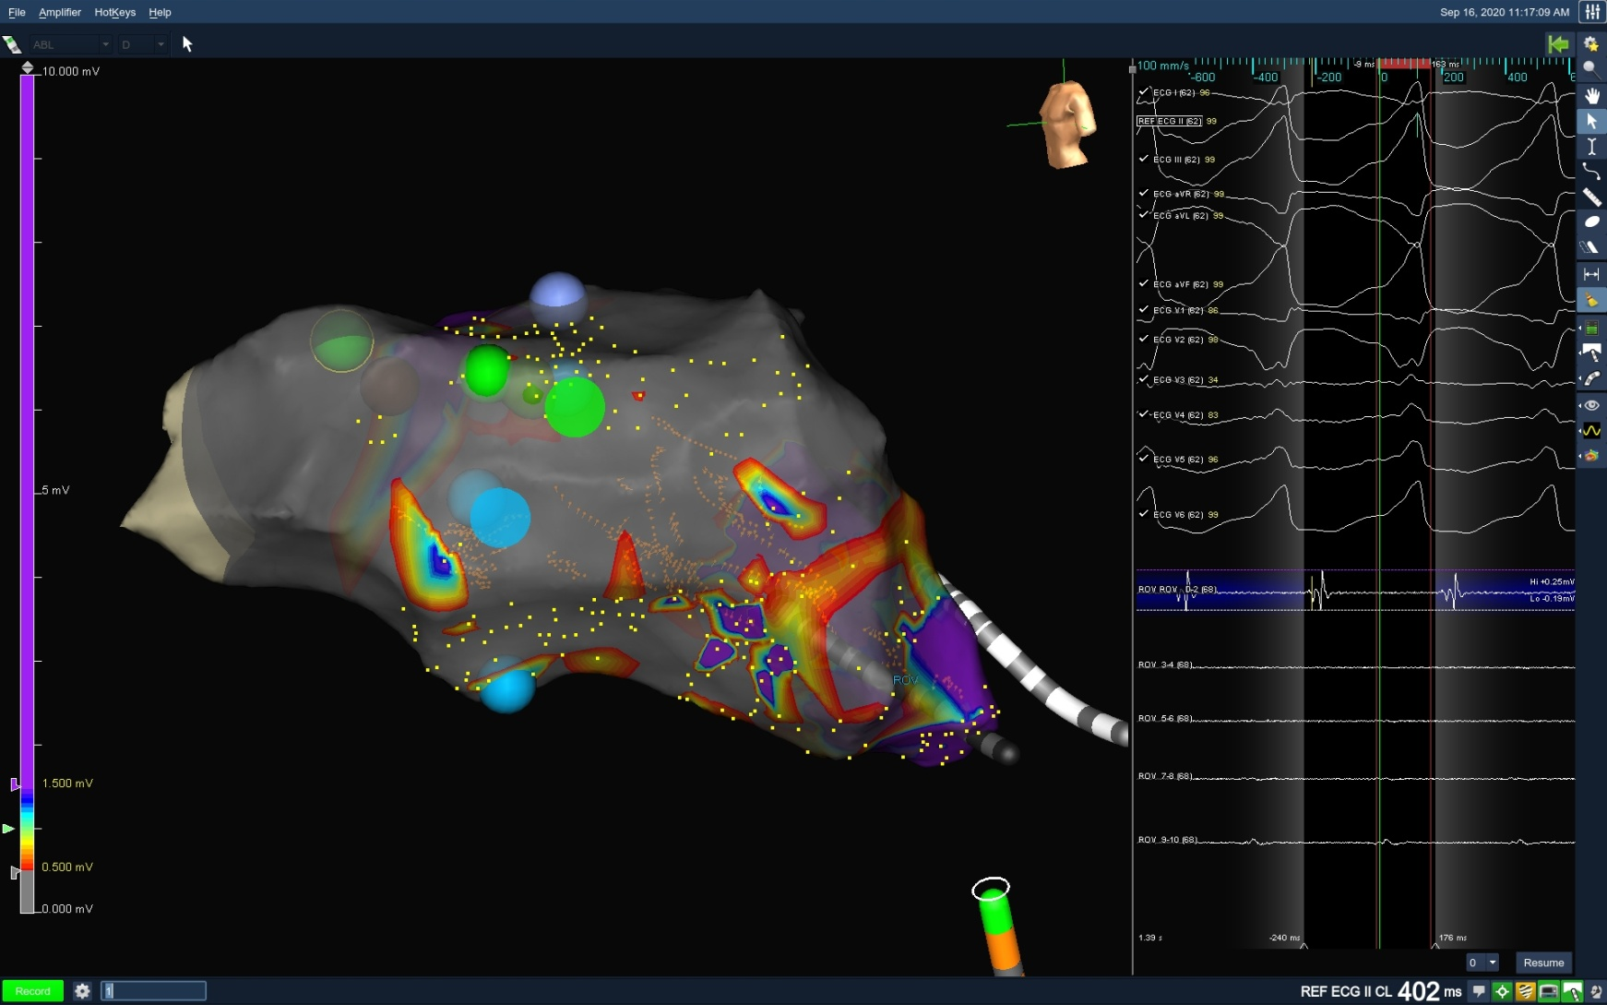

Slide 21
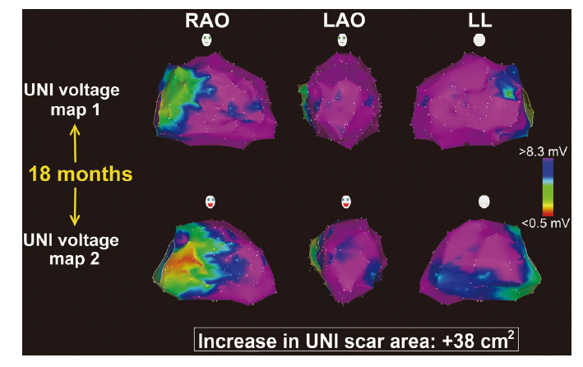
Progressive process

Slide 22
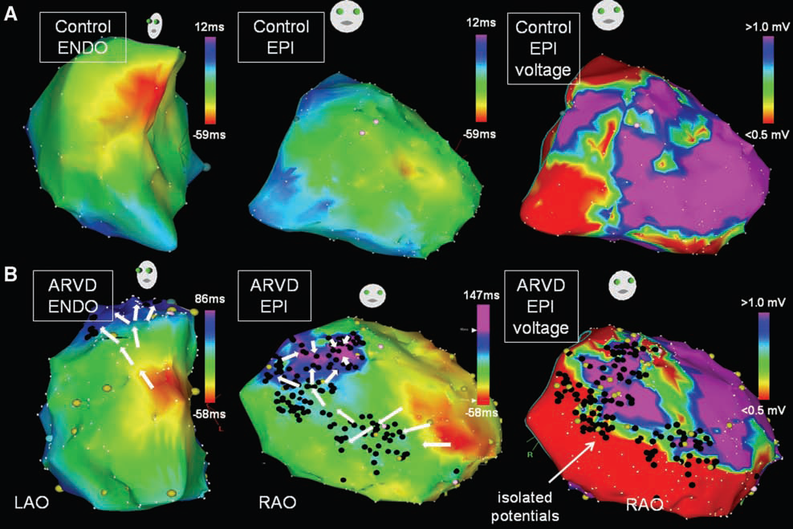
SCAR COMPARTMENTALIZATION
Haqqani et al
Circ Arrhythm Electrophysiol August 2012

Slide 23
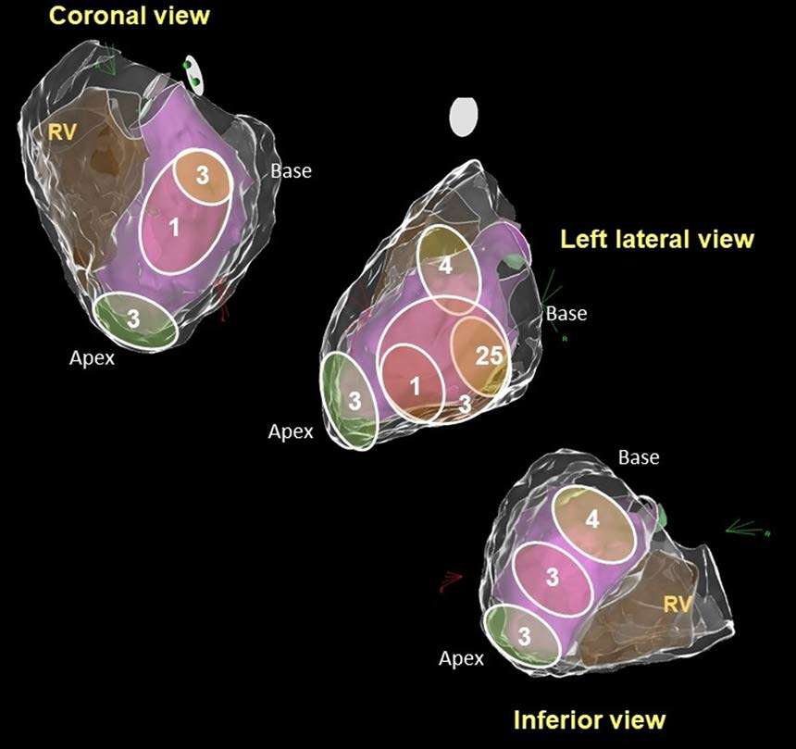
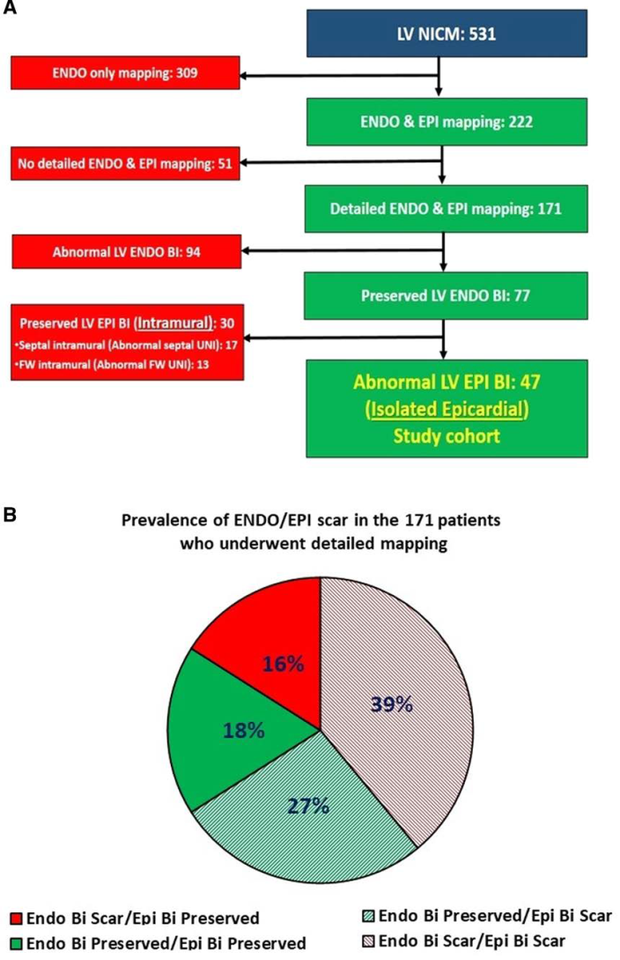
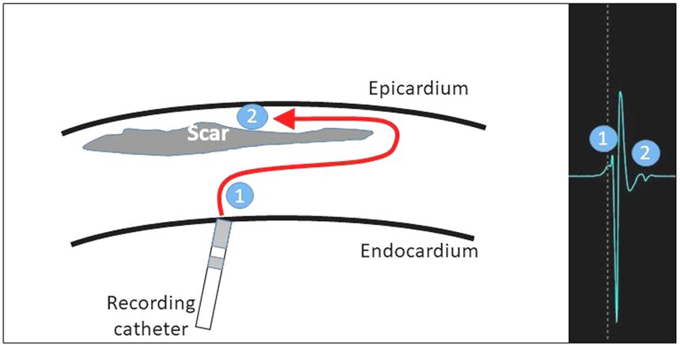
Circ Arrhythm Electrophysiol. 2021;14

Slide 24
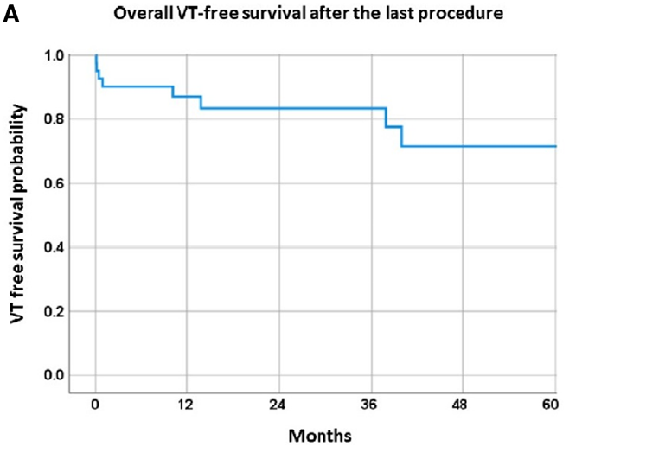
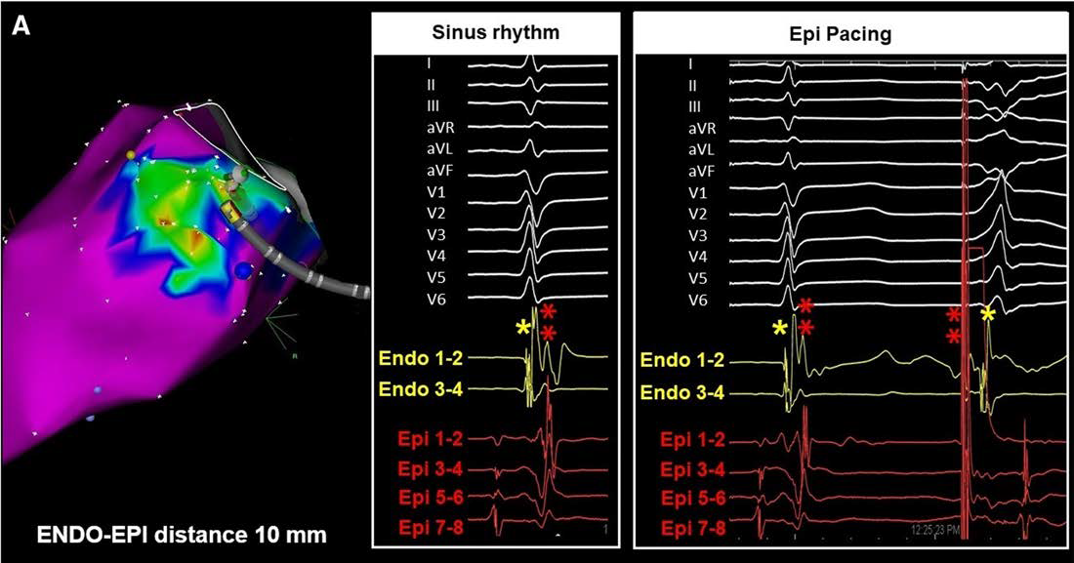
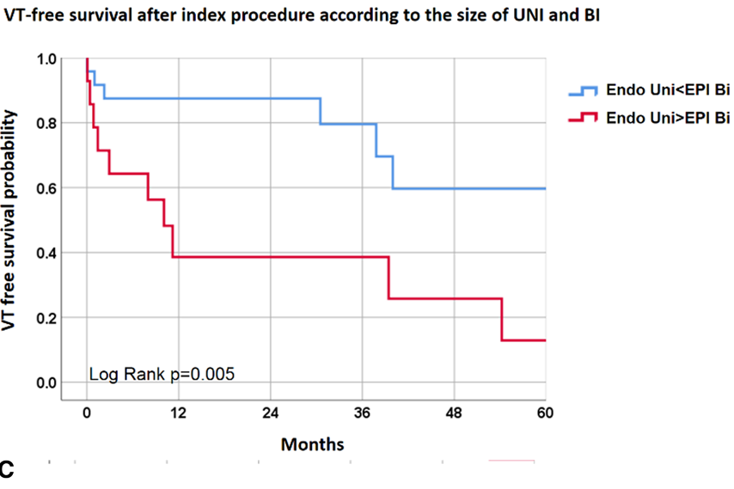
Circ Arrhythm Electrophysiol. 2021;14

Slide 25
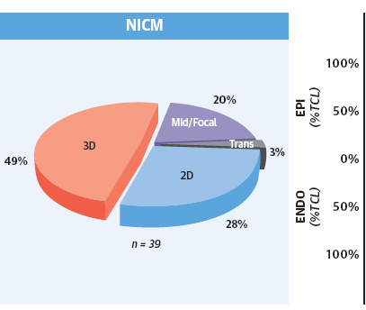
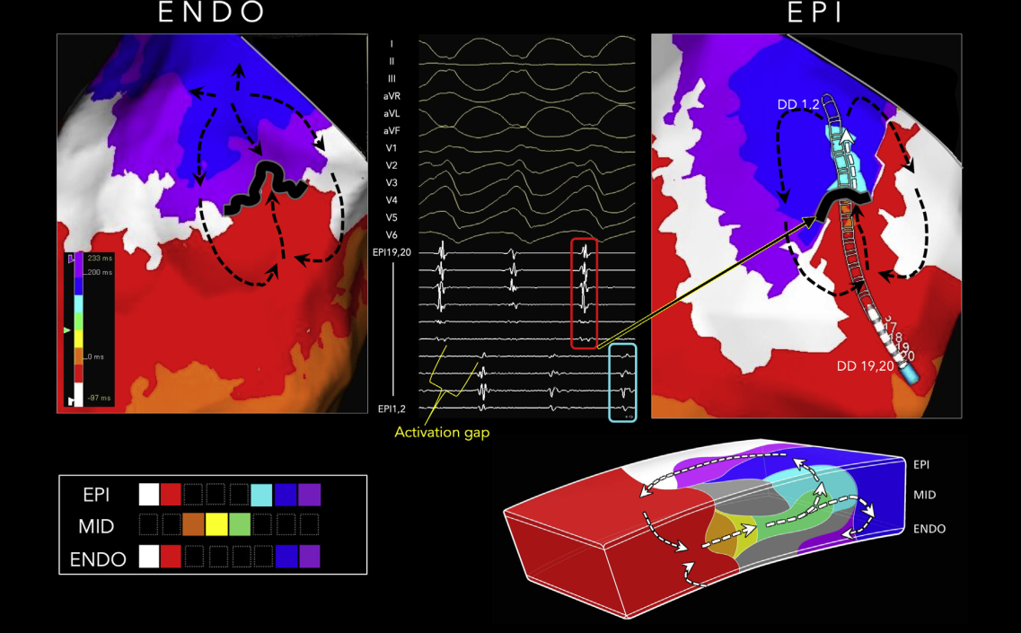
3-Dimensional matrix for sustained monomorphic VT
J A C C V O L . 7 5 , NO . 8 , 2 0 2 0 Tung et

Slide 26
Myocardial fibrosis is a common finding in patients with nonischemic cardiomyopathies
The disease process variably affects the endocardial, midmyocardial, and subepicardial/epicardial layers.
Predominant perivalvular distribution
Catheter ablation is effective in achieving VT-free survival

